Slide 1

Hampshire, Isle of Wight, Portsmouth and Southampton
Violence Reduction Partnership
Strategic Needs Assessment Update
Executive Summary
February 2026
Violence Reduction Unit - (hampshire-pcc.gov.uk)
VRU@hampshire.police.uk

Slide 2
Contents
3
Introduction
7
When is serious violence happening?
3
Key Findings
8
Who is impacted by serious violence?
4
What serious violence has happened in the last year?
9
Who is perpetrating serious violence?
5
What serious violence is happening?
10
How is serious violence happening?

Slide 3
Introduction
Key Findings
The Hampshire, Isle of Wight, Portsmouth and Southampton (HIPS) Violence Reduction Partnership (VRP) has produced its third edition of the HIPS-wide Strategic Needs Assessment (SNA) to provide a comprehensive assessment of serious violence, which will be updated on an annual basis. The following slides are a publically accessible summary providing an overview of the main findings and next steps.
The aim of the SNA, is to assess the current picture of serious violence in the HIPS area. It further aims to help local partners identify groups and places most at risk of serious violence. Outlining the current picture of serious violence across HIPS using partnership data is critical to the ongoing success of the HIPS VRP. As such, the SNA utilises a range of partnership data sources to outline the most comprehensive view of violence possible with the available data.
In response to the Serious Violence Duty, a common definition of serious violence was agreed at the HIPS Serious Violence Reduction Partnership to enable consistency across the partnership.
There were 4,672 serious violence offences recorded across HIPS during 2024/25, which is a 6.0% reduction from last year.
The most prevalent offence was possession of weapon offences (43.9% of the total).
Portsmouth & Southampton accounted for 45.6% of all serious violence occurrences in HIPS.
There is an increase in serious violence at 15:00 hrs, correlating with school finishing times, this remains higher than pre 15:00 count for the rest of the day.
Of identified victims of serious violence, 68.1% are male and 26.4% are female, suggesting males are more likely to be victims of serious violence in HIPS.
Of identified suspects, 82% are male and 17.1% are female, suggesting males are more likely to be involved in serious violence in HIPS.
In terms of youth serious violence, where age is recorded, 20% of those committing serious violence were aged 10-17 years, compared to 18% in the previous year and 17% in 2022/23.
There was a 6.7% (128) reduction in the number of serious violence offences recorded as involving a bladed implement.
The agreed HIPS-wide Serious Violence definition captures the following offences and Home Office crime codes:
Most Serious Violence – Existing Definition (1a and 1b where it is GBH and above incl. death by dangerous driving).
Robbery (3a and 3b).
Possession of Weapon Offences (7).
Public Order (Violence Disorder [65] and Riot [64/1] only).
Any Violence with Injury (1b) not included under MSV where a bladed implement was used.

Slide 4
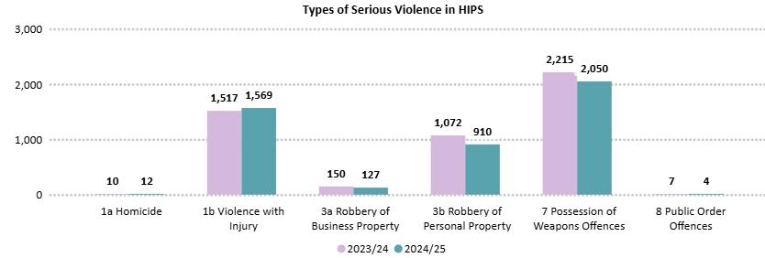
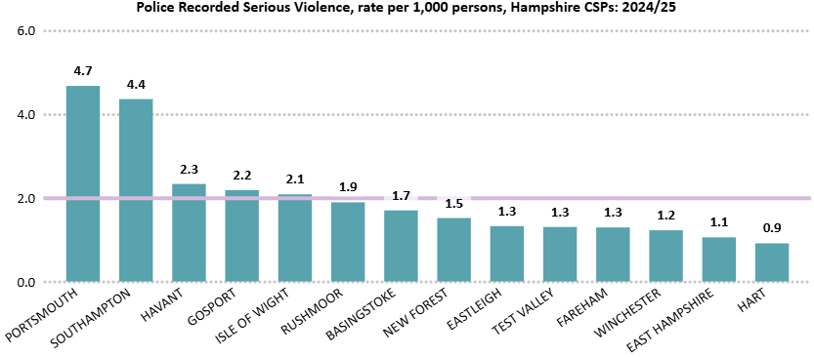
What serious violence has happened in the last year?
Overall, there were 4,672 serious violence offences recorded by Hampshire and Isle of Wight Constabulary across HIPS during the 2024/25 financial year. This is a 6.0% reduction in comparison to the previous year. This is a greater decrease than that seen in 2022/23 to 2023/24 (-3.0%).
Portsmouth and Southampton recorded the highest rates of serious violence per 1,000 residents. Havant, Gosport, and the Isle of Wight also recorded higher rates of serious violence than the HIPS average.
Combined, Portsmouth and Southampton accounted for 45.6% of all serious violence offences in the HIPS area, a small increase on the previous year (44.8%).
Figure 2. Types of serious violence in HIPS
An offensive weapon is defined as “any article made or adapted for use for causing injury to the person or intended by the person having it with them or by some other person.”
The most common serious violence offence in 2024/25 was Possession of Weapons offences; these accounted for 43.9% of all serious violence offences reported. However, this crime type decreased by a greater proportion than all serious violence (-7.4%, compared to -6%). Fareham had the highest proportion of Possession of Weapons Offences (57%) and Winchester had the lowest (38.6%).
When compared to the previous twelve months, Robbery of Personal Property, Robbery of Business Property and Public Order Offences all decreased for 2024/25. Violence with injury increased slightly by 3.4%, homicide rose to 12 incidents.
Figure 1. Police recorded serious violence, rate per 1000 persons, Hampshire CSPs, 2024/25

Slide 5
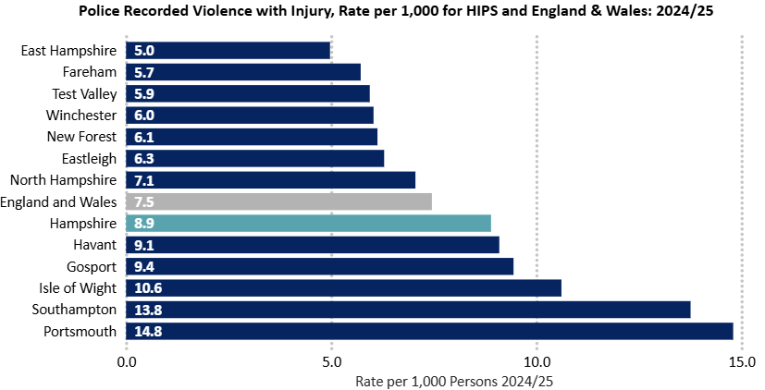
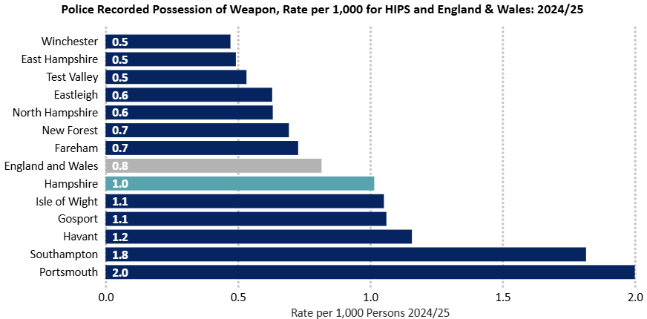
What serious violence is happening?
Violence with Injury
Since 2015/16, HIPS has consistently recorded a higher rate of Violence with Injury incidents per 1,000 residents in comparison to the England average. There were 8.9 Violence with Injury offences per 1,000 residents across the HIPS area in 2024/25. Portsmouth recorded the highest proportion of offences (14.8), whilst East Hampshire recorded the lowest proportion (5.0). Areas with a larger Night Time Economy (NTE) also recorded a higher level of these offences, demonstrating their role in the perpetration of Violence with Injury.
Possession of Weapon Offences
Since 2015/16, HIPS has consistently recorded a higher rate of Possession of Weapons offences per 1,000 residents in comparison to the England average. There were 1.0 Possession of Weapons offences per 1,000 residents across the HIPS area in 2024/25. In this year, HIPS rate per 1,000 decreased by 0.1 percentage points in comparison to the England & Wales rate which remained the same. Similarly to Violence with Injury offences, Portsmouth recorded the highest proportion of Possession of Weapons offences (2.0). Whilst Winchester recorded the lowest proportion with 0.5. The most common type of these offences was Offensive Weapons (91.3%).
Figure 4. Police recorded possession of weapons offences per 1000 persons across the HIPS area in the year ending March 2025
Figure 3. Police recorded violence with injury, rate per 1000 persons, Hampshire CSPs and England, 2024/25

Slide 6
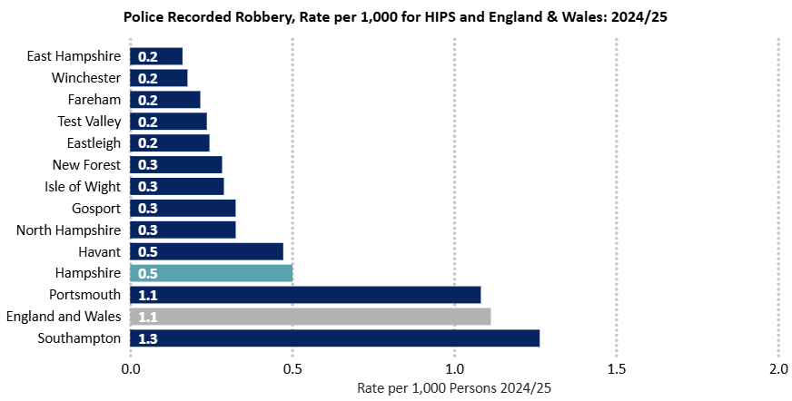
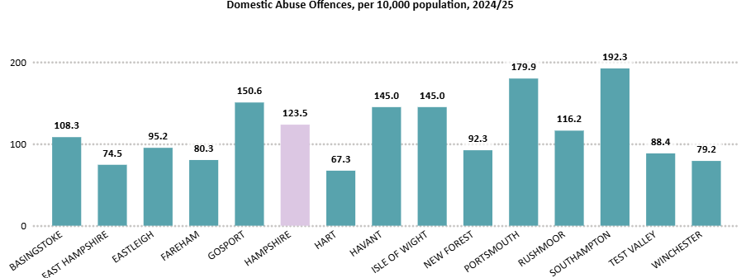
What serious violence is happening?
Robbery
Since 2015/16, HIPS has consistently recorded a lower rate of Robbery per 1,000 residents in comparison to the England average. There were 0.5 Robbery offences per 1,000 persons across the HIPS area in the last financial year. Robbery was recorded as the lowest rate of offences in comparison to both Possession of Weapons and Violence with Injury offences. Both Southampton and Portsmouth recorded the highest rate of Robberies in HIPS (1.3 and 1.1 respectively), although Portsmouth was lower than the England average. Whilst East Hampshire recorded the lowest proportion of offences with 0.2 per 1,000 persons.
Domestic Abuse
Domestic Abuse is not currently included in the VRP serious violence definition as a distinct offence, but it is still essential that Domestic Abuse is monitored and understood in the HIPS area. The link between Domestic Abuse and serious violence is clear and monitoring it in this way ensures a more comprehensive understanding of serious violence in the HIPS area.
While only 12.3% of serious violence offences in HIPS were flagged as domestic abuse, DA accounts for a large proportion of violence overall. The following figures look at all domestic abuse offences. Southampton recorded the highest rate of offences (192.3), whilst Hart recorded the lowest rate of offences (67.3) per 10,000 population.
Figure 5. Police recorded robberies, rate per 1000 persons, Hampshire CSPs and England, 2024/25
Figure 6. Domestic abuse offences, per 10, 000 persons, 2024/25

Slide 7
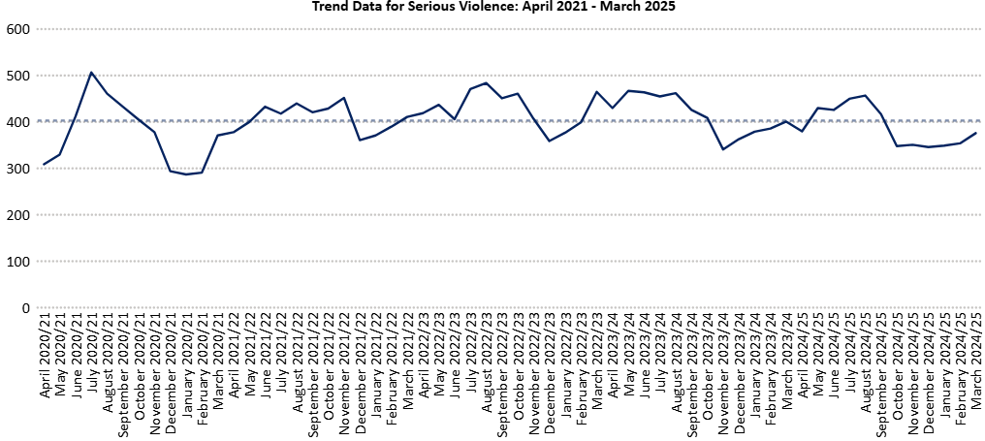
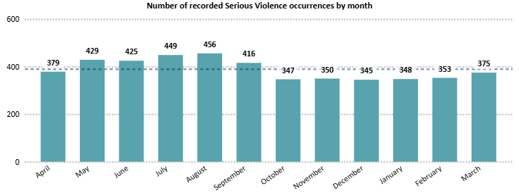
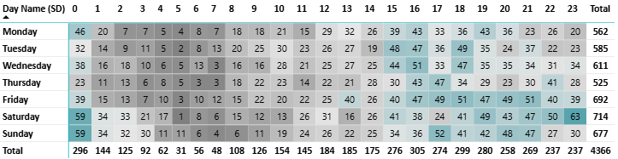
When is serious violence happening?
Over the last five years, there has been a relatively stable trend in the number of serious violence occurrences. There is a dip in occurrences in late 2020, likely due to the Covid-19 pandemic. There are also seasonal decreases seen around November/December and increases in the summer months.
In the most recent financial year, more serious violence took place between May and September than any other period. This peak aligns with school summer holidays and better weather, and may also be influenced by specific police operations or partnership areas of focus during school holiday and summer periods. However, it is not the case that all districts and unitary areas recorded the same peaks in offences. This understanding is essential when designing partnership responses to serious violence.
Figure 8. Trend Data for Serious Violence: April 2020 – March 2025
Figure 9. Serious Violence by day and time, 2024/25
The most serious violence occurrences are recorded on Fridays, Saturdays and Sundays. There is an increase in occurrences at 15:00 hrs which then plateaus. This correlates with school finishing times, but this pattern is also seen at weekends and this trend is seen in districts across HIPS. The greatest number of offences in a single hour is between 23:00-23:59 hrs on a Saturday night, which is likely linked to the Night Time Economy (NTE).
Figure 7. Number of Serious Violence occurrences by month, April 2024 – March 2025

Slide 8
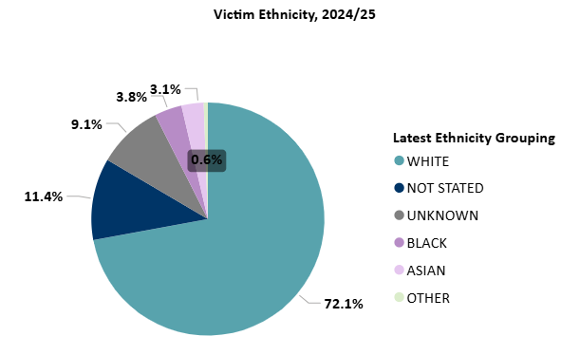
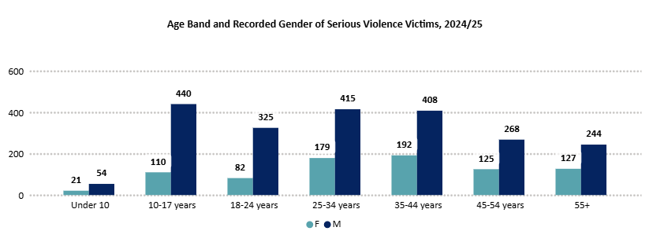
Who is impacted by serious violence?
In 2024/25, there were 3,158 victims of serious violence identified across HIPS. Of those, 68.1% (2,150) are male and 26.4% (834) are female. This suggests males are more likely to be victims of serious violence across HIPS. Of the remaining 5.5% (174) of offences, no victim gender was recorded.
Males aged 10-17 were most likely to be victims, compared to females who were more likely to be aged 35-44 years. This is a contrast to 2023/24, when those aged 25-34 were most likely to be victims of serious violence for both males and females. Of all victims, 34.5% are recorded as being under the age of 25 years, which is similar to the previous year.
Where ethnicity was recorded, 72.1% of victims are defined as White, by officer-defined ethnicity. For 20.5% of individuals ethnicity was either not Stated or Unknown.
Figure 11. Victim ethnicity, 2024/25
Figure 10. Age band and recorded gender of serious violence victims, 2024/25

Slide 9
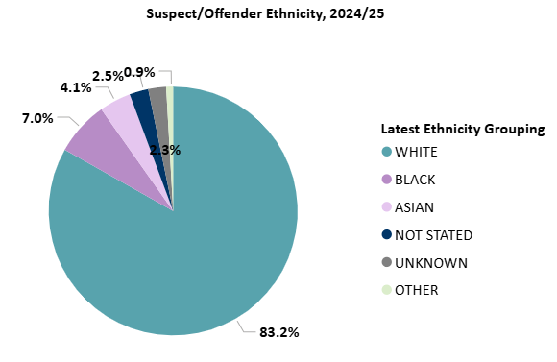
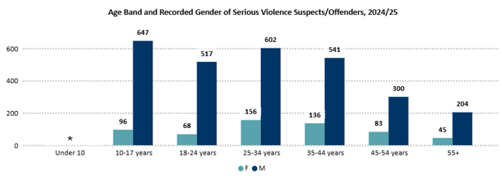
Who is perpetrating serious violence?
In 2024/25, there were 3,426 individuals identified as suspects of serious violence across HIPS. Of those, 82% (2,810) are male and 17.1% (585) are female. This suggests males are considerably more likely to be involved in serious violence across HIPS.
Among women, those aged 25-34 years were most likely to be involved in serious violence, followed by those aged 35-44. For males, the most common recorded age category of suspects was 10-17 years, followed by 25-34.
Those aged 10-17 years accounted for an average of 20% of those committing serious violence, where age is recorded, compared to 18% in the previous year and 17% in 2022/23.
Where ethnicity was recorded, 83.2% of suspects were defined as white, by officer-defined ethnicity. This was followed by 7.0% of individuals defined as Black. The ethnicity of 4.8% of suspects was either Not Stated or Unknown.
Figure 13. Suspect ethnicity, 2024/25
Figure 12. Age band recorded gender for serious violence perpetrators, 2024/25

Slide 10
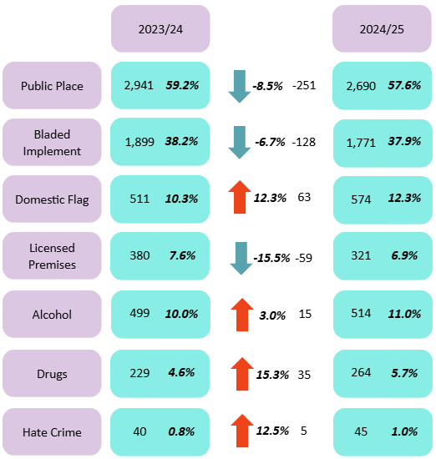
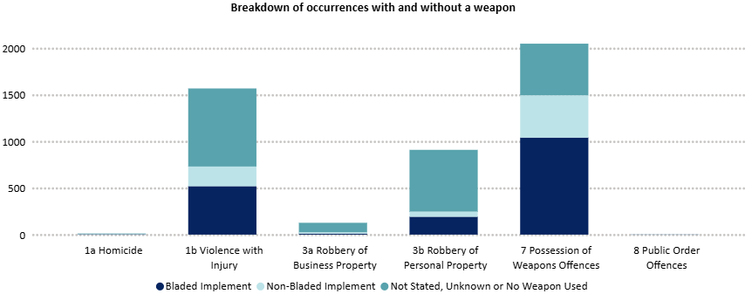
How is serious violence happening?
Figure 14 sets out a breakdown of the associated factors linked to serious violence occurrences, and a comparison of 2024/25 to the 2023/24 year. These factors are not consistently applied and should, therefore, be considered only a representation of associated factors.
Although the majority of serious violence offences occur in a public setting (57.6%), there was an 8.5% (-251) decrease from the previous year.
Of all serious violence offences in HIPS, 37.9% (1,771) were recorded as involving a bladed implement, a 6.7% (-128) decrease on the previous year. The only other flag to decrease was licensed premises, which fell slightly by 15.5% (-59) to 6.9% (321) of all serious violence offences.
The domestic flag was used in 12.3% of all serious violence offences, a 12.3% (63) increase from the previous financial year. The drugs flag also showed a small increase of 15.3% (35) to 5.7% (264) of all serious violence offences.
The alcohol and hate crime flags remained stable with only slight increases and the proportion of these crimes remained similar when compared with the previous year.
Figure 14. Serious violence : Police-recorded associated factors
Figure 15. Serious violence occurrences involving a weapon, 2024/25

Slide 11
If you would like to know more about the Violence Reduction Partnership, please contact us at:
VRU@hampshire.police.uk

