Slide 1

Hampshire, Isle of Wight, Portsmouth and Southampton
Violence Reduction Partnership
Strategic Needs Assessment
Executive Summary
April 2025
Violence Reduction Unit - (hampshire-pcc.gov.uk)
VRU@hampshire.police.uk

Slide 2
Contents
3
Introduction
11
How is serious violence happening?
5
12
Why is serious violence happening?
What serious violence has happened in the last year?
6
16
Community voices
What serious violence is happening?
8
18
Partnership evaluation
When is serious violence happening?
9
19
Recommendations
Who is impacted by serious violence?
10
Who is perpetrating serious violence?

Slide 3
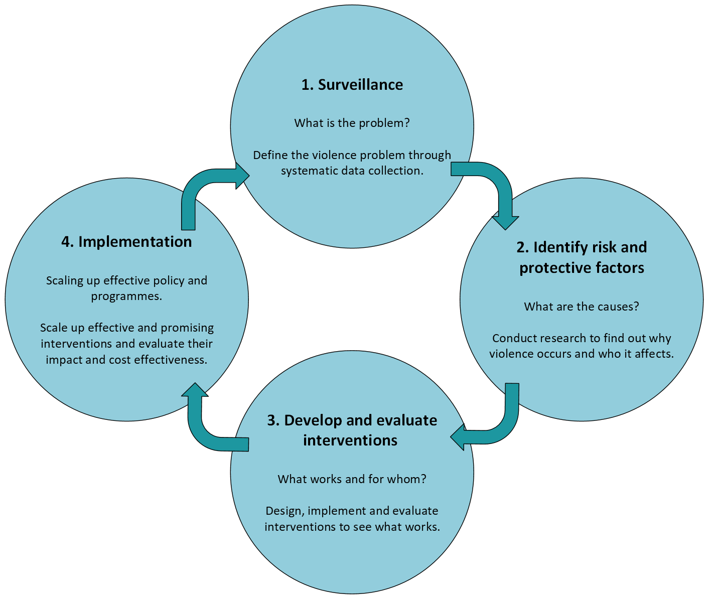
Introduction
Public Health Approach
The Hampshire, Isle of Wight, Portsmouth and Southampton (HIPS) Violence Reduction Partnership (VRP) has produced its third edition of the HIPS-wide Strategic Needs Assessment (SNA) to provide a comprehensive assessment of serious violence, which will be updated on an annual basis. The following slides are a publically accessible summary providing an overview of the main findings and next steps.
The aim of the SNA, is to assess the current picture of serious violence in the HIPS area. It further aims to help local partners identify groups and places most at risk of serious violence. Outlining the current picture of serious violence across HIPS using partnership data is critical to the ongoing success of the HIPS VRP. As such, the SNA utilises a range of partnership data sources to outline the most comprehensive view of violence possible with the available data.
In response to the Serious Violence Duty, a common definition of serious violence was agreed at the HIPS Serious Violence Reduction Partnership to enable consistency across the partnership.
The HIPS VRP are focussed on embedding a public health approach to reducing violence and aim to do so while implementing the following underlying principles:
Focussing on a defined population,
With and for communities,
Not constrained by organisational or professional boundaries,
Focussing on generating long term and short term solutions,
Based on data and intelligence to identify the burden on the population,
Rooted in evidence of effectiveness to tackle the problem.
The agreed HIPS-wide Serious Violence definition captures the following offences and Home Office crime codes:
Most Serious Violence – Existing Definition (1a and 1b where it is GBH and above incl. death by dangerous driving).
Robbery (3a and 3b).
Possession of Weapon Offences (7).
Public Order (Violence Disorder [65] and Riot [64/1] only).
Any Violence with Injury (1b) not included under MSV where a bladed implement was used.

Slide 4
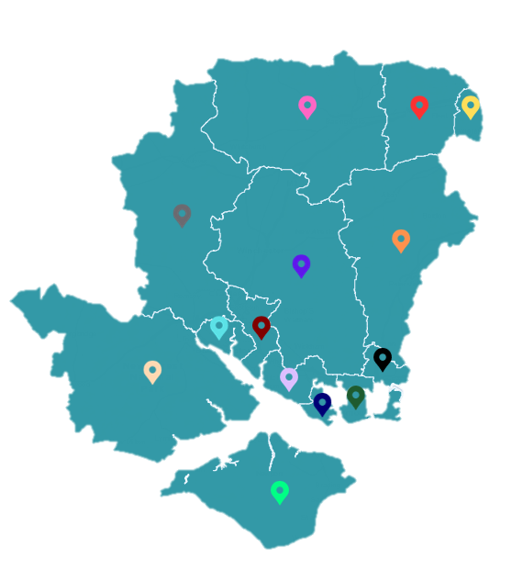
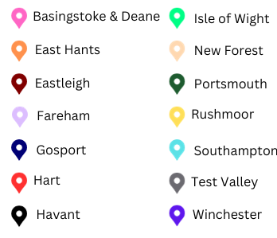
Introduction
Portsmouth
Unitary Authority.
Population estimate of 210, 300 in 2023. Between 2011 and 2021, the population increased by 1.5%, lower than the South East average of 7.5%.
Most densely populated area records 19872.5 residents per km2
1 University.
85.2% of residents self-defined as white.
Hampshire
Hampshire County Council (HCC) does not account for Portsmouth and Southampton. HCC is split into eleven districts, each of which is served by two tiers of local government.
Population of over 1.43 million based on 2023 estimates.
Lowest density population is in the New Forest, with 16.3 residents per km2.
Most densely populated area was in Eastleigh, with 11490.9 per km2.
1 University.
92.6% of residents self-defined as white.
Southampton
Unitary Authority
Population estimate of 264, 957 in 2023.
Population density ranges from 918.1 to 22756.2 residents per km2.
2 Universities. Largely due to the University population, 18.6% of residents are aged 16-24 years, compared to just 10.6% in England.
80.7% of residents are self-defined as white.
Isle of Wight
Unitary Authority.
Population estimate of 142, 426 in 2023.
Population density ranges from 25.2 to 9840.4 residents per km2.
97% of residents self-defined as white.

Slide 5
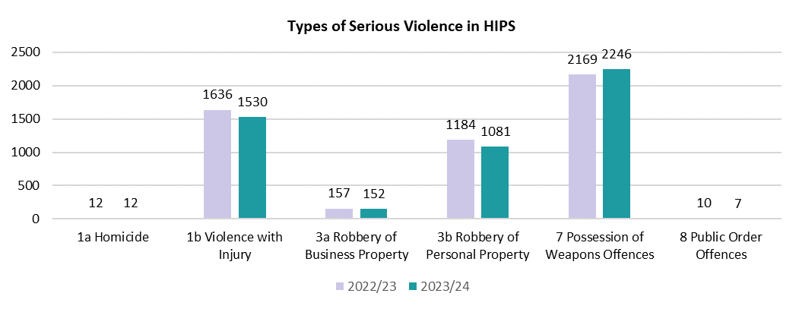
What serious violence has happened in the last year?
Overall, there were 5028 serious violence offences recorded by Hampshire and Isle of Wight Constabulary across HIPS during the 2023/24 financial year. There was a 2.7% decrease in serious violence in comparison to the previous year, which was in line with 2019/20 and 2021/22.
Taking the Covid-19 pandemic into consideration, there has been almost no change in levels of serious violence over the last five years (0.4% increase). Southampton, Portsmouth and Rushmoor recorded the highest rates of serious violence per 1000 residents.
Combined, Portsmouth and Southampton accounted for 45% of all serious violence offences in the HIPS area.
Figure 2. Types of serious violence in HIPS
An offensive weapon is defined as “any article made or adapted for use for causing injury to the person or intended by the person having it with them or by some other person.”
The most common serious violence offence in 2023/24 was Possession of Weapons offences; these accounted for 45% of all serious violence offences. IOW had the highest proportion of Possession of Weapons Offences (56%) and Portsmouth had the lowest (40%). Compared to the previous year, Possession of Weapons offences have increased by 3.6%.
When compared to the previous twelve months, Violence with Injury, Robbery of Personal Property, Robbery of Business Property and Public Order Offences all decreased for 2023/24. Homicide remained at 12 incidents.
Figure 1. Police recorded serious violence, rate per 1000 persons, Hampshire CSPs, 2023/24

Slide 6
What serious violence is happening?
Violence with Injury
Since 2014/15, HIPS has consistently recorded a higher rate of Violence with Injury incidents per 1,000 residents in comparison to the England average. There were 9.6 Violence with Injury offences per 1000 residents across the HIPS area in 2023/24. Portsmouth and Southampton recorded the highest proportion of offences (15.4), whilst East Hampshire recorded the lowest proportion (5.3). Areas with a larger Night Time Economy (NTE) also recorded a higher level of these offences, demonstrating their role in the perpetration of Violence with Injury.
Possession of Weapon Offences
Since 2015/16, HIPS has consistently recorded a higher rate of Possession of Weapons offences per 1,000 residents in comparison to the England average. There were 1.11 Possession of Weapons offences per 1000 residents across the HIPS area in 2023/24. Similarly to Violence with Injury, both Southampton and Portsmouth recorded the highest proportion of Possession of Weapons offences (2.02 and 1.92 respectively). Whilst, Fareham recorded the lowest proportion with 0.55. The most common type of these offences was Offensive Weapons with 89% of these offences being recorded as Offensive Weapons offences.
Figure 4. Police recorded possession of weapons offences per 1000 persons across the HIPS area in the year ending March 2024
Figure 3. Police recorded violence with injury, rate per 1000 persons, Hampshire CSPs and England, 2023/24

Slide 7
What serious violence is happening?
Robbery
Since 2013/14, HIPS has consistently recorded a lower rate of Robbery per 1000 residents in comparison to the England average. There were 0.61 Robbery offences per 1000 persons across the HIPS area in the last financial year. Robbery was recorded as the lowest rate of offences in comparison to both Possession of Weapons and Violence with Injury offences. Both Portsmouth and Southampton, recorded the highest rate of Robberies in HIPS (1.37 and 1.32 respectively), although Southampton was lower than the England average. Whilst, Winchester recorded the lowest proportion of offences with 0.18 per 1000 persons.
Domestic Abuse
Domestic Abuse is not currently included in the VRP serious violence definition as a distinct offence, but it is still essential that Domestic Abuse is monitored and understood in the HIPS area. The link between Domestic Abuse and serious violence is clear and monitoring it in this way ensures a more comprehensive understanding of serious violence in the HIPS area.
Gosport recorded the highest rate of offences (161), whilst Hart recorded the lowest rate of offences (69) per 10,000 population. This data is collected by Hampshire County Council so does not include data from Portsmouth, Southampton and IOW.
Figure 5. Police recorded robberies, rate per 1000 persons, Hampshire CSPs and England, 2023/24
Figure 6. Domestic abuse offences, per 10, 000 persons, Hampshire County Council

Slide 8
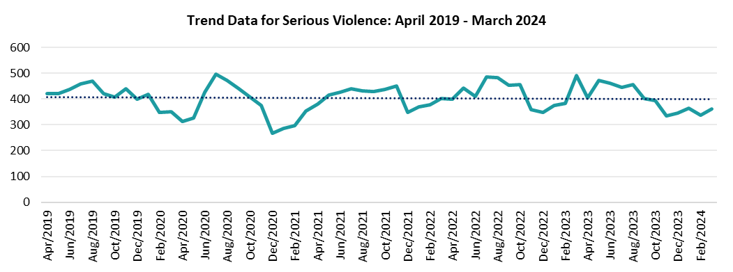
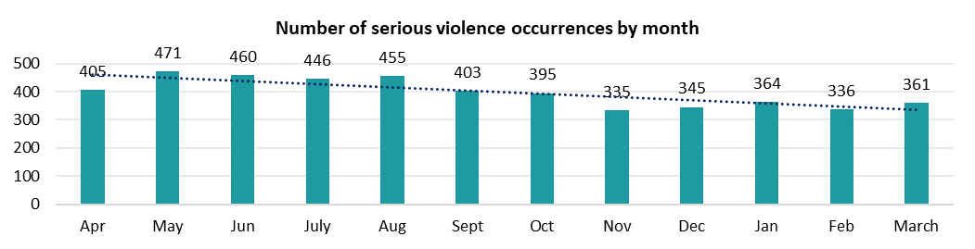
When is serious violence happening?
Over the last five years, there has been a relatively stable trend in the number of serious violence occurrences. The most prominent peak in occurrences was recorded in July 2020, following the end of the first major lockdown for the Covid-19 pandemic.
In the most recent financial year, more serious violence took place between May and August than any other period. This peak aligns with school summer holidays and better weather, and may also be influenced by specific police operations or partnership areas of focus during school holiday and summer periods. However, it is not the case that all districts and unitary areas recorded the same peaks in offences. This understanding is essential when designing partnership responses to serious violence.
Figure 8. Trend Data for Serious Violence: April 2019 – March 2024
Figure 9. Serious Violence by day and time, 2023/24
The most serious violence occurrences are recorded on Fridays, Saturdays and Sundays. There is an increase in occurrences after 15:00 hrs which then plateaus through the evening. This correlates with school finishing times, but this pattern is also seen at weekends. The greatest number of offences in a single hour is between 00:00-00:59 hrs on a Saturday morning, which is likely linked to the Night Time Economy (NTE).
Figure 7. Number of Serious Violence occurrences by month, April 2023 – March 2024

Slide 9
Who is impacted by serious violence?
In 2023/24, there were 3134 victims identified across HIPS. Of those, 71% (2219) were male and 27% (859) were female. This suggests males are more likely to be victims of serious violence across HIPS. Of the remaining 1% (42) of offences, no victim gender was recorded and 0.4% (14) were ‘local business’ or ‘property’ offences.
Those aged 25-34 years were most likely to be victims for both males and females. This is a contrast to 2022/23, when males aged 10-17 years and females aged 35-44 years were most commonly recorded as victims of a serious violence offence. Of all victims, 35% were recorded as being under the age of 25 years.
Where ethnicity was recorded, 61% of victims were defined as White, either by self-defined or officer-defined ethnicity. This was followed by 34% of individuals where no ethnicity was recorded.
Figure 11. Victim ethnicity, 2023/24
Figure 10. Age band and recorded gender of serious violence victims, 2023/24

Slide 10
Who is perpetrating serious violence?
In 2023/24, there were 3743 individuals identified as suspects of serious violence across HIPS. Of those, 83% (3117) were male and 16% (595) were female. This suggests males were considerably more likely to be involved in serious violence across HIPS.
Among women, those aged 35-44 years were most likely to be involved in serious violence, whereas, for men, the most common age category of suspects was 25-34 years. This is similar to the previous financial year, during which both males and females involved in serious violence were most likely to be aged 25-34 years.
Those aged 10-17 years accounted for an average of 18% of those committing serious violence, similar to the 17% during the previous financial year.
Where ethnicity was recorded, 74% of suspects were defined as white, either by self-defined or officer-defined ethnicity. This was followed by 9% of individuals defined as black.
Figure 13. Suspect ethnicity, 2023/24
Figure 12. Age band recorded gender for serious violence perpetrators, 2023/24

Slide 11
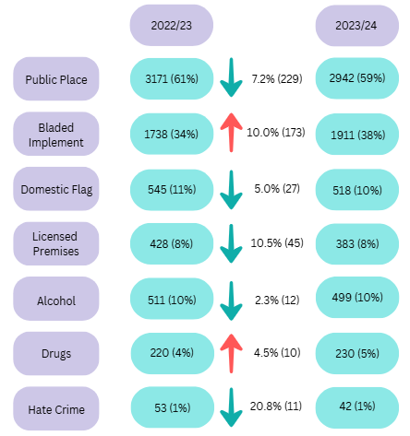
How is serious violence happening?
Figure 14 sets out a breakdown of the associated factors linked to serious violence occurrences, and a comparison of 2023/24 to the 2022/23. These factors are not consistently applied and should, therefore, be considered only a representation of associated factors.
Of all serious violence offences in HIPS, 38% (1911) were recorded as involving a bladed implement, a 10% (173) increase on the previous financial year. The only other flag to increase was drugs, which increased slightly by 4.5% (10) to 5% (230) of all serious violence offences.
Although the majority of serious violence offences occur in a public setting (59%), there was a 7.2% (229) decrease from the previous year.
There were other slight decreases in factors including for licensed premises, alcohol and hate crime, although the proportion of these crimes stayed the same when compared with the previous year.
The domestic flag was used in 10% of all serious violence offences, a 5% (27) decrease from the previous financial year.
Figure 14. Serious violence : Police-recorded associated factors
Figure 15. Serious violence occurrences involving a weapon, 2023/24

Slide 12
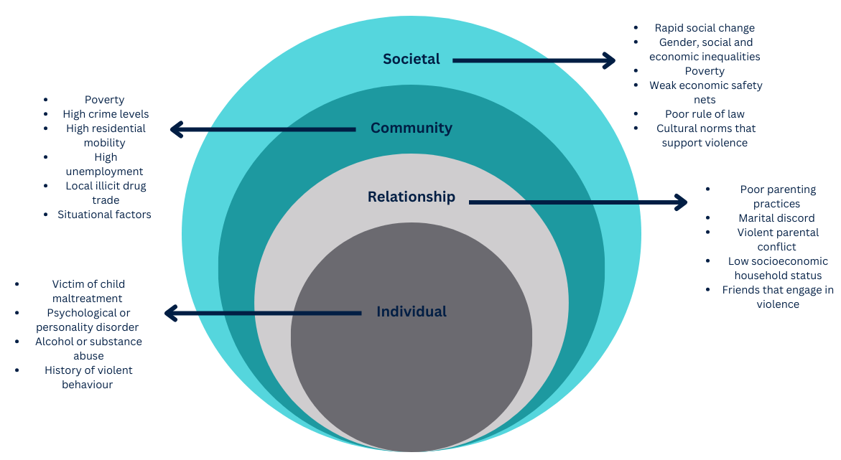
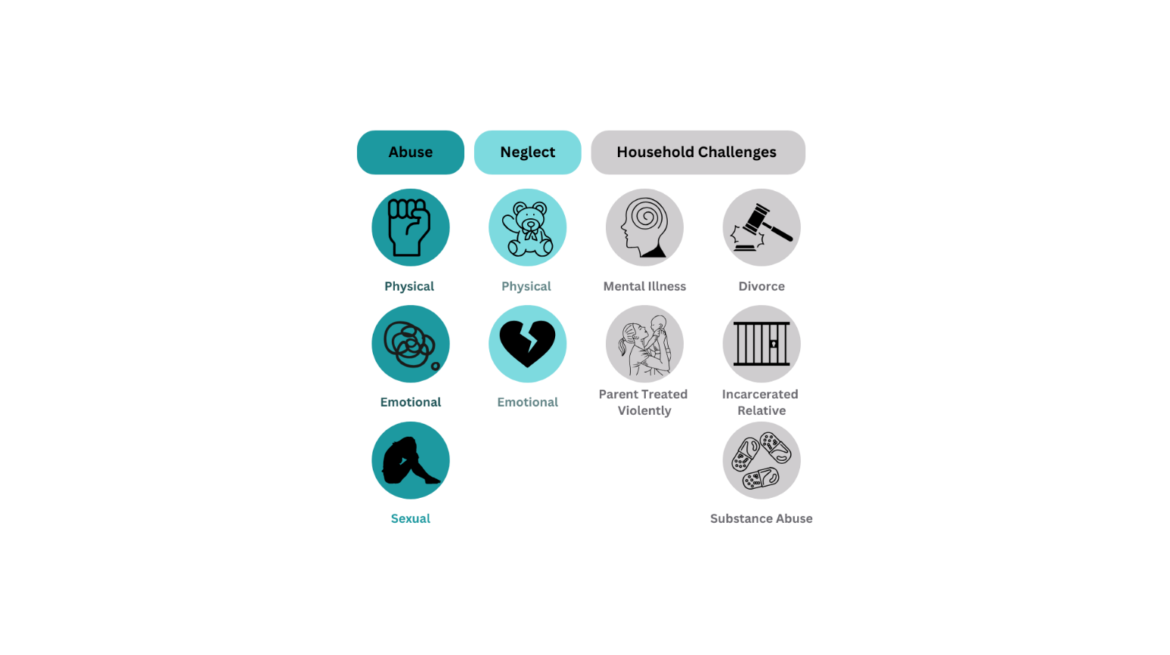
Why is serious violence happening?
Risk factors
Adverse Childhood Experiences (ACEs)
Research highlights the risk of ACEs for involvement in serious violence. These risk factors are cumulative, meaning that the more factors an individual experiences, the greater the risk. ACEs include emotional, physical, and sexual abuse, neglect, household violence, substance abuse, mental illness, imprisonment, parental separation, bullying and community violence.
Other factors include, individual (impulsiveness, low school achievement, poor problem-solving etc.), relationship (delinquent peers, parental conflict and lack of parental attachment), community (poverty, gang activity, etc.), and societal factors (limited education, limited economic opportunities).
The ecological framework considers violence to be the outcome of an interaction between several of the above factors, operating at four levels:
The Individual Level : includes being a victim of childhood maltreatment, alcohol or substance abuse and a history of aggressive behaviour.
The Relationship Level : family, friends, partners and peers all influence an individual’s likelihood of becoming involved in violence.
The Community Level : includes unemployment, population density, and the prevalence of local drugs trades.
The Societal Level : primarily concerns whether society as a whole inhibits or exacerbates the likelihood of an individual becoming involved in violence.

Slide 13
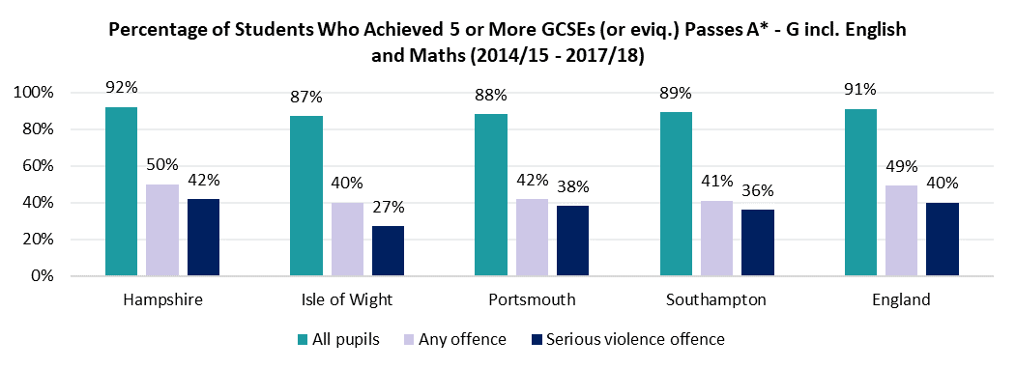
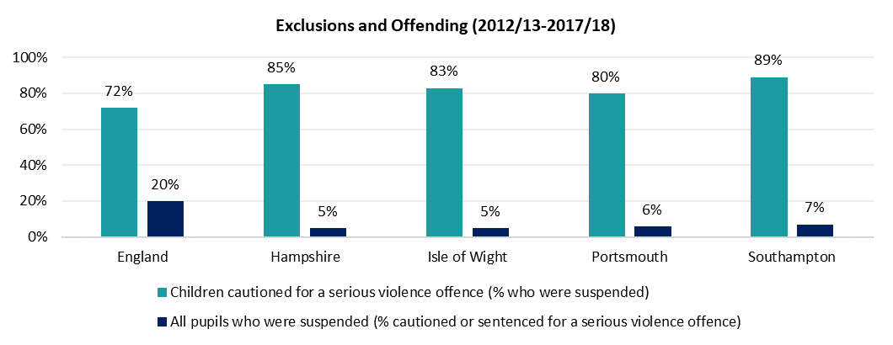
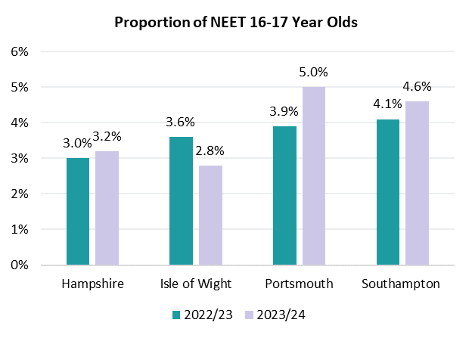
Why is serious violence happening?
Permanent Exclusions
The Youth Endowment Fund reported that 74% of excluded pupils reported perpetrating serious violence, compared to 16% of the general 13-17 year old population. Further, those who are permanently excluded from school were twice as likely to have a caution or conviction for serious violence. As Figure 16 shows, for 2012 to 2018, between 80% and 89% of young people who had been cautioned or sentenced for a serious violence offence, had also been suspended from school.
Attainment
Research indicates a link between poor academic attainment and youth offending. Figure 17 supports this link, though other risk factors may also play a role, such as persistent absenteeism.
Figure 17. Percentage of students who achieved 5 or more GCSEs across HIPS and England between 2014/15 and 2017/18
NEET
A NEET individual is anyone who is not in education, training or employment. Education and employment are protective factors, and young people who are NEET are more likely to be involved in criminal behaviour and poor health outcomes. As shown in Figure 18, over the last financial year, across HIPS, the Isle of Wight was the only region to decrease in the number of NEET 16-17 year olds.
Figure 16. Link between exclusion and offending data across HIPS during 2012/13 to 2017/18
Figure 18. Proportion of NEET 16-17 year olds across HIPS during 2022/23 and 2023/24

Slide 14
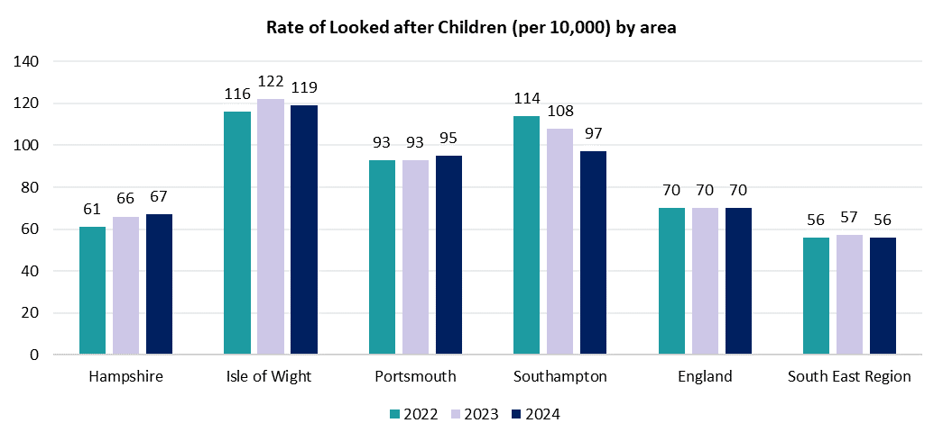
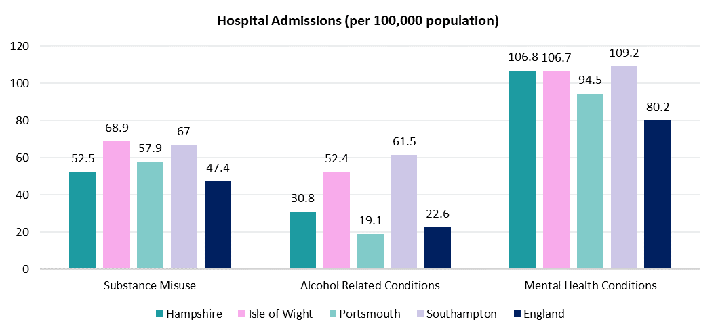
Why is serious violence happening?
Children in the care system
Children in care are overrepresented in the Criminal Justice System. More than half (52%) of children in care have a criminal conviction by the age of 24 years, compared to 13% of children who had an interaction with the criminal justice system and had not been in care. All HIPS areas are above the average for the South East region for children in care, and all areas have recorded similar figures when compared to the previous year. Isle of Wight have recorded the highest rate of looked after children in HIPS over the last 3 years, considerably higher than the regional average.
Hospital Admissions
Alcohol, substance misuse and mental health conditions have all been identified as risk factors that can make an individual more likely to become involved in serious violence, either as a perpetrator or a victim. All areas across HIPS recorded a higher rate of hospital admissions for substance misuse for 15-24 year olds and mental health conditions for under-18s than the national averages. Similarly, hospital admissions for alcohol related conditions in under 18s were higher in all areas across HIPS, with the exception of Portsmouth, in comparison to England.
Figure 19. Rate of looked after children (per 10,000) by area across HIPS, South East and England
Figure 20. Hospital admissions (per 100,000 population) across HIPS and England

Slide 15
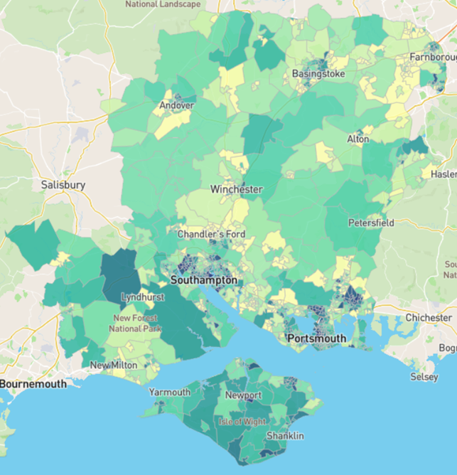
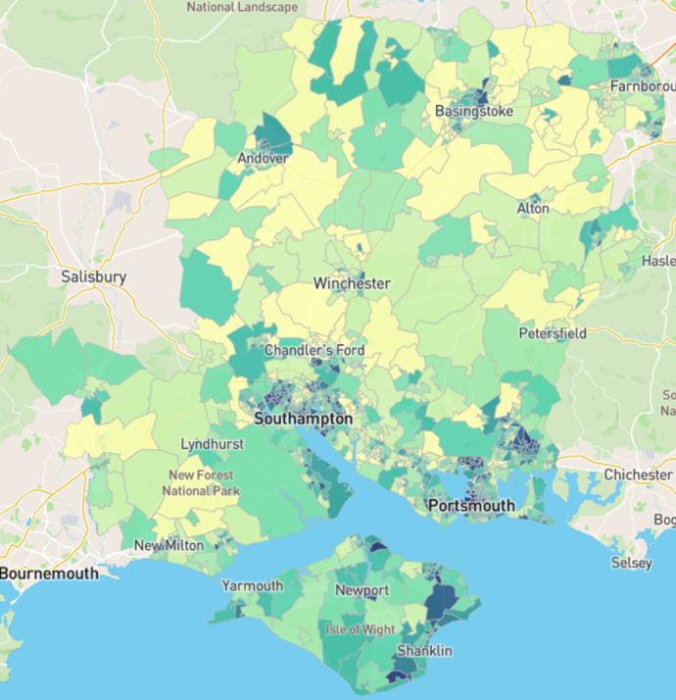
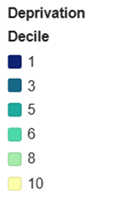
Why is serious violence happening?
Deprivation
Research has highlighted a positive correlation between deprivation and violence, with deprived communities feeling the greatest impact of violence.
Across the HIPS area, there are 44 areas which are ranked in the 10% most deprived nationally. Portsmouth falls into one of the 20% most deprived districts or unitary authorities in England. Southampton is ranked 55th out of 317 local authorities, where one is the most deprived, when looking at a national comparison. Roughly 20% of children in both Southampton and Portsmouth are considered to come from low income families.
When focussing on child deprivation, 49 local areas are ranked in the 10% most deprived areas nationally. With 16 and 19 of these coming from Portsmouth and Southampton respectively.
The IDACI is a supplementary index to IMD data, which only looks at children up to the age of 15 years living in income deprived households. Figure 22 below shows the breakdown of IDACI data across the HIPS area, where darker blue areas are more deprived and lighter green and yellow areas are less deprived.
IMD data is the official measure of relative deprivation in England. Figure 21 shows the IMD data for HIPS, where 1 (dark blue) is most deprived, and 10 (yellow) is the least deprived.
Figure 21. Map of IMD data across HIPS
Figure 22. Map of IDACI data across HIPS

Slide 16
Community voices
Community Safety Surveys
The purpose of community safety surveys are to gather peoples’ views on what effects their personal sense of safety within their communities, this often centres around crime and anti-social behaviour. Across HIPS in 2023/24, these surveys were conducted in Portsmouth, Rushmoor and Southampton. Below are some key results from the surveys:
44% of respondents thought knife crime was a problem in Portsmouth.
The proportion of young people in Portsmouth having reported seeing someone carrying a knife rose from 40% to just over 50% in 2024.
72.9% of respondents in Rushmoor currently feel safe in their communities.
22% of respondents from Rushmoor had been a victim of crime or ASB, however, most did not report because they felt nothing would be done.
Just 18% of respondents in Southampton agreed that public services were doing a good job of dealing with community safety.
For respondents in Southampton, 14 out of 16 crimes showed increases in reporting since 2023, including serious violent crime.
Knife Crime
The Serious Violence and Knife Crime survey and the VRP Participation Pack are two key initiatives developed within the HIPS VRU to engage directly with young people most affected by serious violence. Designed to complement each other, these tools aim to amplify youth voices and inform strategies around knife crime. Below are some key results from the knife crime survey:
43% agreed or strongly agreed that its ok to do whatever it takes to protect yourself.
47% agreed or strongly agreed that they were worried about others carrying a knife or a weapon.
Parents/family members were the most commonly trusted adult when it came to disclosing information about someone possessing a knife.
27% of young people did not report a crime because of their lack of trust in the police.

Slide 17
Community voices
Youth Commission Report 2023
The youth commission are a group of young people aged between 14 and 25 years, across HIPS, who act as a conduit between their peer group and the Police and Crime Commissioner, providing the youth voice regarding their experiences of policing and crime and how they believe these issues should be addressed. Below are the topics that stood out to these young people and their recommendations:
Relationships with the police – Importance of a trusted two-way relationship, more school and community visits from police, more police on the streets.
Domestic abuse – More education and awareness training for professionals and young people, harsher punishments for offenders, more victim support.
Safe on the streets – More police and surveillance on the streets, more education, more community safe spaces.
Make your mark UK Youth Parliament survey
The ‘Make your mark’ survey is designed to help inform what topics should be debated and discussed in the UK Youth Parliament that year. It represents what topics are most important to those aged 11 to 18 years. Overall, crime and safety was the second biggest issue in the UK amongst young people. Across HIPS, it was the most important in Southampton (21%), 3rd in Hampshire (11%), and 4th on the Isle of Wight (12%). This aligns well with the results presented in this SNA as Southampton had the highest rate of serious violence.
BeeWell Neighbourhood data hive 2023
BeeWell work in partnership with schools to survey the domains and drivers of the wellbeing of pupils across HIPS. Some of the average results for HIPS include; 6.59 for life satisfaction (0 to 10 scale), 5.74 for emotion regulation (3 to 9 scale), 3.27 for feeling connected to school (1 to 5 scale), 4.3 for bullying (3 to 12 scale), and 75.4% said they had never consumed alcohol. Also when asked about whether their area was safe to live those that lived in Havant NW, Barncroft, and Warren Park had the highest proportion of disagrees (26.9% and those who lived in Winchester town, Alresford, and Micheldever had the highest proportion of agrees (92.7%).

Slide 18
Partnership evaluation
PESTELO Analysis
A PESTELO analysis is a way of analysing a multitude of factors that may impact upon an organisation. This was conducted with partners during an away day within the HIPS TVRP. Participants took part in small groups and noted how the PESTELO factors affected them and their roles. Below are some key points:
Political – New Labour government means new opportunities and priorities, Government has promised to halve knife crime.
Economic – Uncertainty of funding for partners within the TVRP, more devolved funding and home office funding? Possibility of cuts?
Social – Social issues often coincide with lack of accessibility to services, cost of living crisis, right wing protests (summer 2024) could be a result of disenfranchised populations.
Technological – Usefulness of information sharing, but partners may use different systems which can act as a barrier to information sharing.
Environmental – Increase in housing estates (can increase population size and risk of serious violence), local authorities have to fulfil their duties in terms of environmental policies.
Legal – Possible changes to Serious Violence Duty, new legislation, early release of prisoners, higher threshold to remand children in custody.
Organisational – Employment structures, retention and recruitment, resources and budgets available to organisations to fulfil their duties.
Evaluation is consistently promoted by the VRU to partners. By evaluating what we do, we can understand what works. Therefore, we can effectively implement a public health approach. Either by evaluating our own work and sharing with partners, or by encouraging and supporting our partners to evaluate their own work, we can help build and inform better practices across HIPS. Two pieces of evaluation conducted within the partnership are highlighted here.
Support and Provision available to Community Safety Partnerships (CSPs), Youth Justice Services (YJS), and Voluntary, Community and Social Enterprise (VCSE)
Surveys were distributed to partners, professional contacts and those attending engagement events (those who work for either a CSP, YJS, or a VCSE). The goal of this project was to paint a clearer picture regarding where there are gaps where more input and interventions should be directed. As a result of the project below are some of the key recommendations:
Reduce barriers to MH services.
Explore how the police can be a more effective partner for CSPs.
Maintain engagement and relationships with statutory services.
Raise awareness of diversionary activities for CSPs (proved effective for YJS).
Understand better how to recruit more responses to surveys from the VCSE sector.
Encourage CSPs from Southampton to use Saints Foundation as a support (it was well supported by YJS participants from the area).

Slide 19
Recommendations
To effectively tackle serious violence it is essential that strategies are informed by data. Combining criminal justice datasets presents the opportunity to identify patterns and trends that would otherwise be hidden. The VRP should continue to prioritise enhanced data sharing and development to inform strategy and operational activity. The Partnership Data Tracker should be used to measure progress on a quarterly basis.
To focus on developing collaborative, evidence-based interventions focused on highest need. The data demonstrates that violence is concentrated in specific geographical areas and disproportionately affects certain age groups. This data and similar evidence should inform decision-making regarding where and how interventions are introduced.
To build a stronger evidence base of effective practise. The VRP should improve the quality and consistency of impact evaluations to develop evidence of what works. Key performance indicators aligned with violence reduction objectives should be tracked to assess progress and inform continuous improvement.
To make the best use of education or employment as a protective factor against involvement in serious violence. The VRP should work together in partnership to reduce risk of harm for students after school hours.
To reflect the voice of communities and individuals most affected by serious violence, ensuring those voices are central to the design and delivery of interventions. Serious violence is often rooted in complex, overlapping vulnerabilities such as poverty, school exclusion, and exposure to domestic abuse. Developing a counter narrative for young people at risk of serious violence is essential to shifting perceptions and reducing harm.

Slide 20
If you would like to know more about the Violence Reduction Partnership, please contact us at:
VRU@hampshire.police.uk

