Slide 1
PCC Candidate Briefing
Chief of Staff Kate Gunson

Slide 2
Police & Crime Commissioner
Be the voice of the people and hold the police to account. They are responsible for the totality of policing in their area.
Establish a police and crime plan.
Any decisions will be reported to the Police and Crime Panel, who “to scrutinise the actions and decisions of their PCC, providing both support and challenge, acting as a critical friend”.
PCCs ensure community needs are met as effectively as possible and improving public trust and confidence in policing.
Commission dedicated local victim support services as well as crime prevention services to address issues such as domestic abuse, youth crime and ASB.
Hold the chief constable to account for the exercise of their functions and the functions of the officers and staff under their direction and control.
Secure the maintenance of the police force, by setting the budget.
Work with national and local policing and criminal justice partners to reduce crime and help make communities safer.
Secure that the police force is efficient and effective.

Slide 3
Statutory Functions of the PCC
The Office of the Police & Crime Commissioner supports the Commissioner to discharge their statutory functions, achieve the objectives set out in their Police & Crime Plan and hold the Chief Constable to account for the delivery of policing services.
The Police Reform & Social Responsibility Act 2011, The Police Act, 1996 and The Policing & Crime Act 2017
The Policing Protocol, 2011
The Strategic Policing Requirement, 2023
The Police Reform and Social Responsibility Act 2011, The Police Act 1996 and The Police and Crime Act 2017 have more information on the statutory duties of the PCC.

Slide 4
The Police & Crime Panel
Review and report on all elements of the PCC’s Police and Crime Plan
Review or scrutinise decisions made and actions taken by the PCC
Publish any reports and recommendations made
Review (and if necessary veto) PCC’s level of precept
Review and report on the PCC’s annual report
Initial handling and informal resolution of complaints against PCC / DPCC
Review senior appointments (Deputy PCC, Chief Executive and Chief Finance Officer)
Review (and if necessary veto) Chief Constable appointments
Suspend the PCC on their being charged
Appoint an Acting PCC if necessary
What You Need to Know as a PCC, APCC, 2021

Slide 5
Office of the police & crime commissioner Hampshire & isle of Wight
Police & Crime Commissioner
Deputy PCC
Chief Finance Officer
Senior Liaison Officer
Chief of Staff
Director of Violence Reduction Unit (HO funded unit)
Head of Legal and Governance
Head of Communications and Engagement
6 staff members
21 staff members
4 staff members

Slide 6
Chief of Staff – role & responsibilities
Leading continuous improvement through research and development.
Managing organisational risk and identifying opportunities for improvement.
Converting the Commissioner’s political manifesto into a Police & Crime Plan.
Providing good governance & supporting the Commissioner with their statutory responsibilities.
Overseeing financial management & budgetary spend in conjunction with the Chief Finance Officer.
Leading and overseeing the performance of the organisation.
Setting organisational direction & objectives.
Developing organisational standards & other policies.
Managing local stakeholder relationships.
Developing & maintaining strategic relationships with statutory & non-statutory partners.
What You Need to Know as a PCC, APCC, 2021

Slide 7
Chief Financial Officer – role & responsibilities
The CFO’s role is to ensure that the financial affairs of the Commissioner are properly administered, having regard to their probity, legality and appropriate standards. They are responsible for:
Helping to develop and implement strategy and to resource and deliver strategic objectives sustainably and in the public interest.
Ensuring that the financial aspects of immediate and longer term implications, opportunities and risks are fully considered, and aligned with the PCC’s financial strategy.
Leading on the promotion and delivery of good financial management so that public money is safeguarded at all times and used appropriately, economically, efficiently and effectively.
Safeguarding against any unlawful, or potentially unlawful, spending by the PCC or those acting on the PCC’s behalf.
What You Need to Know as a PCC, APCC, 2021

Slide 8
Governance
IBOS
(Implementation Board Oversight and Scrutiny)
Joint Audit Committee
Southern Internal Audit Partnership
Established by the PCC and Chief Constable.
The SIAP provides internal audit services to a wide range of public sector clients including the OPCC and HIOW Constabulary.
Direct activity to deliver the Police & Crime Plan, and ensure the discharge of associated PCC statutory responsibilities within the Police Reform & Social Responsibility Act 2011.
Ensures that effective governance and risk management arrangements are in place and are functioning efficiently and effectively.
Assurance and consulting activities.
Quarterly meetings (split into 2 parts)
Assess how well the systems are operating and how to improve them.
Content is used to inform updates provided to the Police & Crime Panel in relation to the agreed programme
Produces an annual report on the committees work and any concerns/ issues.
It is a statutory requirement that ‘the PCC and the Chief Constable should establish an independent Audit Committee’ which should be a ‘combined body’ to advise the PCC and Chief Constable jointly.
www.hampshire-pcc.gov.uk. Joint Audit Committee Meeting Tuesday 20th February 2024 - Hampshire Police and Crime Commissioner.
www.hampshire-pcc.gov.uk. Scrutiny - Hampshire Police and Crime Commissioner.
Joint Audit Committee of the Police and Crime Commissioner and Chief Constable of Hampshire - Annual Report 2022/23
Southern Internal Audit Partnership – Hampshire County Council

Slide 9
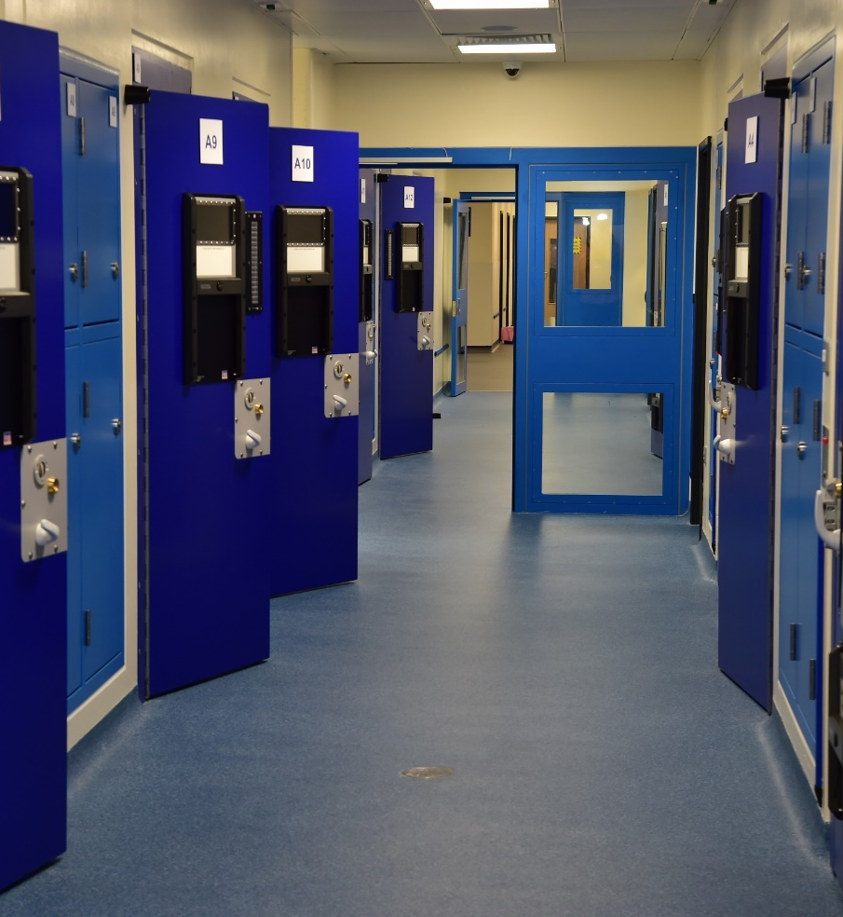
Scrutiny
Scrutiny Panels
Adult Out of Court Disposals Scrutiny Panel
Youth (YOT) Out of Court Disposals Scrutiny Panel
Use of Force Scrutiny Panel
Independent Custody Detention Scrutiny Panel
COPS – Commissioner’s Oversight of Policing Services
Thematic Scrutiny – ASB, Knife Crime, 101 and Police Visibility
Independent Panel Members
Independent Custody Visitors (ICV’s)

Slide 10
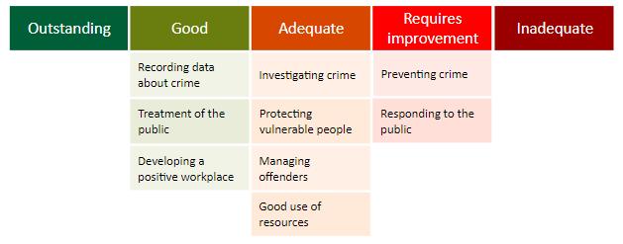
HMICFRS Police force Effectiveness, Efficiency and Legitimacy (PEEL)
2021/22 (published Apr-23)
Need a clear strategy and direction for neighbourhood policing and that officers and staff at all levels understand it.
Improve the time it takes to answer calls from the public and reduce its abandonment rate.
Attend more calls for service in line with its target response times
Ensure call handlers use and correctly record structured initial triage and risk assessments so they can prioritise calls and give the most appropriate response.
Need to make sure call takers give appropriate advice on preventing crime and preserving evidence.
His Majesty’s Inspectorate of Constabulary and Fire & Rescue Services.

Slide 11
Criminal Justice Role
Local Criminal Justice Board
Identifies Priorities
Addresses system issues
Reduces reoffending
Victims and witness improvements
Strives for efficiency and effectiveness of the local CJS
Two sub-groups of the LCJB
Victims & Witnesses Board
Chair: HIOW Constabulary
Ensures quality support is provided to victims and witnesses meeting their needs and improving their experience of the Criminal Justice System.
Reducing Reoffending Board
Chair: OPCC & HMPPS
Brings together relevant agencies to provide support to aid rehabilitation and reduce re-offending

Slide 12
Commissioning Services
Key role of PCC is commissioning projects, services and activities which promote community safety, mitigating offending behaviour and providing support for victims of crime
2023/24 the OPCC managed almost £11.5 million of funding to support this aim. A considerable portion of this funds HIOW charities and organisations, offering support that aligns with the requirements of residents and fostering long-term local resilience. Reducing the burden on front line Policing.
In October 2014 PCCs in England and Wales took responsibility for the commissioning of support services for victims and witnesses of crime (previously MOJ). Each financial year, the MoJ devolves circa £2.4 million to the OPCC, to support delivery of victim support services
In addition, the OPCC makes bids for additional funding to government to support specific initiatives in 2023/24 HIOW commissioning team successfully bid for extra funding of £4.3 million

Slide 13
Youth Engagement

Slide 14
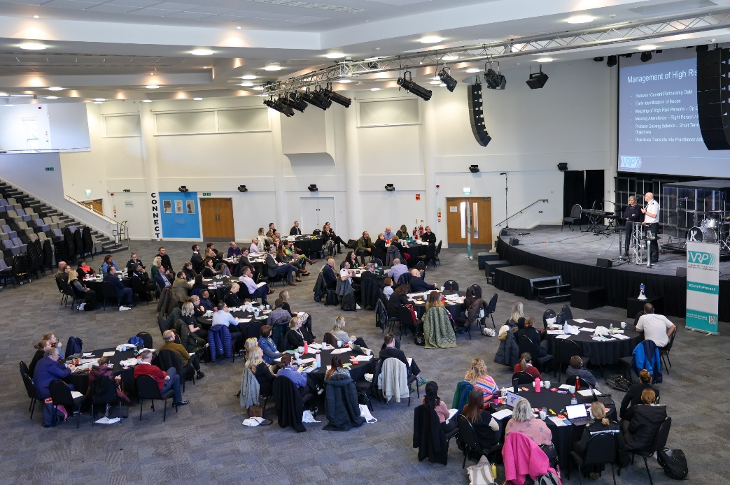
Partnerships
Violence Against Women & Girls
Local Criminal Justice Board
Modern Slavery Partnership
Community Safety Partnerships
ASB Task Force
Strategic Combatting Drugs Partnerships
Homicide Prevention Board
Violence Reduction Partnership
Joint collaboration
Integrated Care Partnership
Trauma Informed Executive Board

Slide 15
Estates - Facts

Slide 16
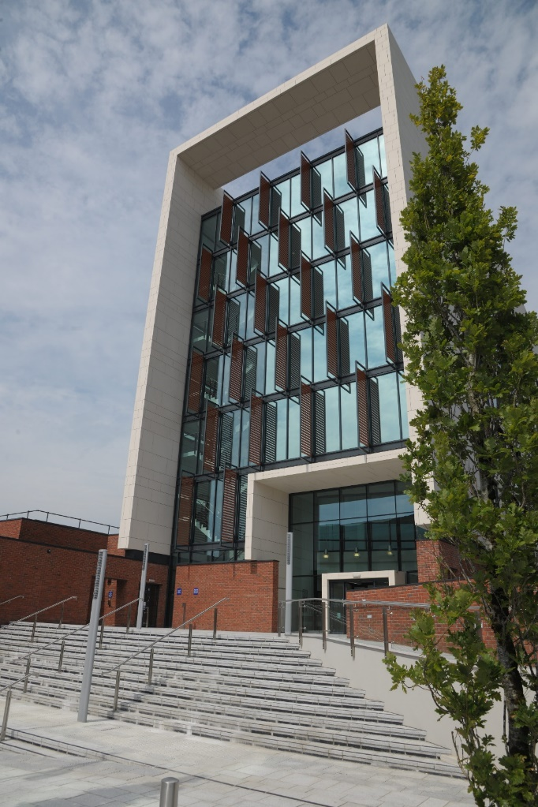
Estates - Principles
De-carbonisation and green credentials where possible to meet government targets as a minimum
Robust Maintenance strategy – maintaining the estate with a view to the long term rather than quick fix
Owned estate preference – to achieve best economic value and remain in control of our estate
Economic to run – looking at more economical, energy-efficient and sustainable ways to run the estate
Collaboration with public partners where it makes sense – to support the one public estate initiative
Provide a consistent standard of workspace across the estate, where practicable to provide an environment which supports the Constabulary in its retention, recruitment, accessibility and productivity aims

Slide 17
The Hampshire and IOW VRU
Hampshire and Isle of Wight VRU is a home office funded team of professionals that work in partnership to coordinate a collaborative response to tackle the root causes of violence. The VRU supports the Violence Reduction Partnership (VRP) made up of 25 different public sector bodies across the Hampshire, Isle of Wight, Portsmouth & Southampton area who come together to make our communities safer.

Slide 18
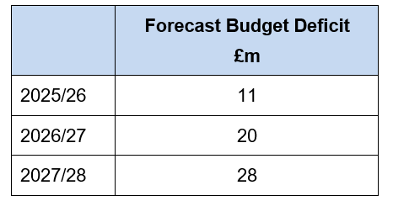
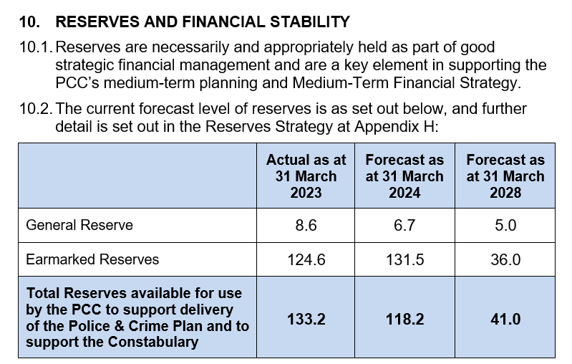
Finance
The force has a balanced budget for 2024/25. Efficiencies of £8m have been delivered in the past three years. The table below shows the projected budget position in future years.
Total net budget for 2024/25 = £462m. Total net budget for policing services for 2024/25 = £417m, including £359m on employee-related expenditure.
The OPCC has a prudent and healthy reserves position. Most of it is earmarked for estate, IT and other vital improvements that annual police budgets do not easily allow for.

Slide 19
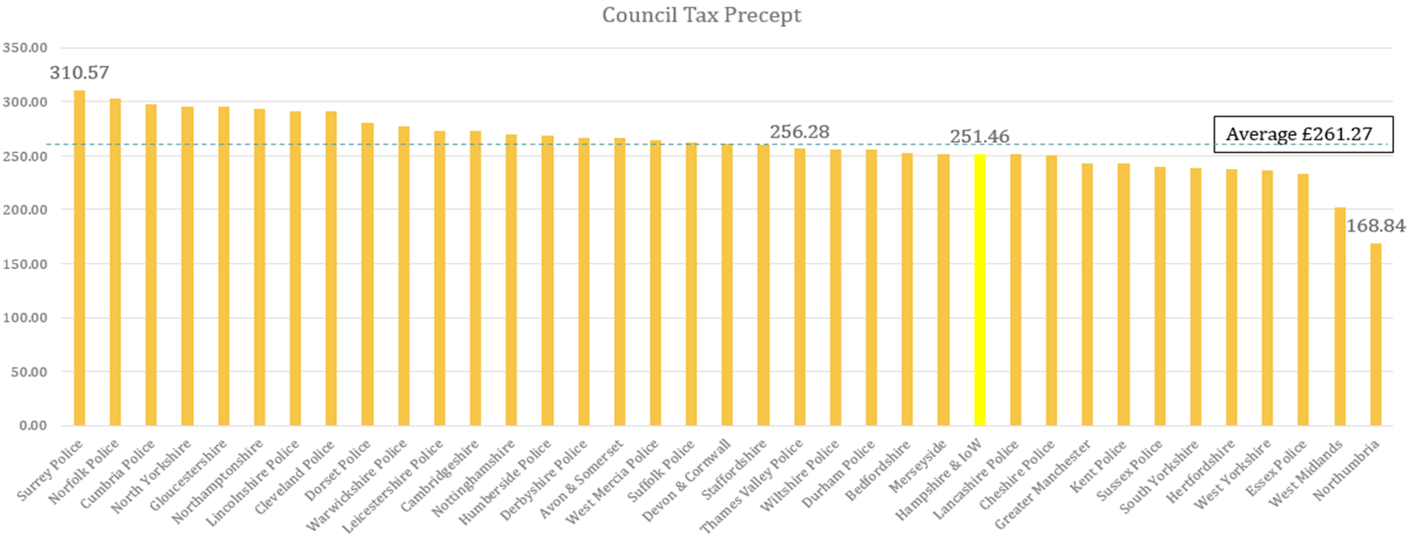
Council Tax Comparison 2023/24
The police force in question has low council tax compared to other forces.
They also receive a low national grant.
Despite these financial constraints, the productivity of their officers remains high.
This productivity contributes to their ability to deliver strong performance.
A fair national funding formula has been promised but has faced delays.
If implemented, it would result in improved service for residents of Hampshire and the Isle of Wight.

Slide 20
Future Challenges
Carbon targets & infrastructure of the future
A fit for now and the future estate
Investment in Infrastructure: The decarbonisation agenda requires significant investment in new infrastructure, including workshops, power substations and charging points.
Cost of Electric Vehicles: Electric vehicles (EVs) currently have higher costs compared to combustion engine vehicles. This could impact the vehicle replacement program, leading to increased contributions.
Operational Considerations: As some EVs would be on charge, there may be a need for more operational vehicles.
Ambitious OPCC plans
Increased local co-located teams.
More officers and staff.
Additional police stations.
Police officer pay
Police Pay scales 6&7 have significant increases. Officers who were recruited during the uplift programme will create a pressure on pay increases in the medium term when they reach these scale points.

Slide 21
The first 100 days
Oath and key decisions
Visits - Hampshire and Isle of Wight Constabulary
Meet the Constabulary's Chief Officer Group
Meeting the OPCC team
Visit with commissioned service providers

Slide 22
You can scan the QR code to view the briefing pack

