Slide 3
Notes:
Relentless pursue offenders
Create a hostile environment for criminals
Bring more offenders to justice
Visible and proactive enforcement activity to reduce crime & ASB
Restore an investigative mindset
Maximise use of information and intel
Don't do the job of other agencies
Exceptional Local Policing
Deliver the Police and Crime Plan
Neighbourhood policing that is visible, connected and trusted
Listen to and engage with communities to solve problems
A quality and timely response to the public
Keep rural communities safe
Value and maximise the impact of our volunteers and partnerships
Victims
Prioritise victims throughout their journey
Keep victims informed
A victim-led not process-led mindset
Listen and respond to the voice of the victim
Prevent and reduce victimisation
Work with partners to support victims
SAFE FOR EVERYONE

Slide 7
Notes:
Executives and Senior Leaders
Set up to lead and deliver
Heads of departments
Ch Supt Fi Bitters
Ch Supt Paul Southey
Ch Supt Clare Jenkins
Supt Rob Mitchell
Deliver and lead in Areas – responsibility for Local policing & CID in each area.

Slide 9
Local Policing
Neighbourhood Policing Teams, District Policing Teams and the Local Policing Support Unit.
Crime & Criminal Justice
Custody, Intelligence and the wider Criminal Justice system. Responsible for building and maintaining relationships with regional and national partners, including Prisons, the Crown Prosecution Service, Courts and Youth Offending.
Crime & Criminal Justice
The JOU is divided into three broad areas of policing specialism – Firearms, Operations and Roads Policing.
Provides resilience for non-collaborated units.

Slide 10
Home Office Headcount Target
3,420
(March 24)
PCC FTE Officer Increase Target
+650
(Jan 20 – March 24)
Staff headcount 1990
PCSO headcount 241
(March 20)
The Constabulary has a strong network of volunteers, including Special Constables, Community Speed Watch, and a Cadets programme for young people.
257
Volunteers (+ Community SpeedWatch)
233
Police Cadets & Leaders
Actual Headcount
in HIOWC
3,440
(March 24)
Actual FTE Officer Increase in HIOWC
+686
(Jan 20 - March 24)
Staff headcount 2228
PCSO headcount
166
(March 24)
Total number of officers recruited Jan 2020 to Mar 2024 = 1706

Slide 11
Home Office officer Headcount Target
3,400
(March 25)
PCC
FTE Officer Increase Target
+725
(Jan 20 – March 25)
PCC Staff headcount Increase
+ 35
(Apr 24 – Mar 25
An increase of 75 for 2024/25
The additional officers will boost local policing, enhance the management of offenders, tackle most serious violence, and bolster our Intelligence Unit and professional standards department
These additional staff will improve our Intelligence capability, enable us to open more front counters, as well as enhancing vetting, mental health and professional standards

Slide 13
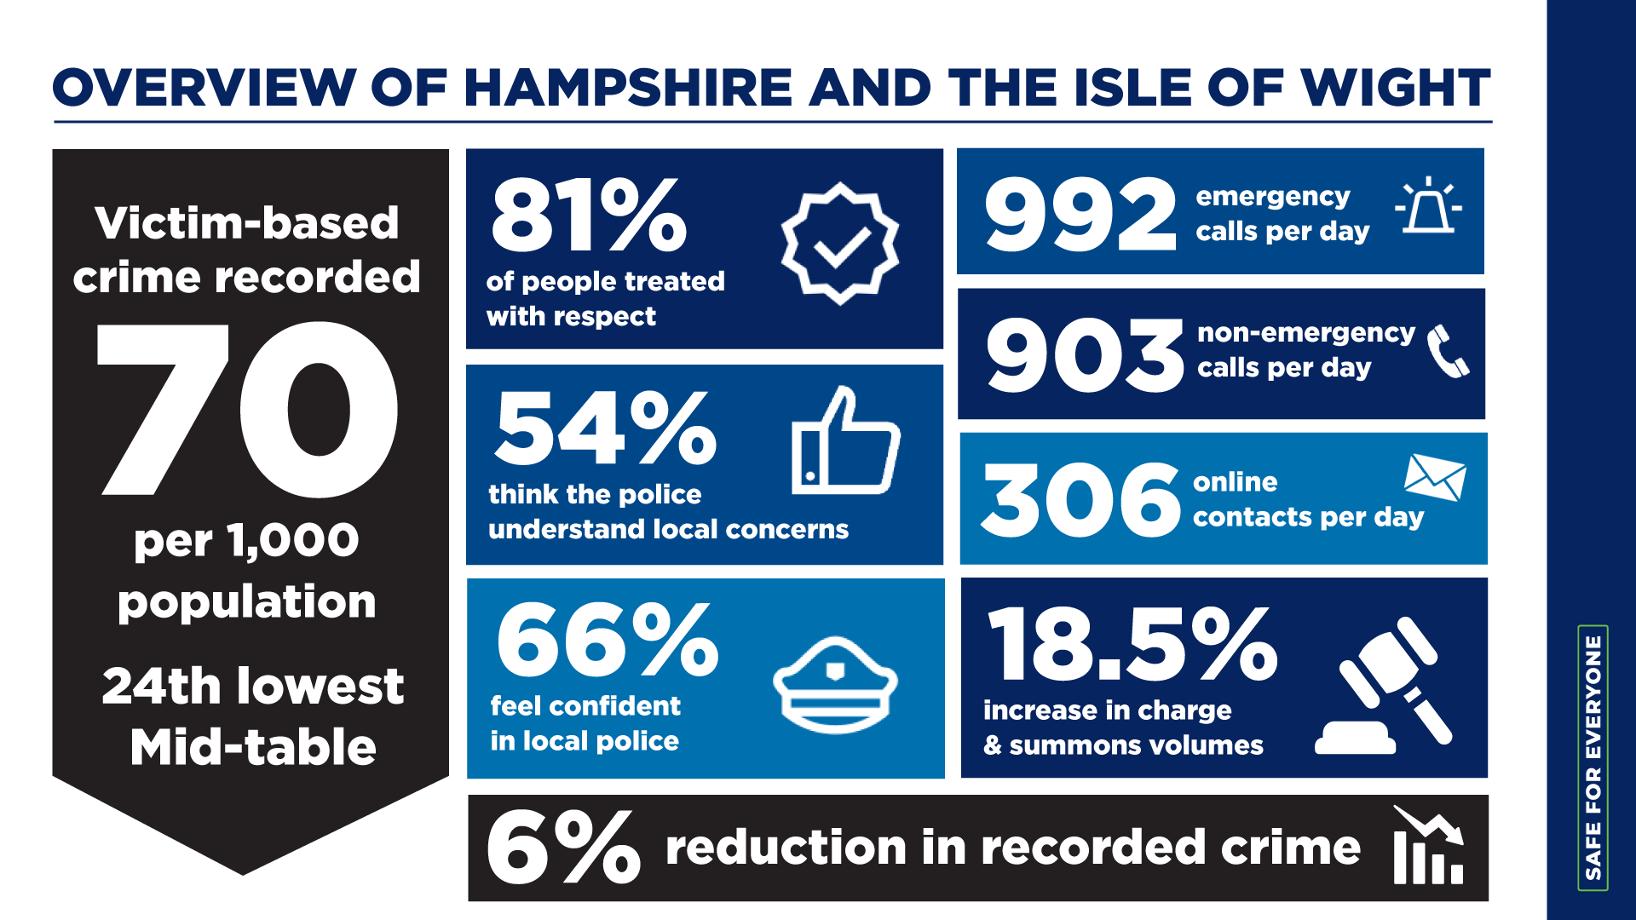

Slide 17
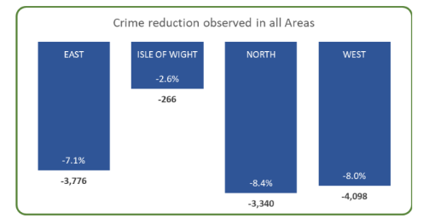
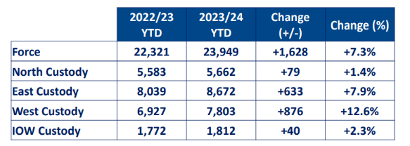
The force is arresting and bringing far more people into Custody than 12 months ago.
Crime is down in all four geographical Areas of the force

Slide 18
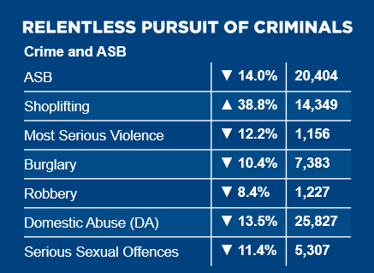
Crime is down in nearly every category, with 10.4% fewer burglaries and a reduction in serious violence of 12.2%.
ASB is down 14%.
The one exception is shoplifting where the force has had a particular drive to encourage reporting and target offenders. This has been welcomed by businesses.
Success in shoplifting – reporting is up, charges against offenders are also up (2,558 more outcomes). Success here is linked to reductions in other crimes (e.g. robbery and burglary).
Notes:
Reduction in significate crime, in all 4 areas.
Not working in silos
One team approach

Slide 19
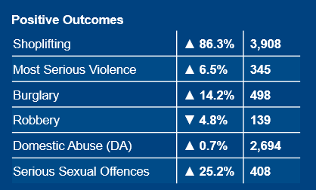
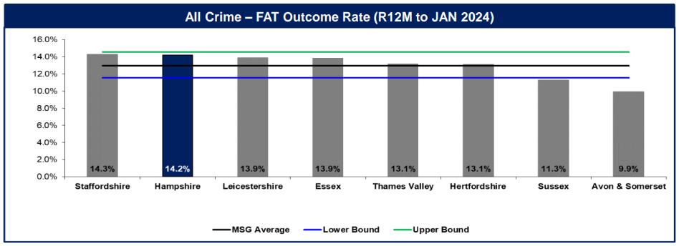
Across many crime types, more offenders were held to account last year than in the previous year.
Outcomes for those committing burglary are up 14.2% and serious sexual offences up by 25.2%.
Force is one of the best, compared with comparable forces, in terms of all outcomes achieved in and out of court

Slide 21
Improvements in in the past year
 | HIOWC
 | 999 | 101
Volume | 1,012 | 1,019
Service Level | 84.29%
Ave. Speed to Ans | 00:08 | 13:13
Total Aband. | 0 | 418
% Aband. After Threshold | - | 26.69%
% Total Abandoned | - | 41.02%
Ave. Speed to Aband | - | 08:36
Maximum Wait Time | 02:54 | 0:53:25
% Calls Ans over 10 mins vs Ans. |  | 51% (306)
MTD SL | 86.10% | 09:45
March 2023
March 2024
 | HIOWC
 | 999 | 101
Volume | 720 | 547
Service Level | 92.92%
Ave. Speed to Ans | 00:03 | 02:02
Total Aband. | 0 | 72
% Aband. After Threshold | - | 6.95%
% Total Abandoned | - | 13.16%
Ave. Speed to Aband | - | 04:25
Maximum Wait Time | 01:46 | 0:57:38
% Calls Ans over 10 mins vs Ans. |  | 5% (24)
MTD SL | 94.54% | 02:19

Slide 22
How have we achieved this improvement?
Victims are now being served far quicker on 999 and 101 services.
Enablers have included a new call centre, new technology, staff issues resolved, a concerted recruitment drive and work to retain staff.
Improved Contact Management staffing levels
March 2023 = 274 (FTE)
January 2024
= 337 (FTE)

Slide 23
The force is dispatching and getting to scene quicker for both Grade 1 (emergencies with the greatest risk) and Grade 2 calls.

Slide 24
New self-serve performance dashboard for statistics and code compliance
Bespoke classroom training for Call Management that is being rolled out across the force
Two-way messaging via Victims Portal
Extra staff into Witness Care Unit to help support victims and witnesses in light of court backlogs and delays
Direct feedback from victims to OIC
Victims Hub and three additional OPCC-funded police staff to signpost to commissioned services
Force-wide eLearning

Slide 28
The policing principles apply to everyone in policing.
They will support your decisions and help shape culture, thereby increasing trust and confidence
in policing.

Slide 30
Notes:
Clare to provide a briefing/notes

Slide 31
2.a What are the issues affecting you in your community which would benefit from joint working between police partners and community members to resolve
Help shape policing in your neighbourhood

Slide 33
Risk Score | ID | Title | Likelihood | Impact | Status
 | STR 186 | Contact Management Service Delivery | Likely | Severe | Static
 | STR 188 | IPCO Non-Compliance | Possible | Severe | Increasing
 | STR 173 | Workforce Mental Health | Likely | Major | Increasing
 | STR 179 | Health and Safety Non-Compliance | Possible | Severe | Reducing
 | STR 187 | Recruitment & Retention | Likely | Major | Static
 | STR 178 | HIOWC Police Legitimacy | Possible | Severe | Static
 | STR 193 | SSD/ DFG Backlog and Capacity | Possible | Major | NEW

