Slide 1
Force Policy and Procedure Update
Hampshire & Isle of Wight Constabulary
February 2024

Slide 2
Force Policies & Procedures
Oldest one overdue – 10/10/2023 (Domestic Abuse)
Makes up 33% of our overdue FPPs
226
FORCE POLICIES AND PROCEDURES
Response & Neighbourhoods
4
12
OVERDUE 5%
12 High / 0 Med / 0 Low
Oldest one overdue – 15/09/2023 (Disclosure Of Unused Material)
Makes up 25% of our overdue FPPs
Investigations
3
13
WILL BE OVERDUE IN THE NEXT 3 MONTHS (January 2023 – April 2024)
Oldest one overdue – 17/03/2023 (Uniform & Standards of Dress)
Makes up 17% of our overdue FPPs
31
PUBLISHED IN THE LAST 3 MONTHS
(November 2023 - January 2024)
DCC
2
Oldest one overdue – 17/01/2024 (Intel)
Makes up 17% of our overdue FPPs
ITD
2
Oldest one overdue – 26/10/2023 (Child Abuse Investigation - CRU Grading Procedure)
Makes up 8% of our overdue FPPs
PVP
1

Slide 3
Force Policies & Procedures
Policy No. | Title | Next Review | Risk | Owner
2120 | Uniform & Standards of Dress | 17/03/2023 | High | DCC
37750 | Personal Use of Social Media | 26/09/2023 | High | PSD
37860 | Abuse of Position for Sexual Purpose or Improper Emotional Relationship | 17/01/2024 | High | PSD
37870 | Sexual Harassment in the Work Place | 17/01/2024 | High | PSD
21400 | Disclosure Of Unused Material | 15/09/2023 | High | Criminal Justice
27400 | Management of Covert Human Intelligence | 17/01/2024 | High | Intelligence
25507 | The Presentation Of Texts In The Crown Court Magistrates Court And Appeal Court | 17/01/2024 | High | Intelligence
2400 | Domestic Abuse | 10/10/2023 | High | Local Policing Support
35400 | Hate Crime and Hate Incidents | 26/10/2023 | High | Local Policing Support
32500 | Threats to Life | 08/12/2023 | High | Local Policing Support
37000 | Police Street Powers Including Stop and Search | 20/12/2023 | High | Local Policing Support
1901 | Child Abuse Investigation - CRU Grading Procedure | 26/10/2023 | High | PVP

Slide 4
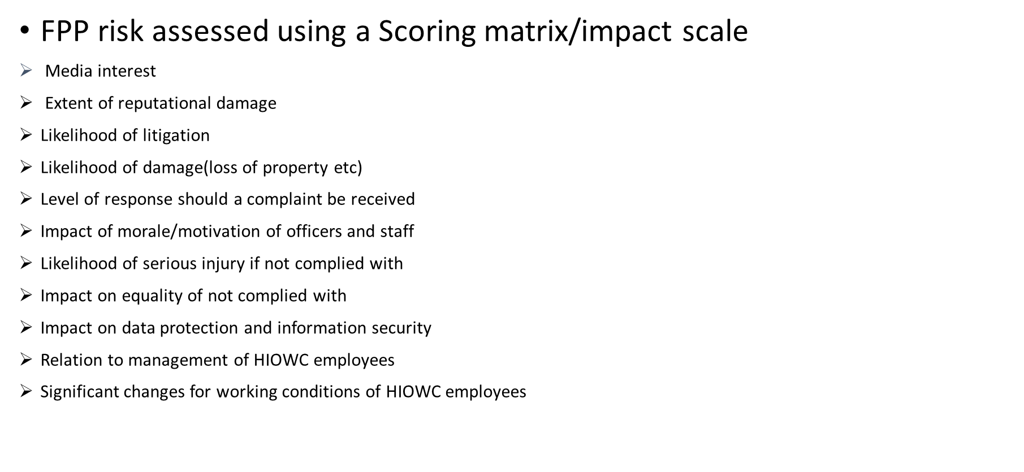
Risk Assessment

