Slide 1

Hampshire, Isle of Wight, Portsmouth and Southampton
Violence Reduction Partnership
Strategic Needs Assessment
Executive Summary
December 2023
Violence Reduction Unit - (hampshire-pcc.gov.uk)
VRU@hampshire.police.uk

Slide 2
Contents
3
Introduction
5
What serious violence has happened in the last year?
6
When is serious violence happening?
7
Where is serious violence happening?
9
Who is impacted by serious violence?
10
How is serious violence happening?
11
Why is serious violence happening?
14
Community Voice
15
Next Steps

Slide 3
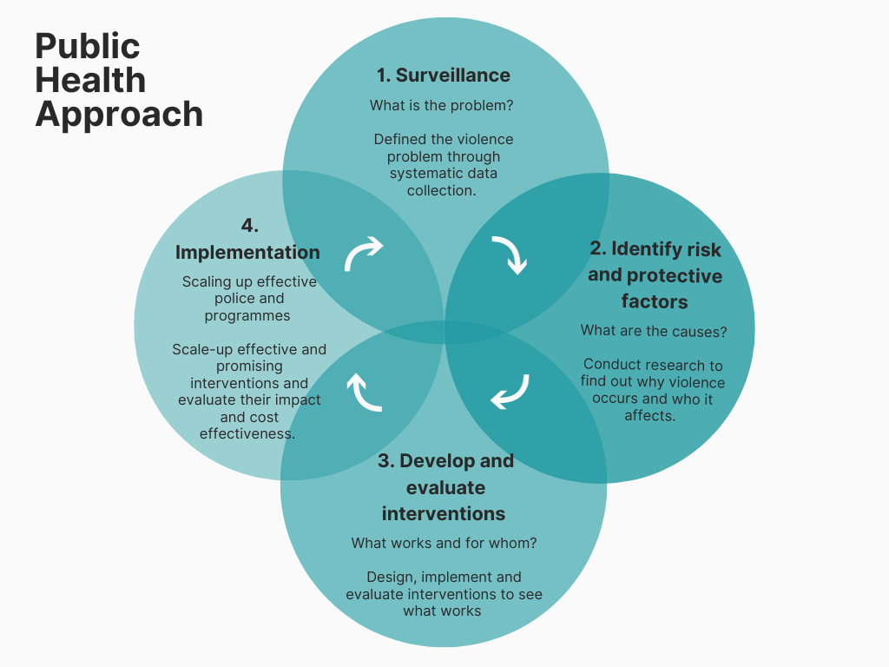
Introduction
The Hampshire, Isle of Wight, Portsmouth and Southampton (HIPS) VRP has produced a HIPS-wide SNA to provide a comprehensive assessment of serious violence, which will be updated on an annual basis. The following slides are a publicly accessible summary providing an overview of the main findings and next steps.
The aim of the strategic needs assessment, produced by the VRP, is to assess the current picture of serious violence in the Hampshire, Isle of Wight, Portsmouth and Southampton (HIPS) area. It aims to help local partners identify groups and places most at risk of becoming victims or perpetrators of violence. Outlining the current picture of serious violence across HIPS using partnership data is critical to the ongoing success of the HIPS VRP. As such, the SNA utilises a range of partnership data sources to outline the most comprehensive view of violence possible with the available data.
In response to the Serious Violence Duty, a common definition of serious violence was agreed at the HIPS Serious Violence Reduction Partnership to enable consistency across the partnership.
The HIPS VRP are focussed on embedding a public health approach to reducing violence and aim to do so while implementing the following underlying principles:
Focussed on a defined population
With and for communities
Not constrained by organisational or professional boundaries
Focussed on generating long term and short term solutions
Based on data and intelligence to identify the burden on the population
Rooted in evidence of effectiveness to tackle the problem
The agreed HIPS wide Serious Violence definition captures to following offences and Home Office crime codes:
Most Serious Violence – Existing Definition (1a and 1b where it is GBH and above incl. death by dangerous driving).
Robbery (3a and 3b).
Possession of Weapon Offences (7).
Public Order (Violence Disorder [65] and Riot [64/1] only).
Any Violence with Injury (1b) not included under MSV where a bladed implement was used.

Slide 4
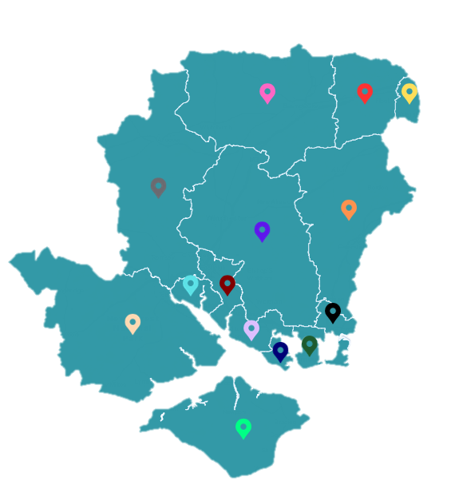
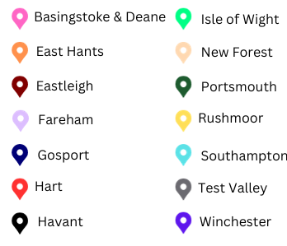
Introduction
The following data sources are used in the HIPS-wide SNA:
Police: Hampshire and Isle of Wight Constabulary recorded crime; serious violence offences; serious violence victims and perpetrators; associated factors.
Fire: Hampshire and Isle of Wight Fire and Rescue Service recorded data; deliberate fire data.
Local Authorities: Data from all local authorities in the HIPS area; deprivation and inequality data; community voice surveys
Health: Hospital admissions (mental health, substance & alcohol misuse, self-harm); feelings of loneliness; NHS sharps injury admissions.
Probation: Criminogenic needs, FTE rates, re-offending rates.
Prisons: Criminogenic needs, offence type, age band.
Youth Justice Service: Juvenile first time entrants; rate of serious violence among 10-17 year olds; custody rate among 10-17 year olds (Portsmouth only).
Education: Open-source data from the Department for Education; attainment data; exclusions; persistent absenteeism; NEET 16-17 year olds; SEN support; looked-after children data.
The HIPS area recorded a population of just over 2 million individuals
The county of Hampshire includes Portsmouth and Southampton, but the Hampshire County Council (HCC) area does not.
HCC is split into eleven districts, each of which is served by two tiers of local government.
Portsmouth, Southampton and the Isle of Wight are all unitary authorities.
The main urban areas are Portsmouth and Southampton.
12% of individuals aged 16-24 in 2022 were classified as NEET.
29% of school age pupils in the HIPS area are eligible for free school meals.
91% of the population in the HIPS area is White.
52% of the HIPS population have a Level 3 qualification or above.
28% of the population in the HIPS area are aged under 25, compared to 29% in England and Wales.

Slide 5
What serious violence has happened in the last year?
There were n.5123 serious violence offences recorded by Hampshire and Isle of Wight Constabulary across HIPS during the 2022/23 financial year. There was a 4% increase in serious violence in comparison to the previous year, which was largely driven by an increase in possession of weapons offences.
Taking the Covid-19 pandemic into consideration, there has been a 6% increase in serious violence over the last five years. Southampton, Portsmouth and Rushmoor recorded the highest rates of serious violence per 1000 residents.
Combined, Portsmouth and Southampton accounted for 46% of all serious violence offences in the HIPS area.
Types of Police recorded serious violence in HIPS compared to the previous financial year
The most common serious violence offence was Possession of Weapons offences; these accounted for 42% of all serious violence offences. 88.6% of all Possession of Weapons offences were classified as Offensive Weapons occurrences. Compared to the previous financial year, Possession of Weapons offences increased by 13%.
An offensive weapon is defined as “any article made or adapted for use for causing injury to the person or intended by the person having it with them or by some other person.”
When compared to the previous twelve months, Violence with Injury, Robbery of Personal Property and Public Order Offences all recorded a decrease in offences. Homicide increased from n.15 incidents to n.17 incidents in the last year. Robbery of Business Property also increased by 13%.
Police recorded serious violence, rate per 1000 persons, Hampshire CSPs: 2022/23

Slide 6
When is serious violence happening?
Over the last five years, there has been a relatively stable trend in the number of serious violence occurrences. The most prominent peak in occurrences was recorded in July 2020, following the end of the first major lockdown of the pandemic.
In the most recent financial year, more serious violence took place in the months of July (n.472) and August (n.484) than any other month. These peaks align with school summer holidays, although it is not the case that all districts and unitary areas recorded the same peaks in offences. This understanding is essential when designing partnership responses to serious violence.
Peaks in serious violence are likely influenced by specific police operations or partnership areas of focus during school holiday periods.
Night Time Economy
The greatest number of occurrences in a single hour were between 22:00-23:00 on a Saturday evening, which is likely linked to NTE across the HIPS area. This is particularly true of the districts and unitary authorities with a large NTE presence, particularly Portsmouth and Southampton.
This is also the case when looking at the sustained increase in offences in the early hours of Saturday and Sunday. This is likely linked to later opening times of NTE venues over the weekend.
Police recorded serious violence occurrences by day and time: 2022/23 financial year
The most occurrences happen on Fridays, Saturdays and Sundays. There is also an increase in occurrences after 16:00 and throughout the evening and the greatest number of occurrences happened between 18:00-19:00.
Police recorded serious violence occurrences by month: 2022/23 financial year

Slide 7
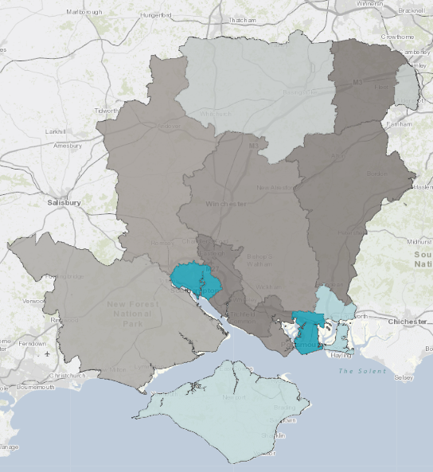
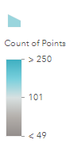
Where is serious violence happening?
The HIPS area recorded 10.7 violence with injury offences per 1000 persons in the last financial year, in comparison to 9.4 per 1000 residents across England CSPs. Southampton presented the greatest number of violence with injury offences per 1000 individuals (n.17.3), while East Hampshire recorded the lowest proportion (n.6). Across all districts, town centres feature prominently as keys areas for violence against the person.
The districts coloured darker grey on the map recorded less than n.49 incidents across the entire year. The darker blue areas are districts, specifically Portsmouth and Southampton, which recorded the most incidents of violence with injury. The HIPS area as a whole has consistently recorded more violence per injury incidents per 1000 residents in comparison to the England average since the 2014/15 financial year.
Police recorded possession of weapons offences, rate per 1000 persons, Hampshire CSPs and England: 2022/23
Since the 2015/16 financial year, the HIPS area has recorded a higher rate of possession of weapons offences per 1000 residents compared to the England average. Both have experienced a steady increase in the rate of possession of weapons offences since the 2013/14 financial year, although the HIPS area has increased at a steeper rate and did not record the same decrease as the England average during the Covid-19 pandemic.
The above table shows the rate of possession of weapons offences across the HIPS area, compared to individual districts as well as England CSPs as a whole. According to these Home Office figures, there were n.1.1 possession of weapons offences per 1000 persons across the HIPS area in the year ending March 2023, which is higher than the England CSP average (n.0.96).
Similar to violence with injury offences, Portsmouth (n.1.92) and Southampton (n.2.11) recorded the highest rate of possession of weapons offences, although Gosport ranks third (n.1.23) and above the HIPS average.
Police recorded possession of weapons offences per district: 2022/23

Slide 8
Where is serious violence happening?
Portsmouth and Southampton recorded the most robbery (business and personal) incidents, but Basingstoke and Rushmoor both also recorded above the average number of incidents in the HIPS area. When looking at the robbery figures per 1000 residents, Havant recorded the highest rate (n.0.59) behind Portsmouth (n.1.51) and Southampton (n.1.51).
Since the 2013/14 financial year, the HIPS area has consistently recorded a lower rate of robbery per 1000 residents in comparison to the England average.
Both HIPS and the England average recorded a decrease during the 2020/21 financial year, although the HIPS area recorded a much smaller decrease. Neither had returned to pre-pandemic levels, which is contrary to the pattern recorded for possession of weapons and violence with injury incidents. It is likely police recording practices have had a significant impact on the number of robbery offences recorded.
Domestic Abuse
Domestic abuse (DA) is not currently included in the VRP serious violence definition as a distinct offence, but it is still essential that domestic abuse is monitored and understood in the HIPS area. The link between domestic abuse and serious violence is clear and monitoring it in this way ensures a more comprehensive understanding of serious violence in the HIPS area.
Excluding Portsmouth and Southampton, Havant (n.157) and Rushmoor (n.156) recorded the greatest number of domestic abuse offences per 10,000 population. Hart recorded the lowest domestic abuse rate per 10,000 population (n.62).
The identification of these areas as key districts for domestic abuse is vital as neither Havant nor Rushmoor have a prominent night time economy. Therefore, focus on DA in these areas is essential to reduce serious violence as it is likely a greater proportion of these areas’ violence can be attributed to DA.
An important element to note here, however, is that the available domestic abuse data does not include Portsmouth and Southampton due to the data being collected by Hampshire County Council.
Portsmouth and Southampton are the only districts to have recorded a higher rate of robbery per 1000 residents compared to both the HIPS average and England CSPs.
Police recorded robbery, rate per 1000 persons for HIPS and England: 2013/14 - 2022/23

Slide 9
Who is impacted by serious violence?
HIPS Prison Population
47% of individuals in HMP Winchester are there due to a violent offence.
Criminogenic needs are factors in an offender’s life that are directly linked to recidivism.
The most common criminogenic need identified for individuals in HMP Winchester is pro-criminal attitudes (92%), followed by the lifestyle and associates need (89%).
Across the 2022/23 financial year, there were a total of n.3279 distinct individuals identified as victims of serious violence; of these, 71% were recorded as male.
4% of victims either had no gender recorded or are local businesses and property. The majority of occurrences where no victim is recorded can most likely be attributed to the high number of Possession of Weapons Offences recorded in all districts.
Among females identified as victims of serious violence, those aged 35-44 (n.191) were the most commonly recorded. For males, the most common age band was 10-17 (n.496), followed by 25-34 (n.494).
Where ethnicity has been recorded for victims of serious violence, 64.8% were defined as White, either by self-defined or officer-defined ethnicity. 97.5% of victims of serious violence either did not, or were not given the opportunity, to self-define their ethnicity.
Age band and recorded gender of police recorded serious violence perpetrators
There were n.3573 distinct individuals identified as suspects of serious violence in the HIPS area; this accounts for 0.17% of the total HIPS population. Where suspect details are recorded, 16.6% were recorded as being female, while 82.6% were recorded as male. For all suspects, the most common age band was 25-34 (n.843), this is the same peak age group as the previous financial year.
Across HIPS, 17% of those suspected of serious violence were aged 10-17, compared to 10% in the 2021/22 financial year.
Where ethnicity was recorded, 79.3% of suspects were defined as White, followed by 6.3% of individuals defined as Black. It is important to note, however, that 60.4% of suspects of serious violence refused or were not asked to self-define their ethnicity. This means the statistics are heavily reliant on officer-defined ethnicity, which is less reliable than self-defined ethnicity.

Slide 10
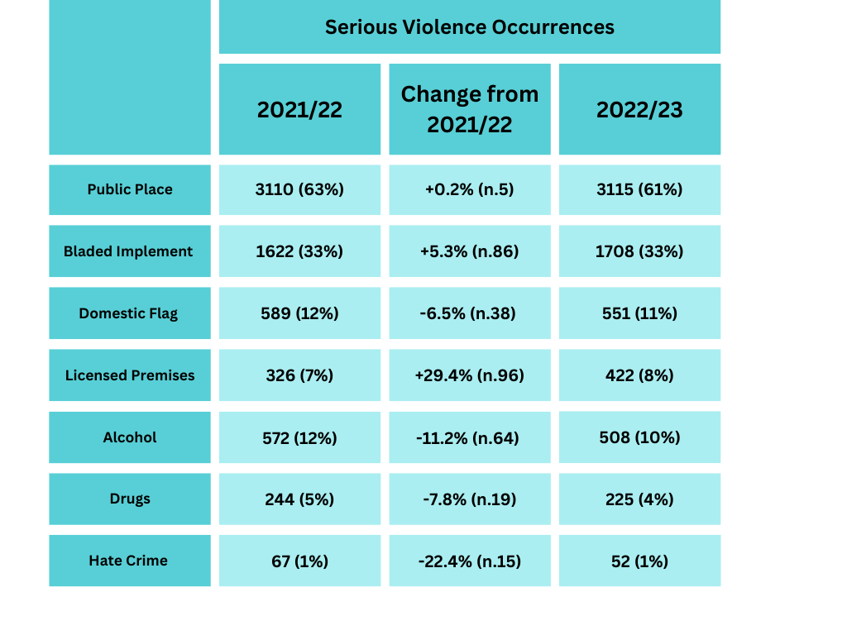
How is serious violence happening?
This table sets out a breakdown of the associated factors linked to serious violence occurrences, and a comparison to the 2021/22 financial year. The central column contains the change in the number of times a flag was attached to occurrences across the HIPS area in the 2022/23 financial year.
The public place flag was the most commonly applied associated factor (61%), indicating the majority of serious violence across the financial year took place in a public setting. This is particularly relevant as the Serious Violence Duty promotes specific focus on offences that occur in public places, although the definition does not exclude domestic offences.
11% of all serious violence incidents across HIPS had the domestic flag applied, suggesting they are linked in some way to domestic abuse. This is a 6.5% decrease compared to the previous financial year.
There was an increase in the number of licensed premises linked occurrences, although the numbers remain relatively small (8%).
The alcohol flag was applied to 10% of relevant occurrences in 2022/23, this is a decrease of 11% compared to the previous year. Similarly, the drugs flag was applied to n.19 fewer offences compared to the previous financial year.
The number of Hate Crime flags also decreased compared to the previous financial year. Nationally, there was a 5% decrease in the number of hate crimes recorded, the first decrease since comparable data began to be collated in 2013. It is known, however, that hate crime is consistently underreported by victims, often because they are unaware what they experienced should be classified as such.
33% of all serious violence offences in HIPS were recorded as involving a bladed implement of some kind. Of these, 93.5% involved only a bladed weapon, while a further 3.5% involved both a bladed implement and a non-bladed weapon.
Serious violence police recorded associated factors

Slide 11
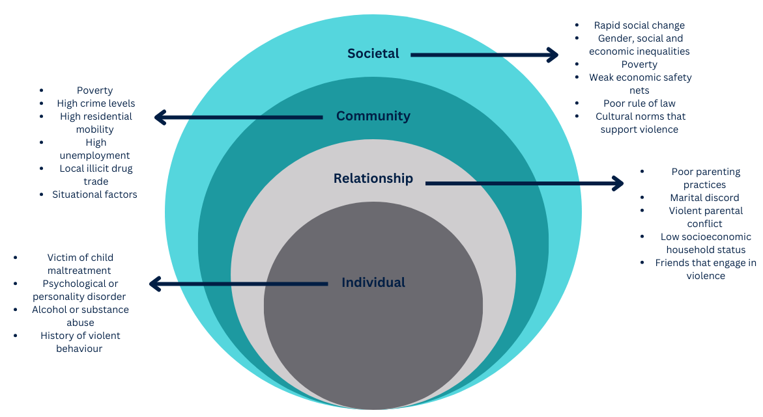
Why is serious violence happening?
Juvenile first time entrants to the criminal justice system are a key indicator of individual’s possessing important risk factors for serious violence. This indicator, collected by Youth Justice Services across the HIPS area, measured the First Time Entrants (FTEs) rate in full year rolling periods using offending data and population estimates for the local area.
According to ONS figures, Portsmouth, Southampton and the Isle of Wight have all recorded the highest proportion of FTEs to the criminal justice system at some point over the last five years.
FTEs are considered anyone aged 10-17 who received a caution or conviction for offences committed in England and Wales, and only includes those who reside in England and Wales. In 2022, Hampshire was the only HIPS area to record fewer FTEs in comparison to the wider South East area, although all four HIPS areas have measured consistently above the regional average across the five year period.
The ecological framework considers violence to be the outcome of an interaction between several of the above factors, operating at all four levels:
The Individual Level : includes being a victim of childhood maltreatment, alcohol or substance abuse and a history of aggressive behaviour.
The Relationship Level : family, friends, partners and peers all influence and individual’s likelihood in becoming involved in violence.
The Community Level : includes unemployment, population density, and the prevalence of local drugs trades.
The Societal Level : primarily concerns with whether society as a whole inhibits or exacerbates the likelihood of an individual becoming involved in violence.
Juvenile first time entrants to the criminal justice system, rate per 100,000 of the 10-17 population by local authority residence: 2018-22

Slide 12
Why is serious violence happening?
There are several risk and protective factors linked to education, many of which have a strong evidence base linking them to serious violence.
One such indicator is permanent exclusions. The most common reason for permanent exclusion across Hampshire, Portsmouth and Southampton was persistent disruptive behaviour, while drugs and alcohol were cited as the most common reason on the Isle of Wight.
The Department for Education identified 7% of children in Southampton and 6% in Portsmouth who had been excluded from school had also been cautioned for a serious violence offence. When looking at children who were cautioned for a serious violence offence between 2012 – 2018, between 80% and 89% of these young people across the HIPS area had been suspended from school.
Persistent absenteeism is known to have a link to exclusions and, in some cases, can be a risk factor for exploitation and criminality. In England, 85% of children who were cautioned or sentenced for a serious violence offence in 2021/22 had been classified as persistently absent at some stage.
It has been found that secondary school attainment, partnered with effective parental supervision and adequate family income are all important protective factors against youth offending.
When attainment data is broken down by those who have been cautioned or sentenced for a serious violence offence, between 42% (Hampshire) and 27% (Isle of Wight) of relevant young people achieved five or more GCSEs (A*-G). By comparison, between 92% (Hampshire) and 87% (Isle of Wight) of young people with no criminal record achieve these results.
Across Hampshire, there was roughly n.34000 young people with Special Educational Needs (SEN) provision in schools during the 2022/23 financial year. While it is clear there is no single direct link between these individuals and their involvement in violence, a lack of necessary, consistent support and the feelings of isolation due to increased rates of exclusion from education can be classified as risk factors of serious violence.
NEET 16-17 year olds (%)
NEET 16-17 Year Olds
A NEET individual is anyone who is not in education, training or employment and there is evidence that young people who are NEET have a higher likelihood than their peers to be involved in criminal behaviour and have poor health outcomes.
During the 2022/23 financial year, both Hampshire and the Isle of Wight recorded a lower percentage of NEET individuals compared to the national and regional average. Southampton recorded above the national average, but below the average rate for the region (6%). Of note, Portsmouth recorded 7.3% of 16-17 year olds as being NEET, which is substantially above the national average (5.2%) and the average for the South East region (6.9%).

Slide 13
Why is serious violence happening?
The NHS records the number of sharps related injury admissions in a rolling twelve month period.
When looking at both admissions for people of all ages and those under 25, Hampshire consistently sits in the middle of the comparison group: most similar police force areas nationally. In both measures, however, there is relatively consistent sharps admission numbers, with no comparable areas showing any major changes.
The relatively stable numbers suggest a stable trend in knife-enabled serious violence more generally. By contrast, police data indicates an increase in the same offence, although police data is more likely to be impacted by changes to recording or periods of intensification.
Alcohol, substance misuse and poor mental health have all be identified as risk factors that can make an individual more likely to become involved in serious violence, either as a perpetrator or a victim.
With the exception of Portsmouth, all HIPS areas recorded a higher rate of hospital admissions for substance misuse among under 25s and alcohol related conditions in under 18s in comparison to the national average.
Similarly, hospital admissions for mental health related conditions among under 18s were higher in all HIPS areas except for Portsmouth when compared to England as a whole.
Hospital admissions for self-harm in the HIPS area are noticeably higher for those aged 15-19 years compared to other ages. Among this age band, the Isle of Wight has the highest rate of hospital admissions in the region (1382.5 per 100,000).
All four HIPS areas recorded a higher rate of hospital admissions for self-harm for all age bands in comparison to the national average.
Hospital admissions, rate per 100,000 population

Slide 14
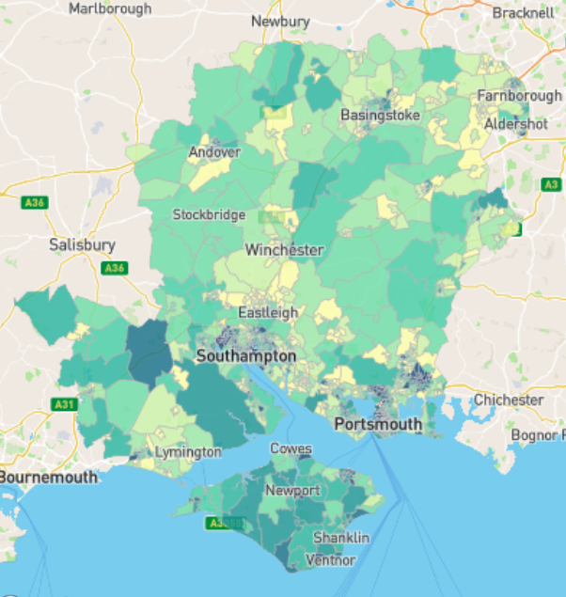
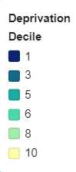
Why is serious violence happening?
Deprivation is not a causal factor for violence in itself. It is, however, a distinct risk factor and contributes to many other identified risk factors, including mental health, education and health.
Across the HIPS area, there are n.44 areas which are ranked in the 10% most deprived areas nationally. This is broken down into: n.7 in Hampshire, of which n.6 are in the Havant district; n.3 on the Isle of Wight; n.15 in Portsmouth and n.19 in Southampton.
Portsmouth is within the 20% most deprived district or unitary authorities in England, where roughly 20% of children in 2019 lived in low income families. Southampton is ranked 55th out of n.317 local authorities, where one is the most deprived. Similar to Portsmouth, roughly 20% of children in Southampton are considered to come from low income families.
Havant should also be noted for its high levels of deprivation and serious violence. This is particularly important as, unlike the cities, Havant has very limited NTE, suggesting a much larger proportion of serious violence is linked to other factors, including deprivation and domestic abuse.
During the 2022/23 financial year, it was reported that there was a 51% increase in food bank vouchers fulfilled in Portsmouth in comparison to the previous year.
The ongoing cost of living crisis is disproportionately impacting poorer households. When looking at those who are claiming Universal Credit across the HIPS area, the May 2022 figures sit at an increased rate in comparison to the pre-pandemic figures.
When broken down to a district level, Gosport, Havant and the Isle of Wight have the largest percentage of their population claiming universal credit, wile Hart has the smallest percentage.
This follows the same pattern as levels of deprivation in those areas.
IMD data for the HIPS area
IMD data is the official measure of relative deprivation in England and encompasses a wide range of living conditions and individual experiences. The above map shows IMD data for the HIPS area where 1 (dark blue) is the most deprived, and 10 (yellow) is the least deprived.

Slide 15
Community Voice
VRP Knife Crime Survey (2023)
The aim of the knife crime survey is to gather the views and opinions of young people (12-24) living in Hampshire and the Isle of Wight on knife crime and violence in their area. The survey was run between 06/07/23 – 31/10/23.
The majority of respondents did not have personal experience of knife crime, but 16% of young people surveyed said they considered knife crime to be a serious or very serious issue in their area. 43% of respondents answered that they thought knife crime was not being tackled at all or was being ‘hardly tackled’ in their local area.
Portsmouth Community Survey (2022)
The community safety survey in Portsmouth consults residents about their concerns and experiences of crime and ASB in their local area. The survey highlighted that 54% of participants avoid or feel unsafe in certain. areas of the city.
25% of respondents reported being the victim of a crime in the last twelve months and is consistent with a fairly stable trend. However, the fear of being a victim of crime substantially exceeded those who were victims of crime. 46% of participants answered that they thought knife crime was a problem in Portsmouth, while 10% said they had seen someone carrying a knife.
Rushmoor Community Survey (2023)
In February 2023, Rushmoor Borough Council carried out a survey asking residents about their feelings of safety, crime and ASB. 53% of respondents said they feel unsafe in their local area after dark.
Over 50% of respondents said they believe the level of crime to be high or very high, although Aldershot residents felt the level of crime was higher compared to Farnborough residents.
Around one third of respondents reported they had been a victim of crime or ASB in the past twelve months and the majority of respondents believe the level of crime and ASB had increased over the last twelve months.
Southampton Community Survey (2021)
The Southampton City Survey aims to gain a better understanding of perceptions on how the council is operating in Southampton. The survey found that general feelings of safety among respondents are similar to the level reported in 2018.
47% of respondents agreed that police and public services successfully deal with crime; males were more likely say that the police are successful (34%) than women (27%). The majority of respondents also said they think crime in their local area has increased or stayed the same. 19% of respondents reported being a victim of crime in the last twelve months.

Slide 16
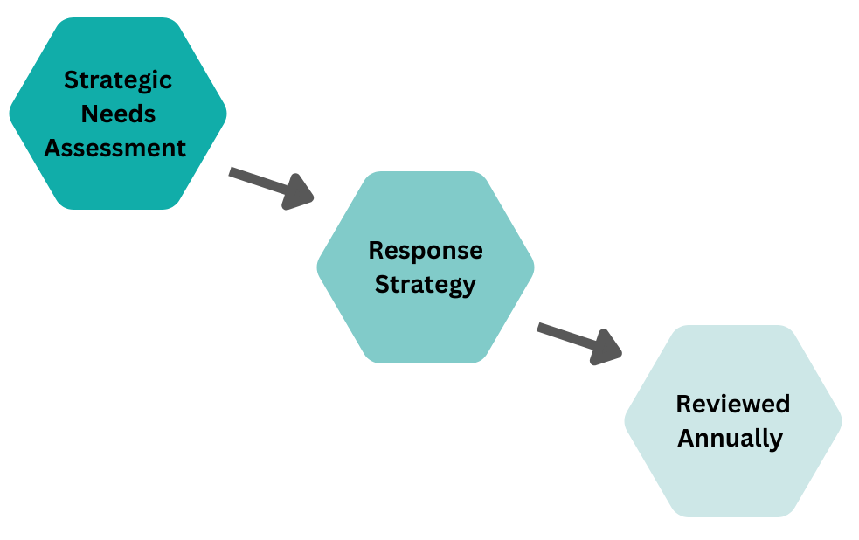
Next Steps
The HIPS VRP continues to work to facilitate and support a true public-health approach to reducing serious violence through multi-agency working, understanding the problem through a data-led approach, engaging with communities and commissioning evidence-based interventions.
The SNA is a mandatory product under the Serious Violence Duty but is especially important to the VRP in understanding what is happening in terms of serious violence across the HIPS area. Ultimately, the SNA is used to inform the Response Strategy for the HIPS wide VRP. Once the SNA has been consulted upon by specified partners, key findings will be published and the Response Strategy will be launched in January 2024.
According to the Serious Violence Duty, an SNA enables the local partnership to identify the types of serious violence that are more prominent in the area as well as looking at the long-term issues relating to serious violence and the cohorts most vulnerable to becoming involved in these issues. The SNA provides a greater understanding of established and emerging trends in serious violence and further high risk issues in the area.
The SNA follows an evidence-based analysis of information relating to the violent crime types included in the serious violence definition, the drivers of crime according to partnership data and the most vulnerable cohorts. These are identified through both police and partnership data, using known risk and protective factors linked to serious violence.
SNA and Response Strategy Process

Slide 17
If you would like to know more about the Violence Reduction Partnership, please contact us at:
VRU@hampshire.police.uk

