Slide 1
SE TARA ( Trauma , Adversity , Resilience and Attachment ) Network – TIC mapping / work in progress
Abridged Version
Author: Jo Tonkin on behalf of the South East regional TARA network
Date: September 2021

Slide 2
Aim and Objectives
The aim is to identify a common language and broad approach to TIC to inform a framework for work across SE building on existing scoping undertaken by the SE ACE Network and the Trauma Informed COVID Response group.
By :
Providing commonly used defintions
By collecting together and categorising resources used to describe, self assess and implement TIC
By mapping the systems and sites where TIC is being applied
Identify questions for additional research and consider communication options

Slide 3
Strengths and limitations of unifying the response to Trauma Informed Care (TIC) :
Strengths:
TIC will be most successful when the approach is universally and proportionately understood and practiced.
TIC is an approach which can be applied across systems, in places , across services and in individual interactions .
TIC is likely to benefit the workforce as well patients , service users and communities.
Limitations:
TIC will be implemented differently in different systems and services.
The understanding and application of TIC will vary across systems and services .
TIC requires a change in culture that will be achieved not through the implementation of a set of standards but a cycle of continual reflection and improvement . Much has still to be learnt about the implementation and impact of TIC.

Slide 4
Some trauma definitions ( agreed by the COVID trauma group)
Trauma: Occurs when a person experiences or witnesses a physically or emotionally harmful or life threatening event. It may be a single incident or a prolonged or repeated experience (known as complex trauma).
Trauma informed: Universal knowledge and understanding about trauma and its effects on individuals, families, communities and society.
Trauma Responsive: Policies and practices in place to minimise damage and maximize opportunities for healthy development. While many organisations are trauma informed becoming trauma-responsive means looking at all aspects of an organisations’ training and recruitment, programmes, environment, language, and values and involving and supporting all staff to better serve clients who have experienced trauma.
Notes:
PHE, 2020, No child left behind: Public health approach to vulnerability in childhood https://assets.publishing.service.gov.uk/government/uploads/system/uploads/attachment_data/file/913764/Public_health_approach_to_vulnerability_in_childhood.pdf

Slide 5
Trauma informed approaches
SAMHSA “A program, organization, or system that is TI realises the widespread impact of trauma and understand potential paths for recovery; recognises the signs and symptoms of trauma in clients, families, staff, and others involved with the system; and responds by fully integrating knowledge about trauma into policies, procedures, and practices, and seeks to actively resist re-traumatisation”
6 key principles
Peer support – to promote recovery and healing
Safety – staff and users feel physically and psychologically safe
Trustworthiness and transparency – operations and decisions with the goal to achieve to trust
Collaboration and mutuality – shared power and role across the organisation and system
Empowerment, voice and trust – shared decision making, promoting self-advocacy
Cultural, historical and gender issues – policies and processes are responsive to racial, ethnic and cultural needs
10 domains for the implementation of a TIA across any organisation or system: governance and leadership; policy, physical environment; engagement and involvement; cross sector collaboration; (screening), assessment, treatment services; training and workforce development; progress monitoring and quality assurance; financing and evaluation
Notes:
Substance misuse and mental health services administration (SAMHSA), 2014, Concept of Trauma and Guidance for a Trauma-Informed Approach, https://store.samhsa.gov/sites/default/files/d7/priv/sma14-4884.pdf

Slide 6
What that means for trauma informed practice :
Recognise the impact of traumatic events on functioning
Remember that trauma responses service a purpose – they are attempts at coping
View recovery from trauma as a primary goal
Maximise service users control over their life
Prioritise relationships and building trust
Create a climate of safety , respect and acceptance
Adaptation over symptoms and resilience over pathology
Minimise potential for re-traumatisation
Situate service users life experience in their cultural context
Be aware of your own feelings and response to their trauma
    ( Elliot , Bjelajac, Fallot , Markoff and Reed, 2005)

Slide 7
Adverse Childhood Experiences
ACEs include a complex set of related childhood experiences including direct abuse i.e. sexual, emotional, and physical and neglect and indirect abuse i.e. household dysfunction, domestic violence, drug and alcohol misuse, mental ill health, criminality, or children who live in care.
Approximately half of the English population have experienced one or more ACEs, although this varies according to the type of ACE.
Notes:
Di Lemma L.C.G., Davies A.R., Ford K., Hughes K., Homolova L., Gray B and Richardson G. (2019). Responding to Adverse Childhood Experiences: An evidence review of interventions to prevent and address adversity across the life course. Public Health Wales, Cardiff and Bangor University, Wrexham.

Slide 8
Resilience
The ability to overcome adversity and to avoid its damaging effects. It can be a feature of individuals, groups or communities.
- Individual: self-esteem, self-efficacy, internal locus of control, and a positive outlook
- Family: strong parent-child relationships, and family cohesion
- Community: peer networks, supportive communities and supportive school environment

Slide 9
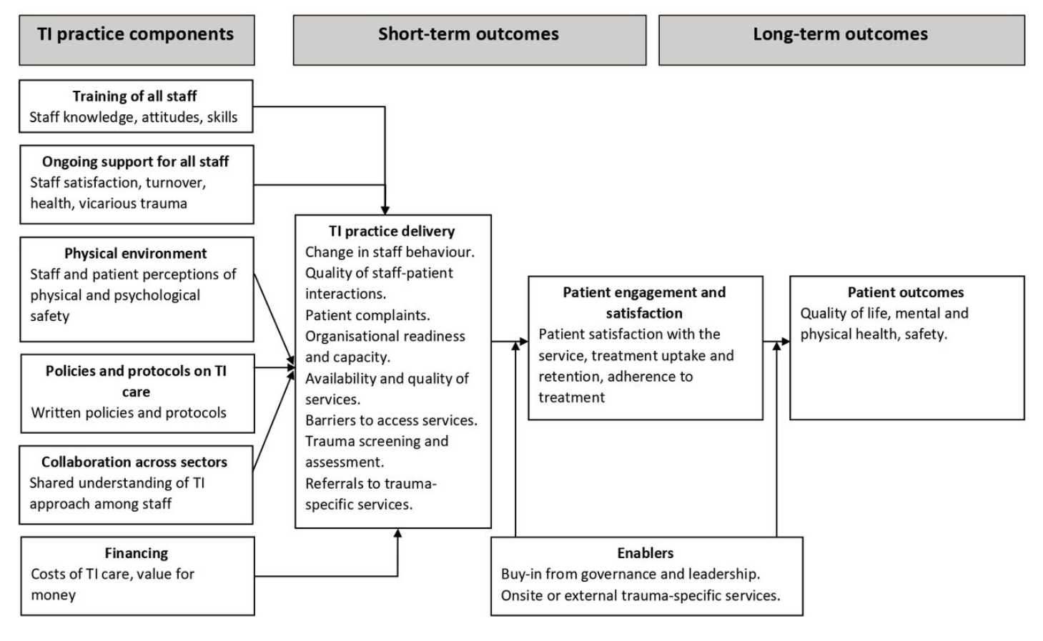
Anticipated outcomes of a TIC service :
Draft logic model of trauma-informed primary and community mental healthcare. TI, trauma-informed. Adapted from Germán in Dawson S, Bierce A,
Feder G, et al. Trauma-informed
approaches to primary and
community mental health care:
protocol for a mixed-methods
systematic review. BMJ Open
2021;11:e042112. doi:10.1136/
bmjopen-2020-042112

Slide 10
Some useful resources
Trauma informed practice guide for professionals https://youngminds.org.uk/media/3091/adversity-and-trauma-informed-practice-guide-for-professionals.pdf
Trauma informed information for schools: https://www.traumainformedschools.co.uk/resources
Anna Freud National Centre for Children and Families https://www.annafreud.org/
Resources to support the signs of trauma: https://beaconhouse.org.uk/resources/
Centre for Mental Health briefings: https://www.centreformentalhealth.org.uk/sites/default/files/2020-05/CentreforMentalHealth_Briefing56_Trauma_MH_Coronavirus_2.pdf
Trauma informed Oregon - COVID-19 Considerations for a Trauma Informed Response for Work Settings (Organizations/Schools/Clinics)
Resources from LGA on managing the wellbeing of staff https://www.local.gov.uk/our-support/workforce-and-hr-support/wellbeing

