Slide 1
Police and Crime Commissioner
Candidate Briefing
12 January 2021

Slide 2
WELCOME AND PROGRAMME FOR THE DAY
9.30 – 12.30 OPCC presentations and facilitated conversations on:
  Introductions from the Chief Executive
  The functions and foundations of the role
  Scrutiny and performance
  Wider partnerships and the criminal justice system
  Protecting the vulnerable and victims through commissioning
  Engaging with the public, stakeholders and partners
  The Commissioner’s role in policing
13:30 – 15:30 Hampshire Constabulary Chief Constable and Deputy Chief Constable
  The breadth of the policing mission
  How the role of the PCC complements that of Hampshire Constabulary
  The complexity of partnership and collaborative service delivery
  Resources and organisational performance, including the challenges, risks and mitigation

Slide 3
HOUSEKEEPING AND ETIQUETTE
The sessions today are being recorded to make the content publically available
To help with the presentations please keep your microphones on mute
For questions please use of the chat function and we will answer as many as we can after each session
Any questions that remain unanswered will be added to the frequently asked questions section of our website and will include written responses

Slide 4
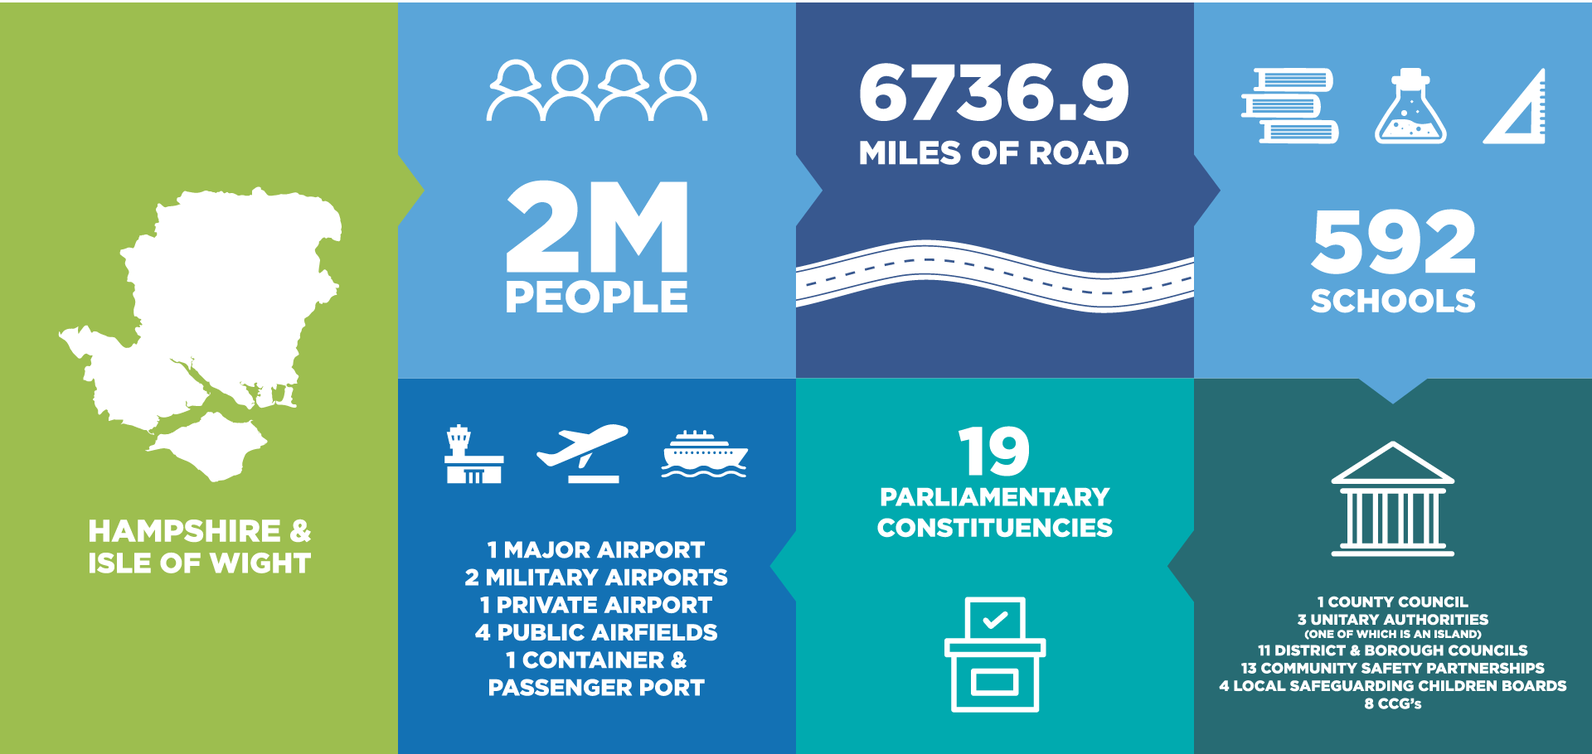
HAMPSHIRE POLICE AND CRIME COMMISSIONERS AREA
641 SCHOOLS
59 COLLEGES
4 UNIVERSITIES
337,000 STUDENTS
230 MILES OF COASTLINE
2
PORTS

Slide 5
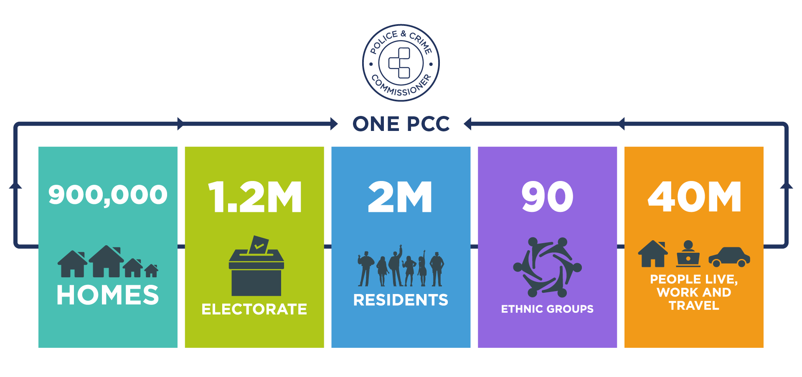
HAMPSHIRE AREA POPULATION

Slide 6
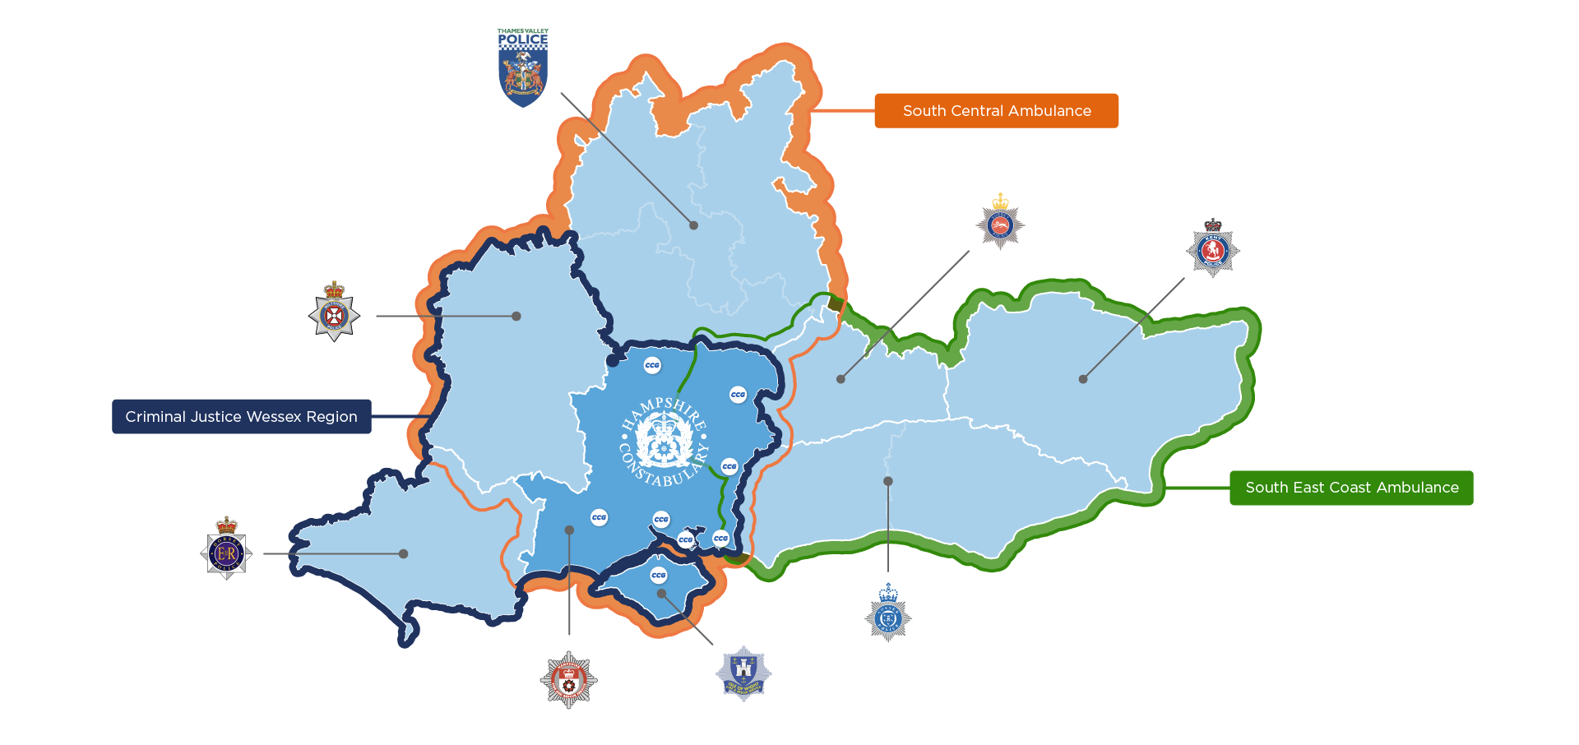
THE WIDER POLICE AND PARTNER AREA

Slide 7
KEY STATUTORY RESPONSIBILITIES OF THE ROLE
Strategic Delivery
Development and regular review of a Police and Crime Plan which sets out the overall strategy for policing and crime reduction in Hampshire, Isle of Wight, Portsmouth and Southampton for the next four years
Budgetary Responsibility
Each year set the police budget and Council Tax precept
Securing grant and additional finance to provide services to reduce crime and support
Public engagement and consultation
Bring together community safety, criminal justice and health partners to ensure local priorities are joined up
Working together with key stakeholders and the public to ensure effective engagement with communities
Scrutiny and Support
Hold the Chief Constable to account for the delivery of policing
Administration of the Police Estate
Administration of the Complaints and Reviews process
Oversight of Hampshire Fire Service governance
Service Provision
Reduction of Crime and Support of victims

Slide 8
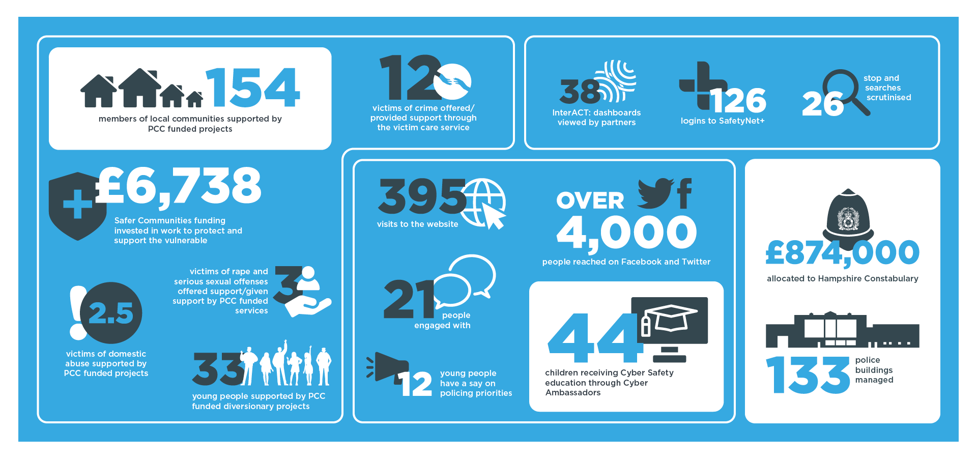
EVERY DAY IN THE LIFE OF A POLICE AND CRIME COMMISSIONER

Slide 9
The functions and foundations of the role
Richard Andrews, Head of Standards and Compliance

Slide 10
DEVELOPING A POLICE AND CRIME PLAN: 1
“The Police and Crime Commissioner for a police area must issue a police and crime plan within the financial year in which each ordinary election is held.
…to which the Chief Constable must have due regard.”
Police Reform and Social Responsibility Act 2011

Slide 11
DEVELOPING A POLICE AND CRIME PLAN: 2
LOCAL AND NATIONAL CONTEXT
CONSULTATION – Public, Police, MPs
PLAN DEVELOPMENT – OPCC Working Group set up to assess and collate data
POLICE AND CRIME PANEL ENDORSEMENT
PUBLISHED BY MARCH 2022
DELIVERY PLAN DEVELOPMENT AND REVIEW

Slide 12

FUNCTIONS AND FOUNDATIONS OF THE ROLE: 1
Association of Police and Crime Commissioners (APCC) pack available to download from its website
Mechanics of the election – Police Area Returning Officer

Slide 13
FUNCTIONS AND FOUNDATIONS OF THE ROLE: 2
Chapter 4 – Statutory Responsibilities
  Police complaints system (more in ch. 14, p29)
  Policing protocol (more in ch. 5, p11)
  Seven Principles of Public Life (Nolan Principles)

Slide 14


FIRE AUTHORITY
The Policing and Crime Act 2017 introduced opportunities for PCCs to take on responsibility for fire and rescue governance.
Police, Fire and Crime Commissioners are responsible for:
Putting in place arrangements to deliver an efficient and effective fire and rescue service;
Setting the fire and rescue objectives for their area through a fire and rescue plan;
Appointing the Chief Fire Officer, hold them to account for delivery of objectives, and if necessary dismiss them; and
Setting the service budget and determine the precept

Slide 15
MANAGING COMPLAINTS
Policing is a regulated profession – the associated complaints and performance management system is also regulated by:
Police Reform Act 2002
Policing and Crime Act 2017
Police (Complaints and Misconduct) Regulations 2020
Police (Conduct) Regulations 2020
Police (Performance) Regulations 2020

Slide 16
STATUTORY DUTIES
Requirement | Current activity
Responsibility for holding Chief Constable to account for performance of the complaints system locally; | Joint scrutiny meetings with Independent Office of Police Conduct (qualitative complaint data, identifying trends/patterns, update on investigations carried out by IOPC; Regular meetings with Professional Standards Department, focusing on individual complaint/conduct investigations and overall departmental performance; Invitation to force meetings (eg. FPG, Strategic Risk Board) where complaints system may be discussed.
Central role in determining how complaints system operates locally; | Three model system available to PCCs: 1 (mandatory) – review body function. Hampshire currently operates this model. 2 – (optional) – PCC to become the initial point of contact for all complaints. 3 – (optional) – as model 2, but includes being responsible for keeping all parties informed and for advising them of the outcome.
Review body for some individual complaints. | Right of review exists for complainants to consider if complaint has been handled reasonably and proportionately. For some complaints, the review body is the PCC, a responsibility transferred from Hampshire Constabulary (The other complaint review body is the IOPC). Delivered by OPCC staff on PCC’s behalf due to volume.

Slide 17
GOVERNANCE AND COMPLIANCE
Legislated as a
separate public sector organisation
A separate body
within the police complaints system
PCC as a public
sector organisation
A data controller under the Data Protection Act
Accountable to
many organisations
and regulators

Slide 18
BUDGET AND PRECEPT SETTING: 1
“Police and Crime Commissioners must:
Secure the maintenance of the police force, by setting the budget
Raise the local policing precept from local area council tax
Secure that the police force is efficient and effective”
Police Reform and Social Responsibility Act 2011

Slide 19
BUDGET AND PRECEPT SETTING: 2
1
Financial scenario planning PCC, OPCC and Hampshire Constabulary
2
Dec/Jan Funding settlement announcement
3
Year long consultation and stakeholder engagement
4
Precept recommendation to Police and Crime Panel
.
5
Annual report and annual accounts

Slide 20
Scrutiny and performance
Anja Kimberley, Head of Performance and Information

Slide 21
STATUTORY DUTY
Police and Crime Plan (PCC)
Police Performance
& delivery (HC)
Police and Crime plan Delivery (OPCC)
The PCC has a statutory duty (PRSR Act 2011) to secure an efficient and effective police force for their area and to hold the Chief Constable to account.
The PCC preforms this role through the scrutiny of the Force’s performance against their plan and the Force Management Statement.
Mechanism:
PCC and CC 121s
COMPASS: Commissioner’s Performance, Accountability,
Scrutiny and
Strategy meeting
Attendance at strategic meetings (e.g. boards)
Evidence and analysis

Slide 22
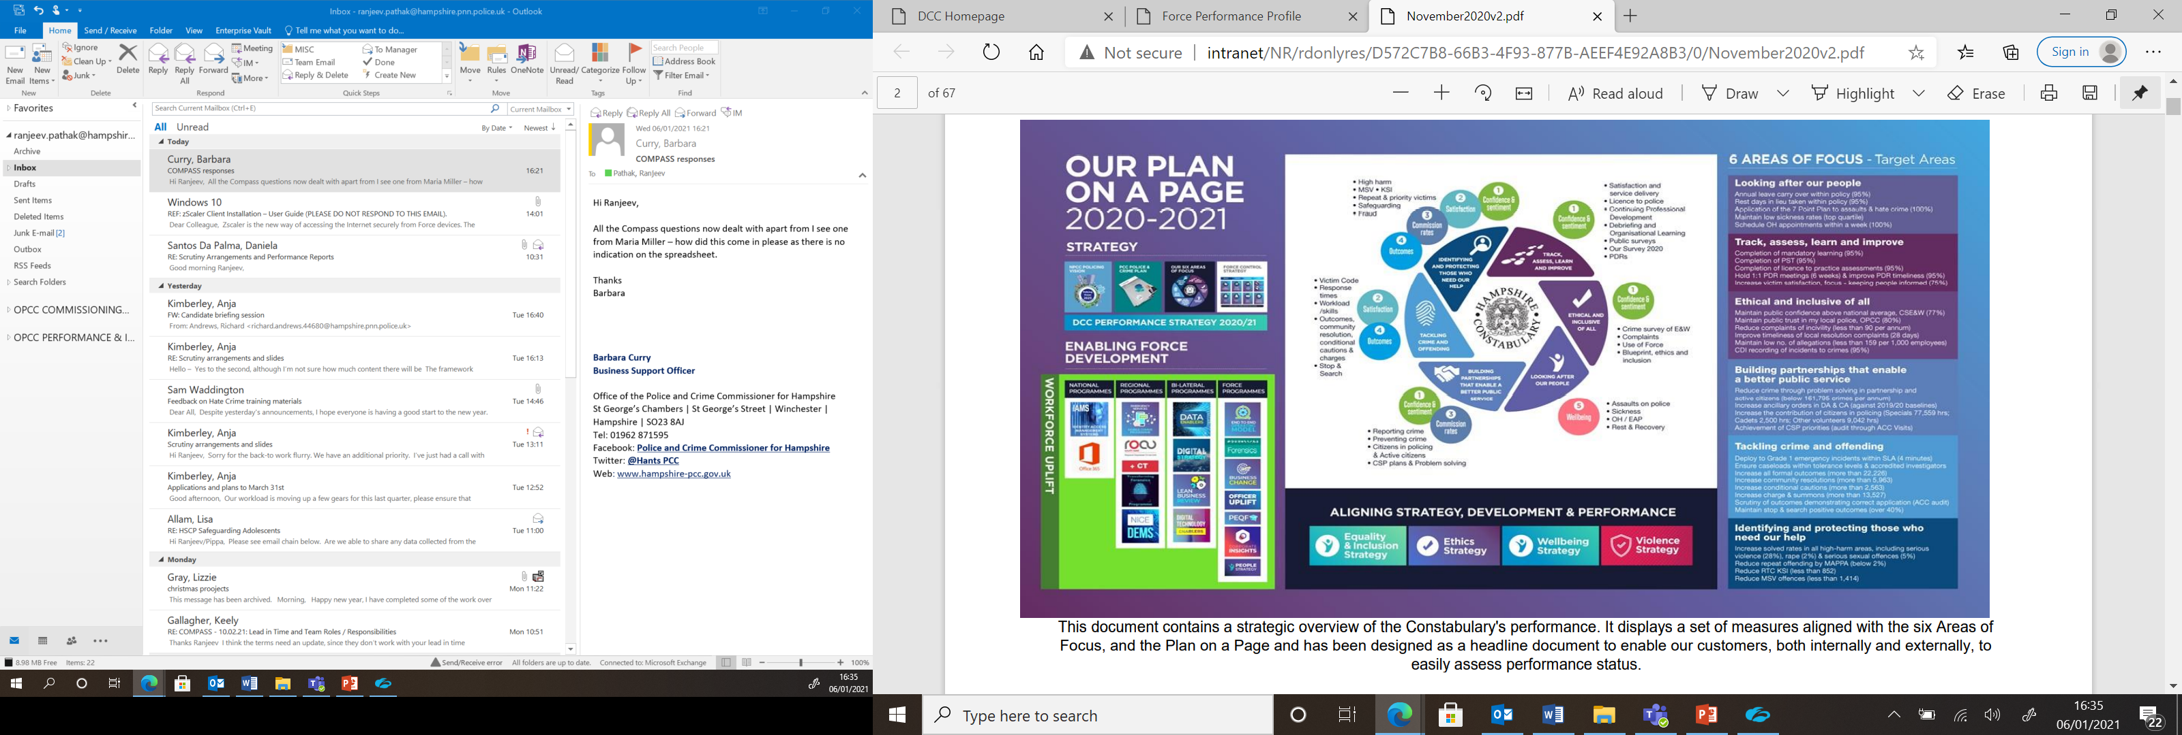
PERFORMANCE FRAMEWORK
Performance Strategy 2020/21
is influenced by:
PCC Police and Crime Plan
NPCC Policing Vision 2025
Evidence base
(InterACT, partnerships and
University collaboration)
Six Areas of Focus
Force Control Strategy

Slide 23

PERFORMANCE FRAMEWORK: 1
Six Areas of Focus
Looking after our people
Track, assess, learn and improve
Ethical and inclusive of all
Building partnerships that enable a better public service
Tackling crime and offending
Identifying and protecting those who need our help

Slide 24
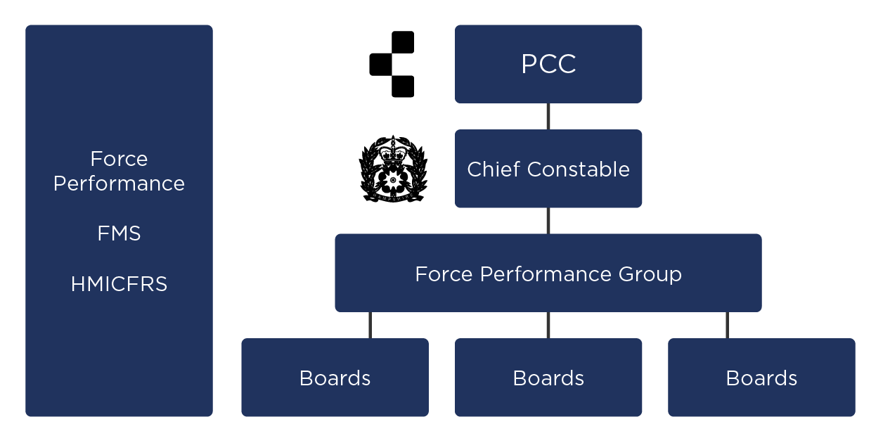
PERFORMANCE FRAMEWORK: 2
Boards
Force Performance Monitoring
Underpin and drive Force performance
Engage
Scrutinise
Influence

Slide 25
Wider partnerships and the criminal justice system
Enzo Riglia, Deputy Chief Executive

Slide 26
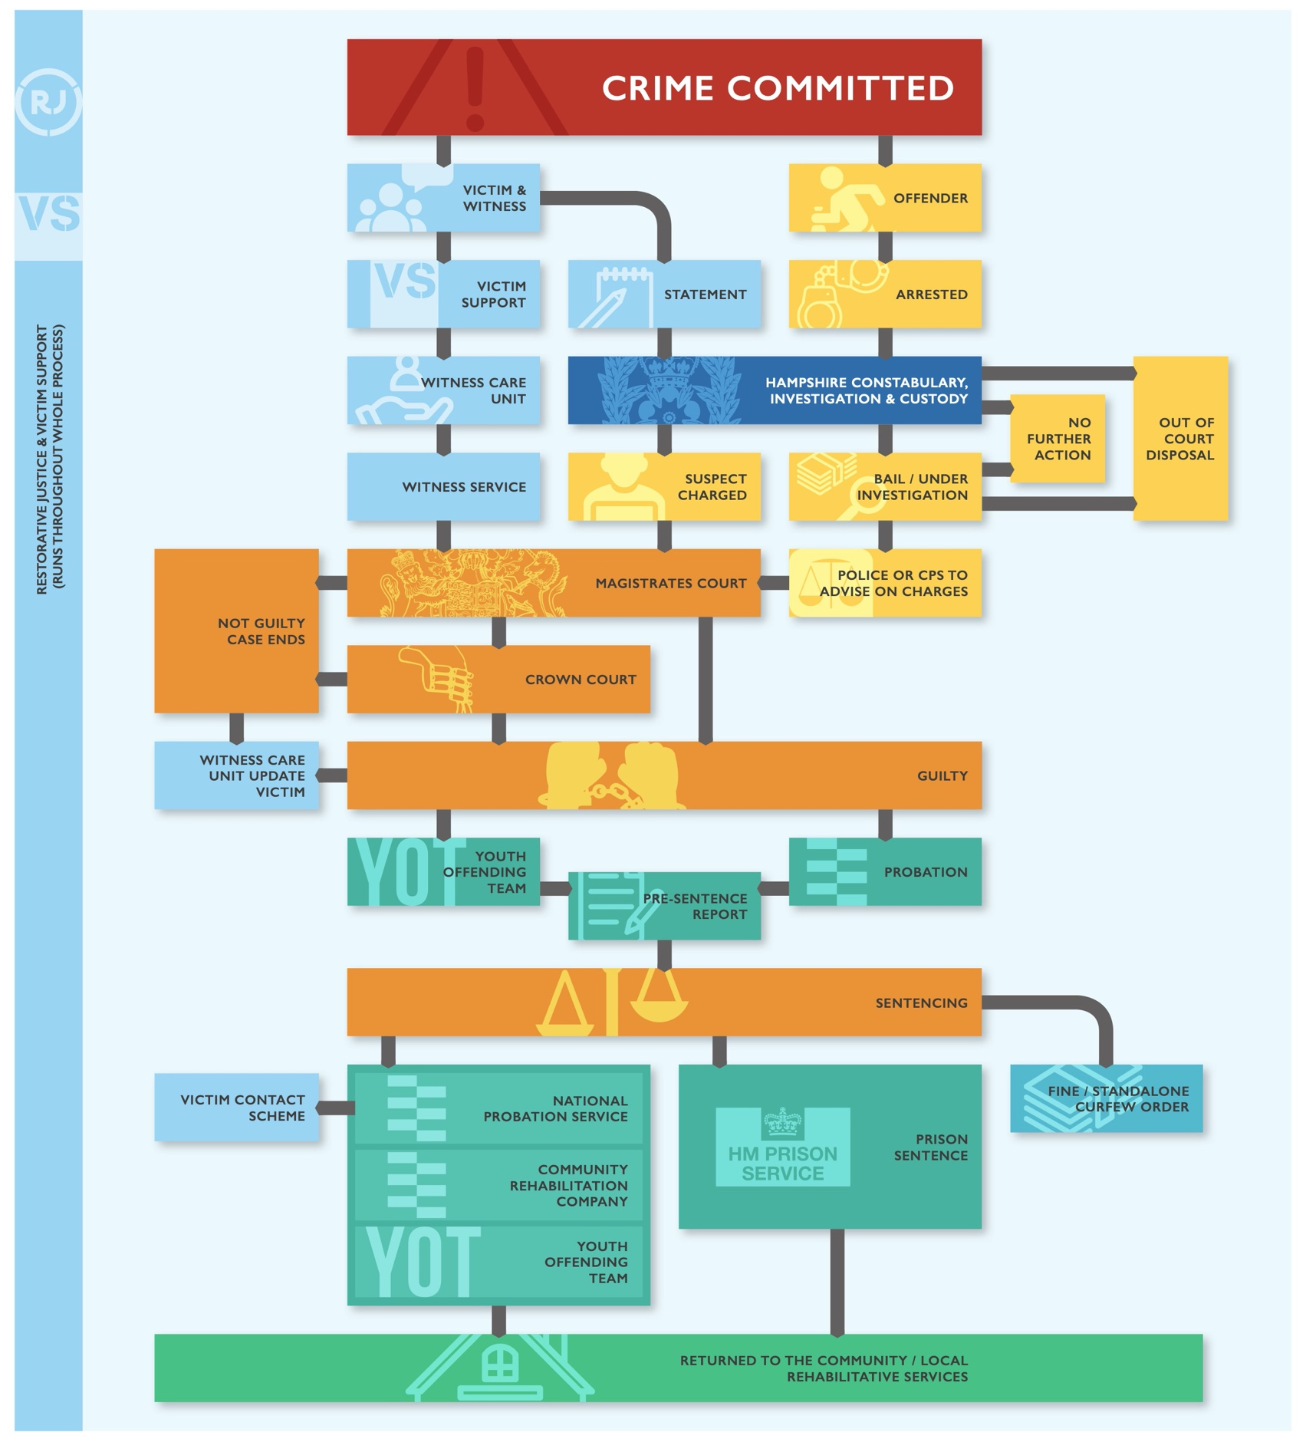
PROVIDING AN EFFICIENT AND EFFECTIVE CRIMINAL JUSTICE SYSTEM
“The elected local policing body for a police area, and the criminal justice bodies which exercise functions as criminal justice bodies in that police area, must make arrangements (so far as it is appropriate to do so) for the exercise of functions so as to provide an efficient and effective criminal justice system for the police area.”
Police Reform and Social Responsibility Act 2011

Slide 27
PARTNERSHIPS
Commissioning
Multi-agency
Broader collaboration
Local Criminal Justice Board
Reducing re-offending grp
COVID-19 recovery board
Community Safety Partnerships
Violence reduction units
National Probation Service
Local Resilience Forum
Youth Diversion
Modern Slavery
Restorative Justice
Domestic Abuse
Integrated offender management
Avon and Somerset/West Midlands - Hate Crime
Dorset/Wiltshire rape prosecution improvement
Home Office Safer Streets Funding
South east region

Slide 28
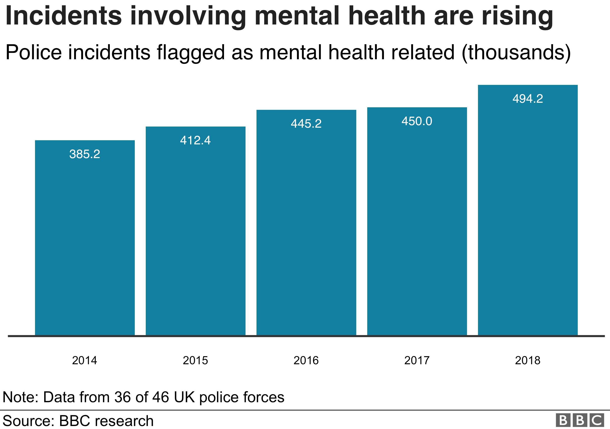
HEALTH PARTNERSHIP TO REDUCE BURDEN ON POLICING
Over the past decade, the police have become the 24-hour public service for people in crisis
Mental health in particular is placing a huge burden on policing
Greater collaboration with our health partners will be vital for the next PCC

Slide 29
Reducing offending and supporting victims through Commissioning
Alan Hagger, Head of Commissioning

Slide 30
PROTECTING THE VULNERABLE AND VICTIMS THROUGH COMMISSIONING
“To provide or arrange for the provision of: (a) services to secure crime and disorder reduction….
“To provide or arrange for the provision of: (b) services to help victims or witnesses of, or other persons affected by, offences and anti-social behaviour.”
Police Reform and Social Responsibility Act 2011.

Slide 31
FOCUS OF COMMISSIONING
Prevent crime
Support victims
Reduce reoffending
Reduce demand on policing
Build Partnerships

Slide 32
WHY IS THIS AN IMPORTANT PART OF THE PCC ROLE?
1
Ensure consistent, targeted, level of service across the policing area
2
Maximise investment and ensure financial stability
3
Understand needs of the community and the supply of support available
4
Look for solutions where gaps are identified in service provision
5
Support and nurture providers to ensure they are fit to deliver
Notes:
.

Slide 33
WHERE WE RECEIVE FUNDING FROM
Ministry of Justice
(Sexual Abuse Counselling)*
Police and Crime Commissioner’s Commissioning Budget
Ministry of Justice
(Victims Fund)*
Home Office Violence Reduction Unit
£2.43m
£0.475m
£0.88m
£1.74m
£7.4M

Slide 34
CONTRACTS AND GRANTS (TO BE UPDATED)
GRANTS
CONTRACTS
Essential, larger, unlikely to change substantially in short term
Small scale, local, voluntary, pilots, research
61 grants funded April 2020 to March 2021
total value of £1,313,671

Slide 35
CURRENT CONTRACTS
Victim Care Service
Support to victims of Domestic Abuse
Support to victims of Sexual Crime
Therapeutic counselling young victims of sexual abuse, Female Genital Mutilation (FGM) and ‘Missing, Exploited and Trafficked’ (MET)
Support worker at the Sexual Abuse Referral Centre
Working with perpetrators of Domestic Abuse
Restorative Justice Services
Integrated Offender Management (Hampshire only)

Slide 36












PARTNERSHIPS & NATIONAL PILOTS
Rationalised Access to Services
Sexual Crime Therapeutic Support Service
(Funded by Ministry of Justice)
Violence Reduction Unit 342 Offenders
(funded by Home Office)
.
Hate Crime Out of Court Disposal
Multi Agency Stalking Intervention Programme

Slide 37













































WHO WE HAVE WORKED WITH

Slide 38
Engaging the public, partners and stakeholders
Laura Cadd, Head of Communication and Engagement

Slide 39

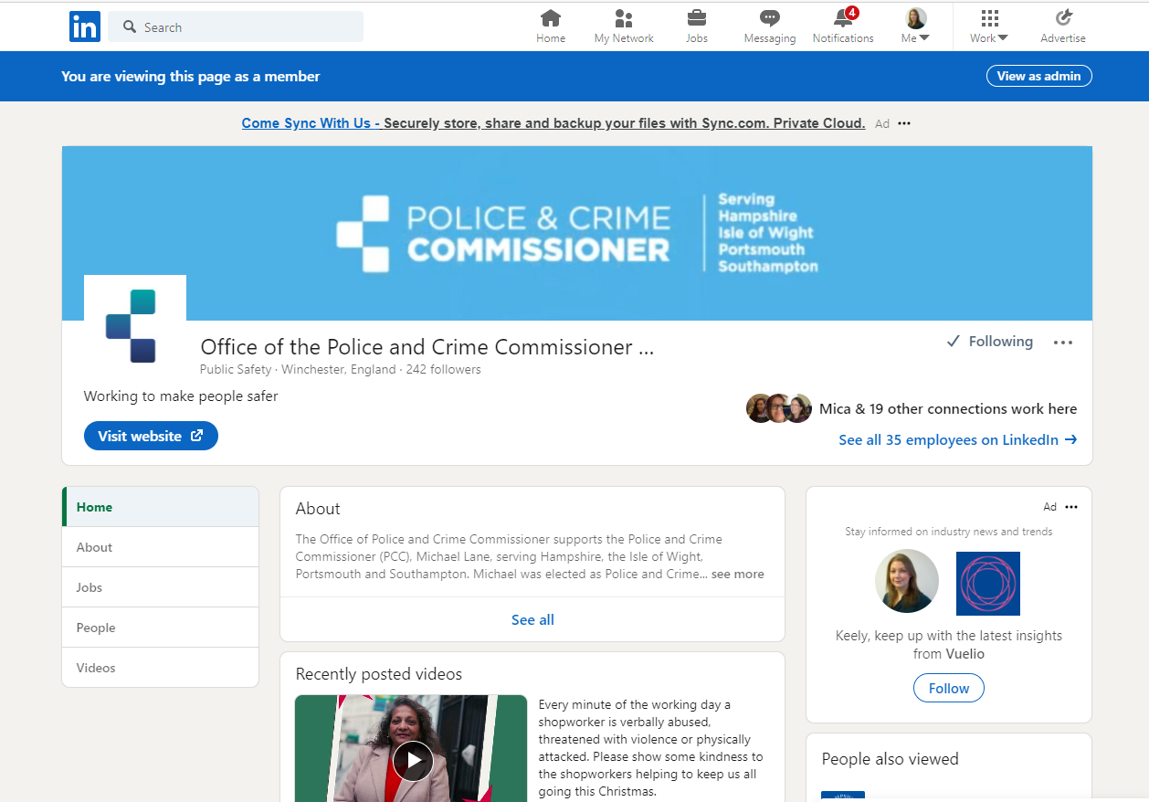

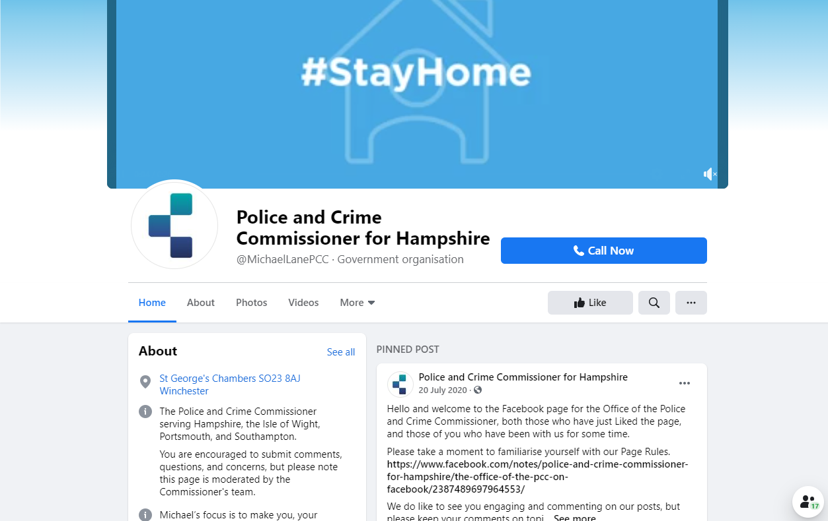
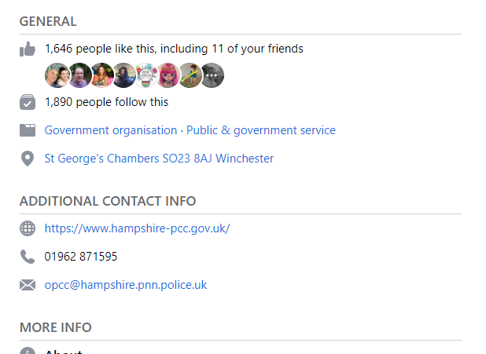
PUBLIC ENGAGEMENT, COMMUNICATION AND CONSULTATION
We are focussed on reaching every person living, working and travelling in the Hampshire Constabulary area through integrated, intelligence-led and targeted communication, engagement and marketing activity.

Slide 40
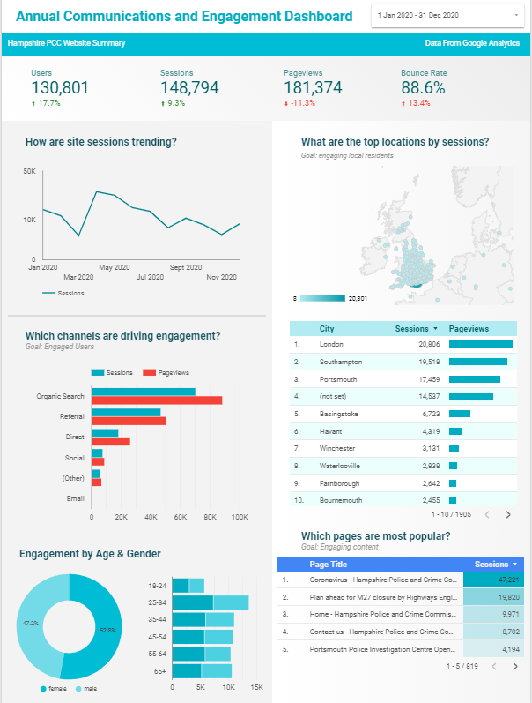
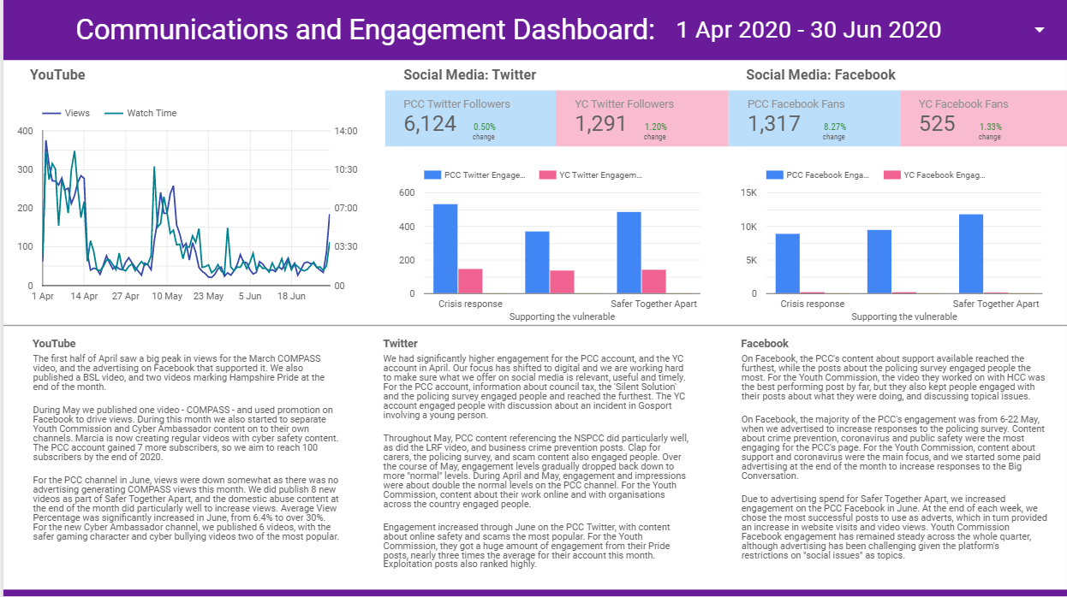
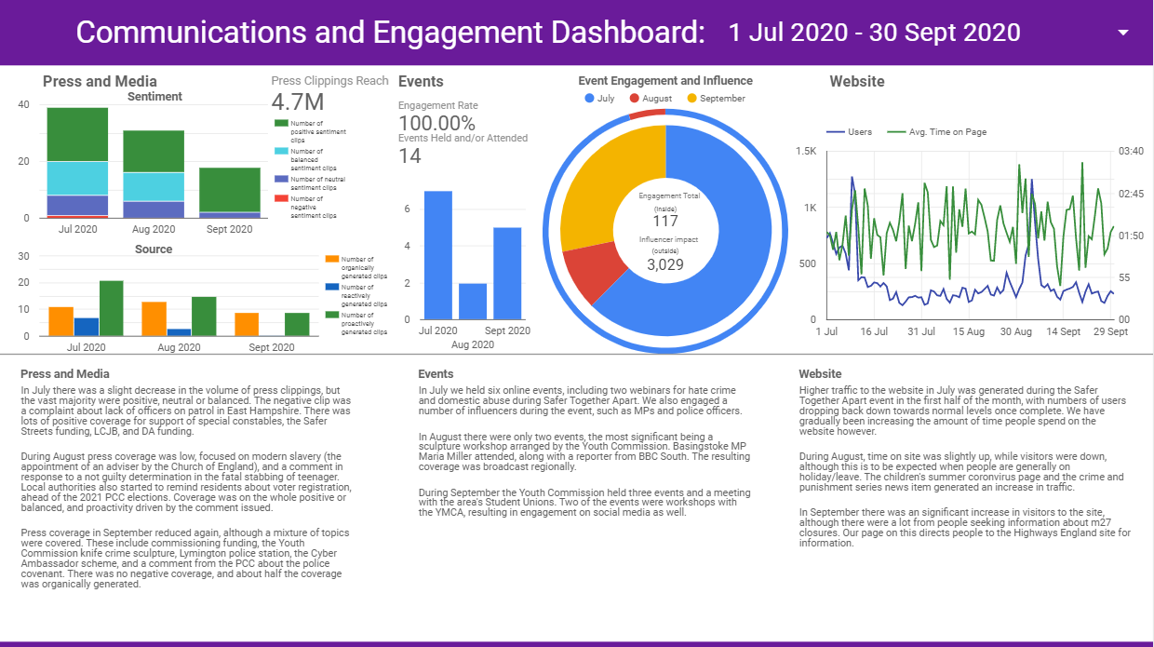
PUBLIC ENGAGEMENT AND COMMUNICATION

Slide 41
DIGITAL AND TRADITIONAL MEDIA REACH
Website visits
(since Sept 17)
353k
Average number of articles per month
109
Total News Reach
(since Sept 17)
112M
Total News Value
(since Sept 17)
£4.9M
Trigger for Coverage
19.7%
51.5%
28.8%
.
Proactive
Organic
Reactive
Most popular Twitter posts:
Password security tips from Hampshire Constabulary (Dec 2020) (15,570 impressions, 53 engagements)
Storm Dennis useful numbers (Feb 2020) (11,863 impressions, 322 engagements)
Cyber Ambassadors Safer Internet Day (Feb 2020) (13,511 impressions, 138 engagements)
Most popular Facebook posts:
Hate crime reporting centres (Oct 2020) (33,742 reach, 926 engagements)
Police pandemic confidence survey (May 2020) (9,277 reach, 285 engagements)
NHS Test & Trace scam warning (Jun 2020) (9,074 reach, 217 engagements)
Reach – number of people who have opportunity to see content
Impressions – the number of times your content is displayed
Engagement – number of interactions people have with your content

Slide 42
KEY STAKEHOLDER RELATIONSHIPS
Policing and
Criminal Justice
Formal partnerships beyond policing
National and political
Community
Chief Constable and Chief Officer Group
Police Federation/Unison/
Superintendents Association
National Crime Agency
Local Criminal Justice Board
Local Resilience Forum
Strategic IAG
Community Safety Partnerships
Commissioned partners and grant recipients
Safer Hampshire Business Partnership
Health and Wellbeing Board
Integrated Public Services Brd
Hampshire Fire and Rescue
Hate Crime Network
Restorative Justice Programme Board
TVP/Hants Collaboration Board
Country Land Association
Modern Slavery Partnership
High Sheriff/Lord Lieutenant/Mayors
Faith Leaders
Community Leaders
Education: Universities, colleges and schools
Neighbourhood Watch/SpeedWatch
Third sector organisations
National Government
HIOW LGA
MPs
Four leaders – top tier authorities
Local Councillors
APCC
SE PCCs
Police and Crime Panel
Hampshire Country Strategy Group
National Police Chief’s Council

Slide 43
PUBLIC ENGAGEMENT AND CONSULTATION
“Arrangements for obtaining the views of the community on policing before a police and crime plan is issued the views of the people in that police area, and the views of the victims of crime in that area, on that plan.”
Police Reform and Social Responsibility Act 2011

Slide 44
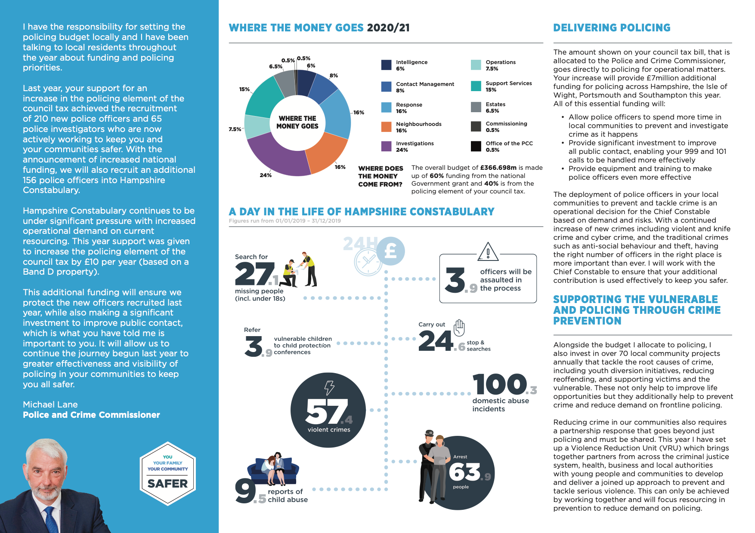

PUBLIC ENGAGEMENT AND CONSULTATION - PRECEPT

Slide 45

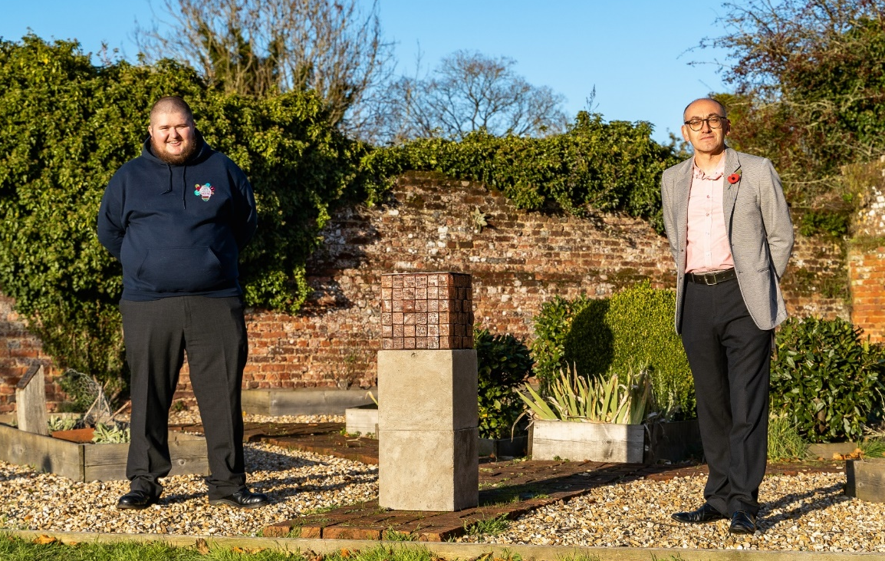

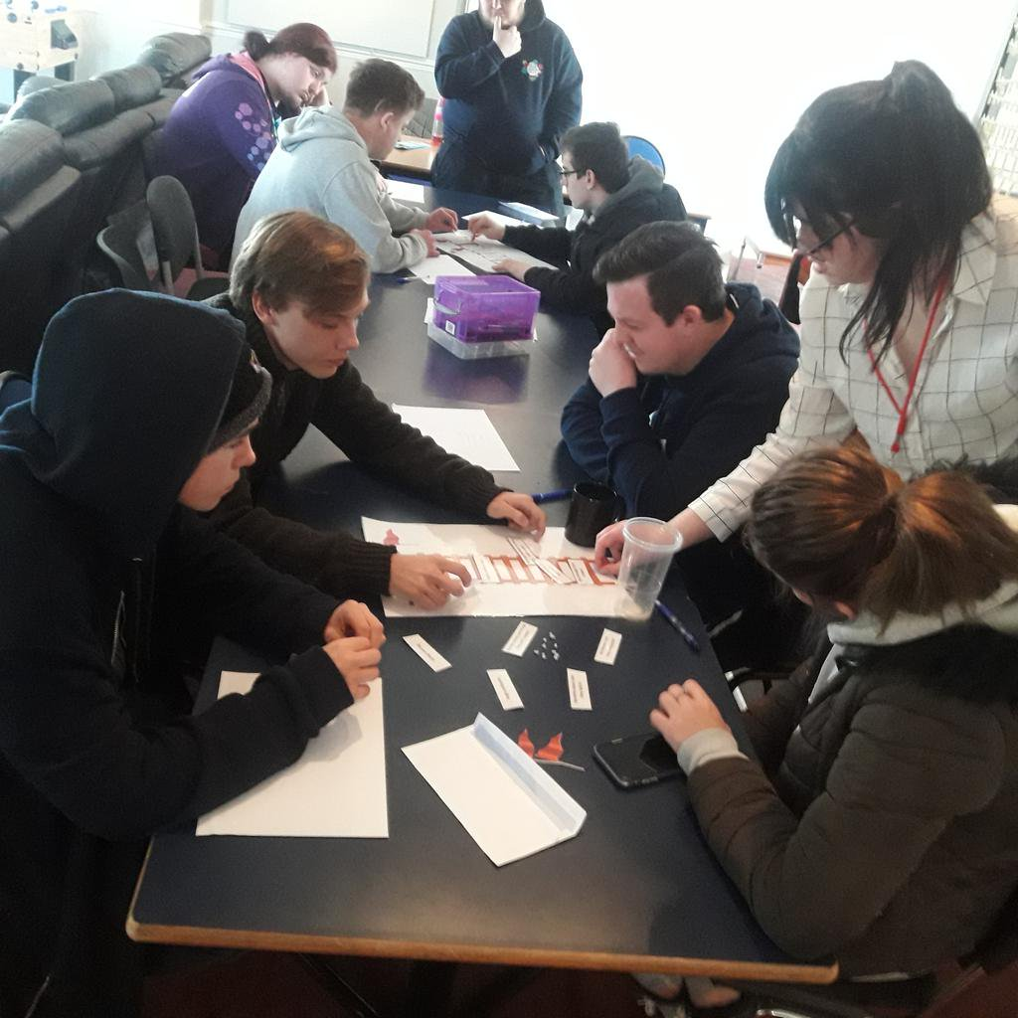



YOUTH ENGAGEMENT - YOUTH COMMISSION
The Youth Commission are young people volunteers, aged 14-25, who use The Big Conversation to consult their peers on issues important to them
Each year over 2500 young people give their views, experiences and solutions, enabling members to formulate annual recommendations that are presented to the PCC and partners
Members ensure young people’s voices are represented at a strategic level and sit on the HIPS Child Exploitation Board, Harmful Practices Strategic and local groups, meet with the Violence Reduction Unit’s, as well as contribute to the Hate Crime network
The Youth Commission work closely with the partners including the Crown Prosecution Service, youth charities, youth offending teams and the Children’s Society
We will be launching the Police Strategic Youth Independent Advisory group shortly, directly feeding back to the Constabulary on young people’s policing and crime concerns

Slide 46
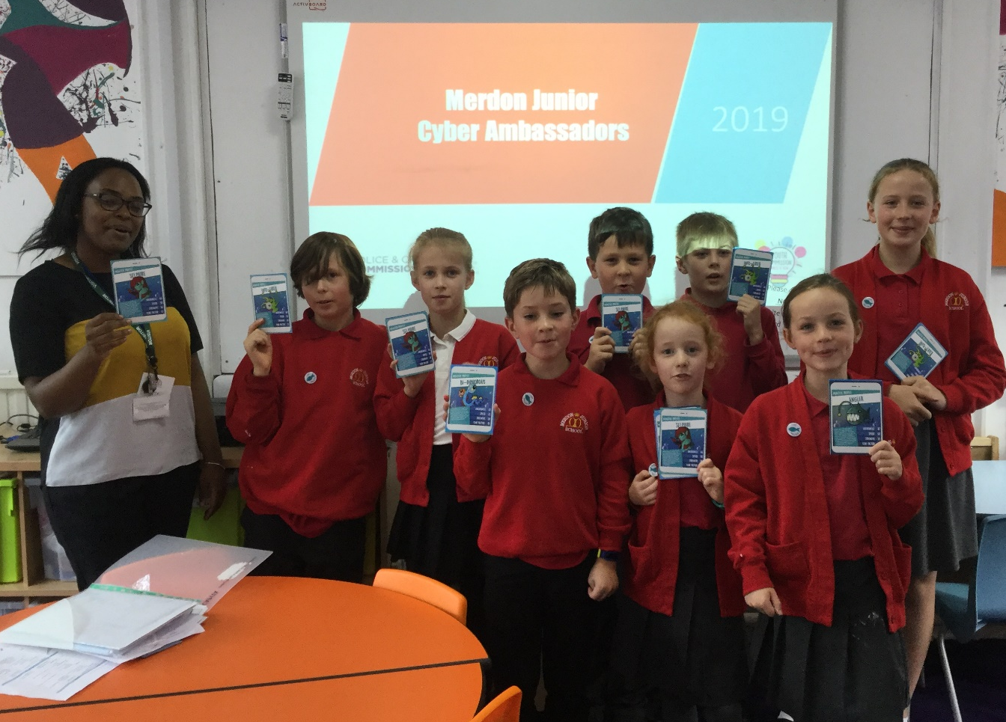
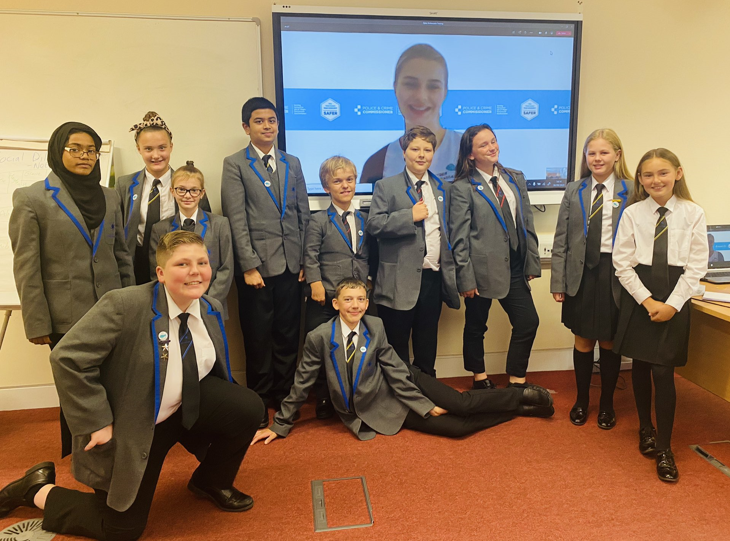


YOUTH ENGAGEMENT - CYBER AMBASSADORS
The Cyber Ambassador scheme was a recommendation from the Youth Commission. This unique peer to peer, free and sustainable education scheme, enables children and young people to lead on cyber education within their setting
The scheme operates in 120 schools including 2 SEN, as well as 2 colleges and 18 youth organisations across the area.
1,200 children and young people are trained as Cyber Ambassadors, delivering cyber education to 15,500 students
The Cyber Ambassador scheme works with a range of local and national partners such as Safeguarding Boards, University of Portsmouth Cyber Clinic, SEROCU, CISCO, CEOP and the Cyber Hub

Slide 47
The Commissioner’s role in policing
James Payne

Slide 48
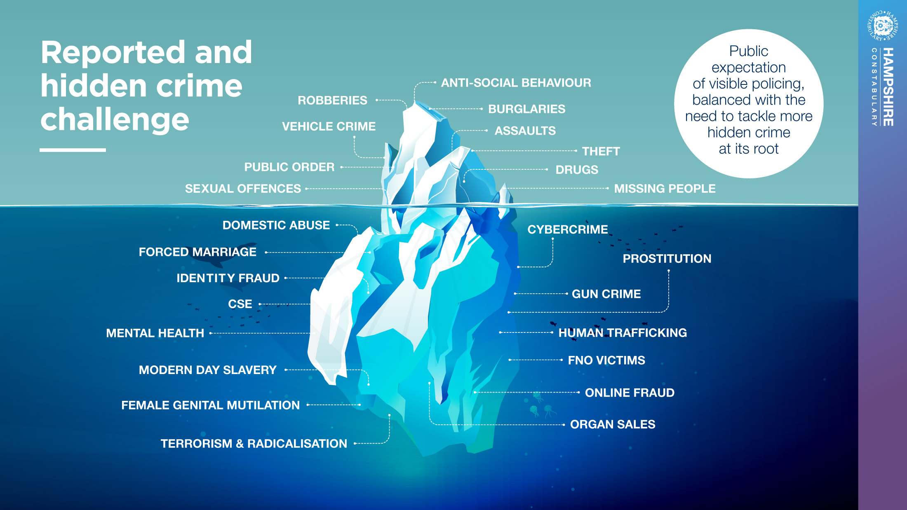
MANAGING PUBLIC EXPECTATIONS – A HIGH HARM MODEL

Slide 49
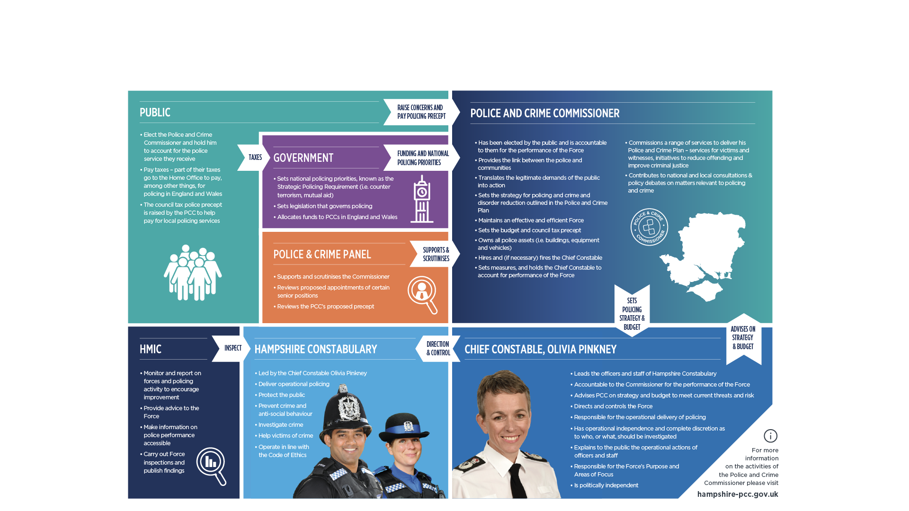
ROLES IN POLICING

Slide 50
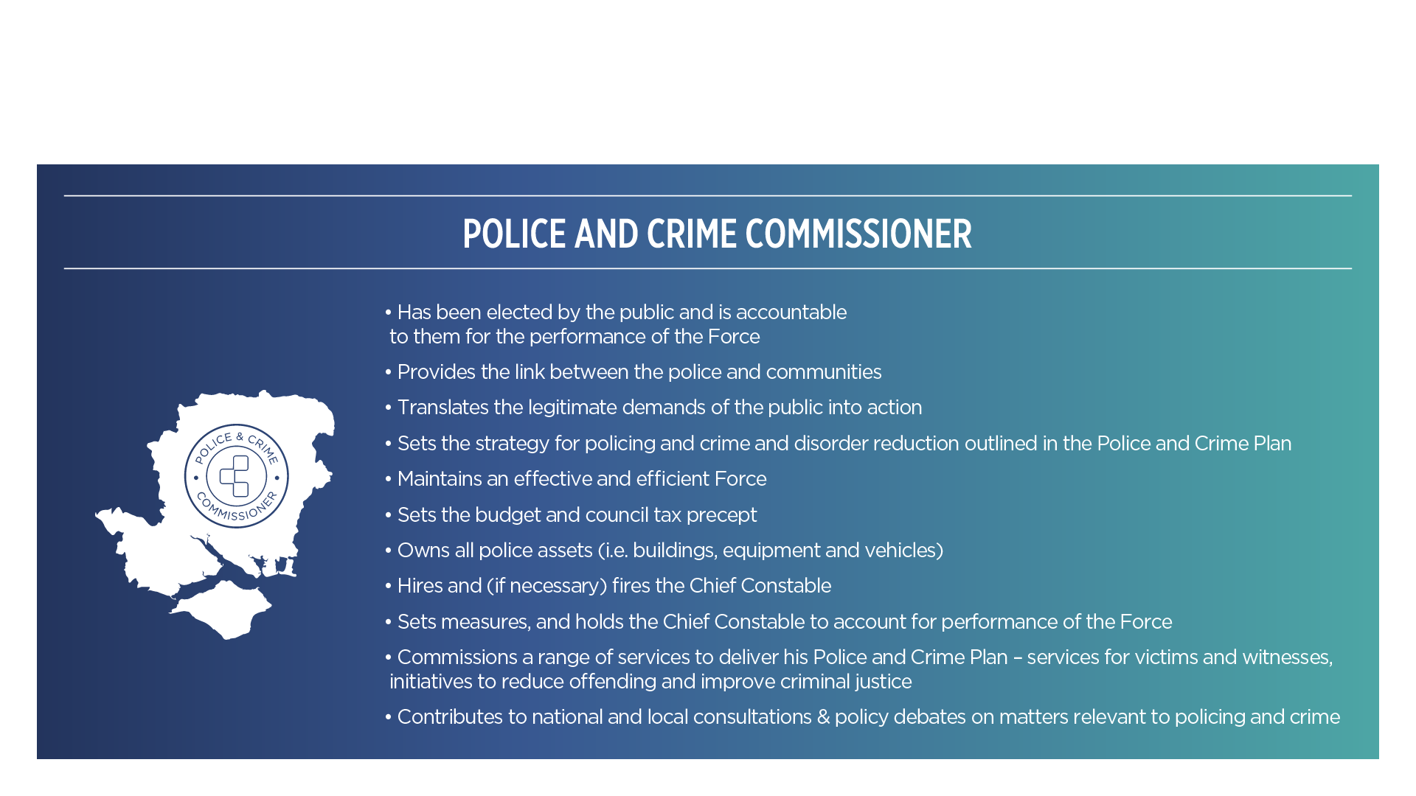
ROLE OF THE POLICE AND CRIME COMMISSIONER

Slide 51
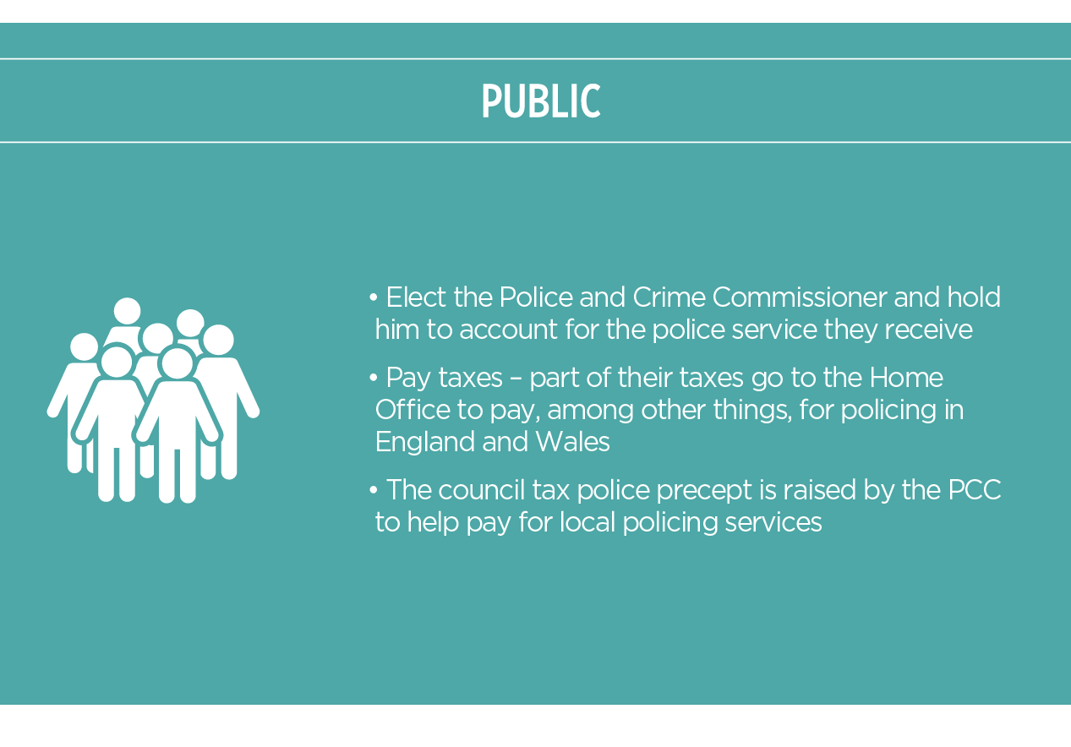
PUBLIC ROLE IN POLICING
PCCs are directly elected to be the voice of the people and deliver an effective and efficient police force in their area.
They are equally responsible for the budget and performance of their force, including cutting crime.

Slide 52
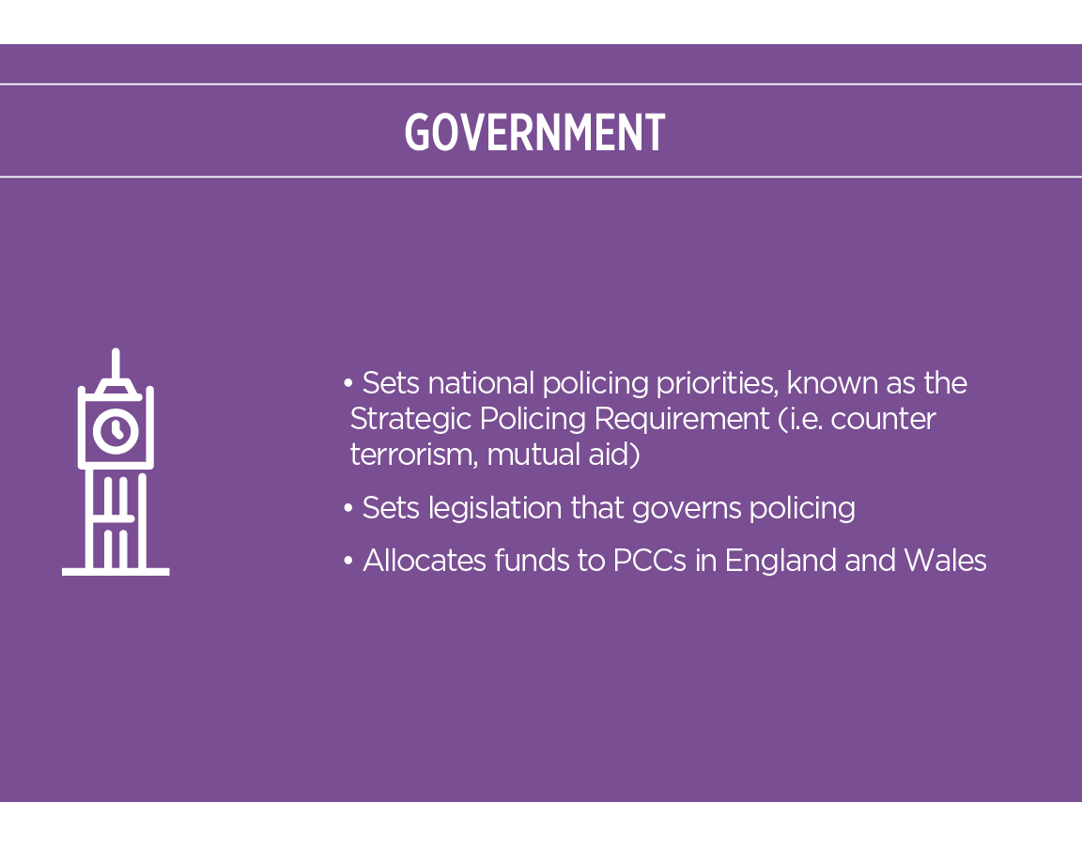
GOVERNMENT ROLE IN POLICING
National Policing Board
Home Secretary (Chair)
Minister of State for Crime and Policing
Minister of State for Security
Minister for Safeguarding
Permanent Secretary to the Home Office
Chair of the National Police Chiefs’ Council
Chair of the Association of Police and Crime Commissioners
Commissioner of the Metropolitan Police Service
Director General National Crime Agency
Chief Executive Officer of the College of Policing
Her Majesty’s Chief Inspector of Constabulary
Head of UK Counter Terrorism Policing
Director General, Crime, Policing and Fire Group
Director General, Office for Security and Counter-Terrorism
Director General, Serious and Organised Crime Group
Policing Director, Crime Policing and Fire Group

Slide 53
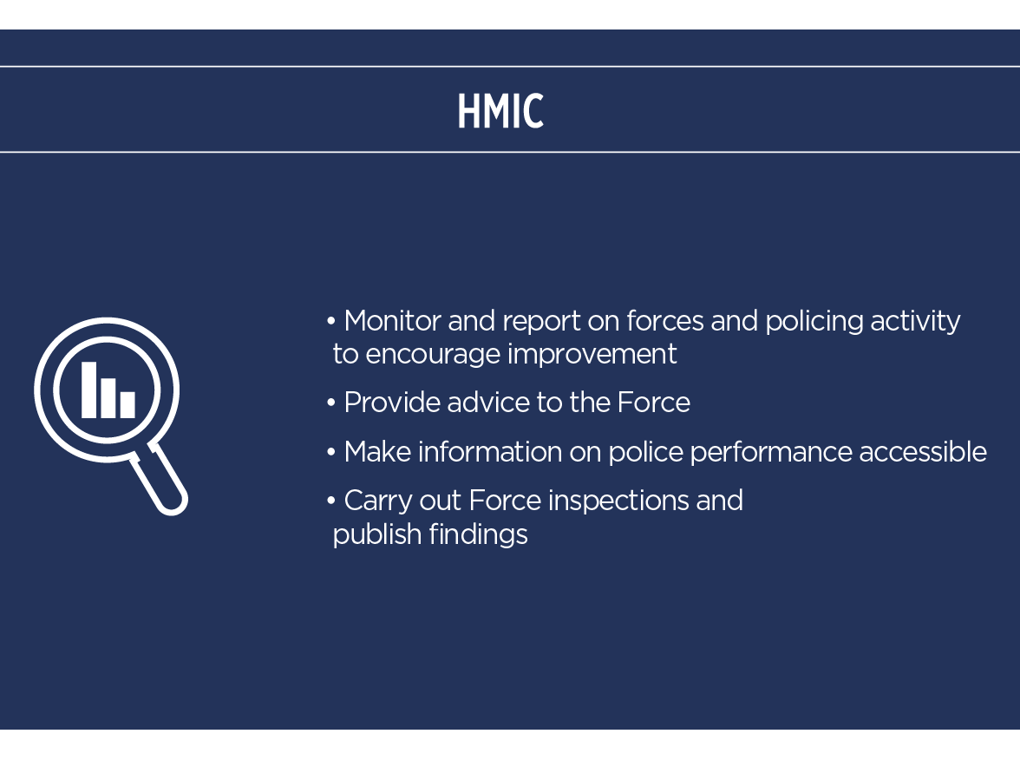
HMIC ROLE IN POLICING
HMICFRS’s fifth PEEL (police effectiveness, efficiency and legitimacy) assessment of Hampshire Constabulary.
the extent to which the force is effective at reducing crime and keeping people safe is good.
the extent to which the force operates efficiently and sustainably is good.
the extent to which the force treats the public and its workforce legitimately is good.

Slide 54
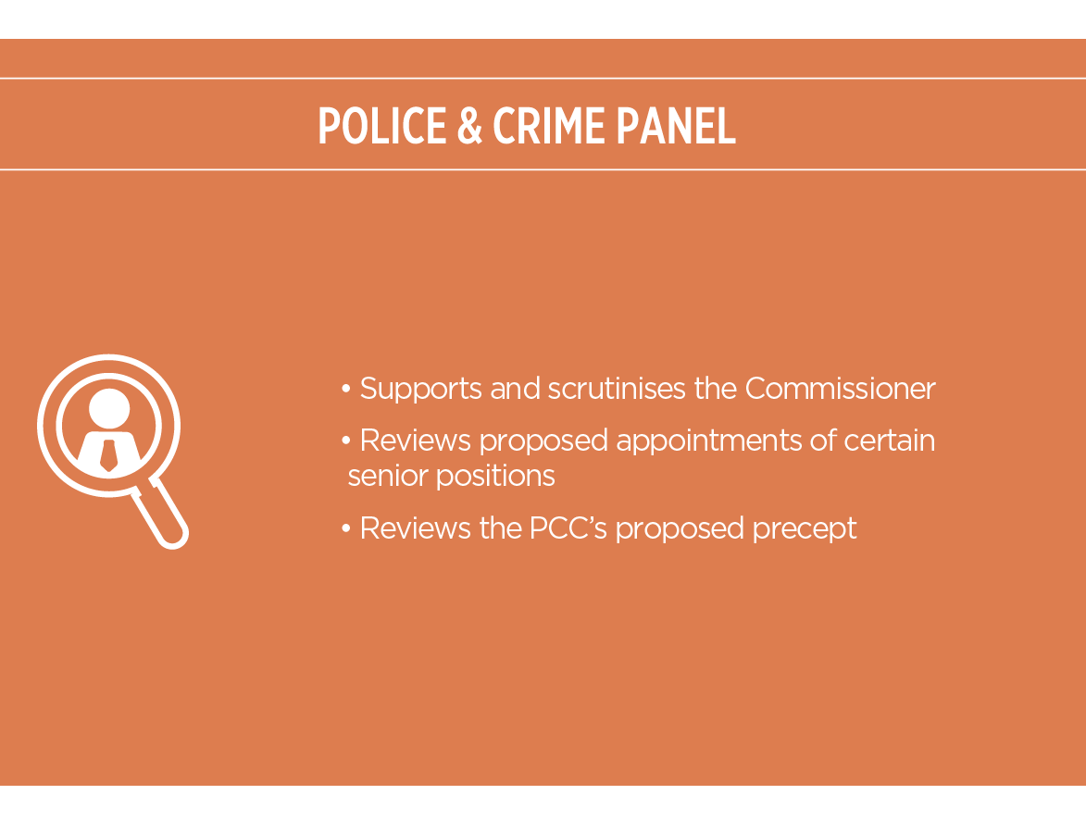
POLICE AND CRIME PANEL ROLE IN POLICING
Meeting formally four times per year, the PCP examines and makes recommendations on various aspects of the PCC’s activity. In particular, powers include:
· Reviewing the draft Police and Crime Plan
· Reviewing (and having the power to veto) the PCC's proposed Council Tax precept levels
· Reviewing and scrutinising decisions and actions by the PCC
· Scrutinising the PCC's annual report
· Confirming (and having the power to veto) the Chief Constable’s appointment
· Confirming senior officer (Chief Executive, Chief Financial Officer) and political roles (Deputy Police and Crime Commissioner) in the PCC’s office
· Reviewing the PCC’s conduct
· To appoint an acting PCC, if required

Slide 55
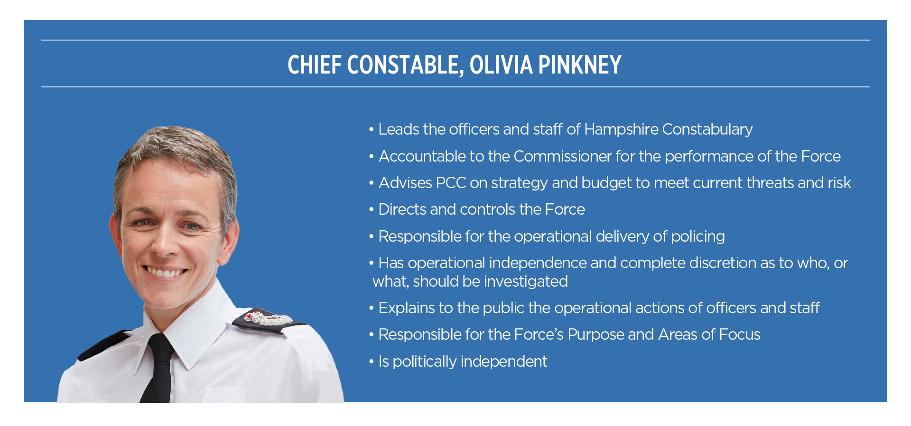
CHIEF CONSTABLE ROLE IN POLICING

Slide 56
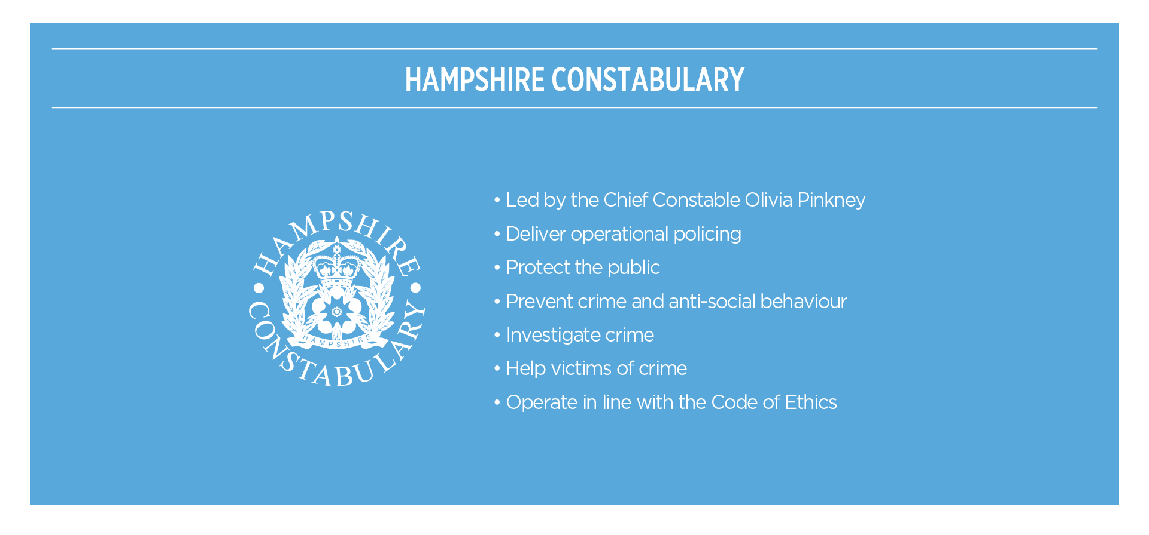
HAMPSHIRE CONSTABULARY ROLE IN POLICING

Slide 57
Thank you
Final questions

