Slide 1
Briefing to PCC Candidates

Slide 6
Officer Productivity
Hampshire has the highest Officer productivity compared to those in the official Most Similar Grouping (MSG)

Slide 7
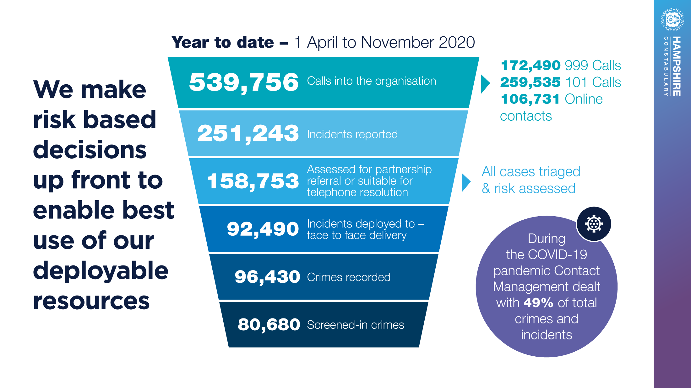

Slide 8
Investing in staff and better technology
Offline |  | June 2020 | November 2020
999 Emergency | Service level | 86.53% | 94.92%
 | Av. Speed to Answer | 8 seconds | 5 seconds
 | % Getting through to a call handler | 99.2% | 99.7%
101 Non-emergency | Service level | 63.15% | 83.72%
 | Av. Speed to Answer | 2 minutes 9 seconds | 43 seconds
 | % Getting through to call handler | 83.2% | 94.8%
Online (Growth) | 2018 | 2019 | 2020
 | 8,223 | 19,691 | 59,276

Slide 10
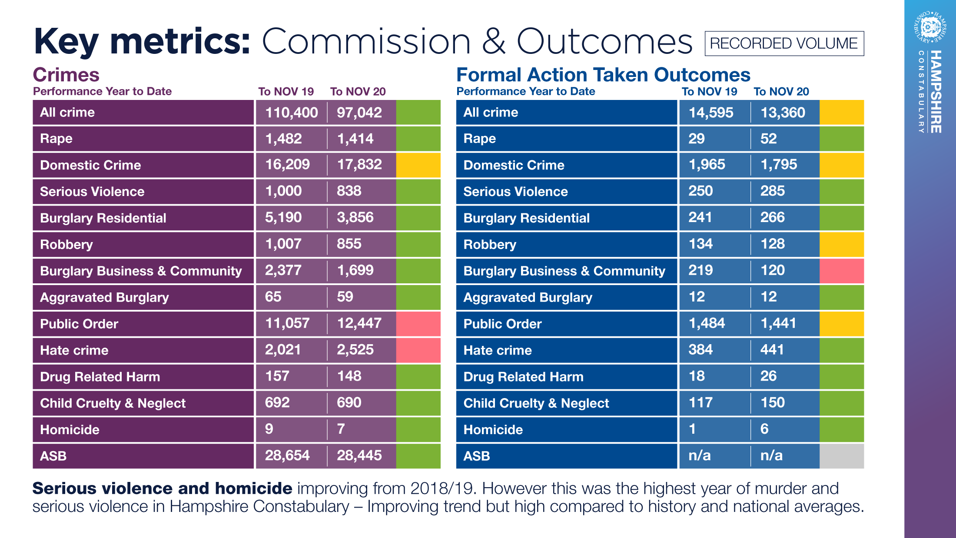

Slide 11
Case studies
Operation Maple Southampton
Operation Scarlet Portsmouth
Innocuous report from public - smell of cannabis
Local investigation by neighbourhood’s team uncover the biggest cannabis factory ever found in Hampshire ( over £1million street value)
Three extremely vulnerable people found tending to plants - victims of an organised criminal drugs network
Intelligence developed that group had plans to intercept police transportation of plants - armed guard for transportation
Gang arrested and combined imprisonment of 13 years
Reports of ‘comings and goings’ from an address led to investigation - trafficking of vulnerable Chinese females
Focus was on protecting the vulnerable victims and brining perpetrators to justice
South East Regional Crime Unit involved leading to broader investigation into trafficking and uncovering large criminal network

Slide 13
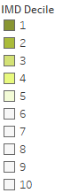
Deprivation & Regional Inequalities
Lower Layer Super Output Areas (LSOA)
2015 - 2019 Average change in rankings | No. of worsening LSOAs | Index of Multiple Deprivation (IMD) | Income | Employment | Education, Skills & Training | Health Deprivation & Disability | Crime | Barriers to Housing and Services | Living Environment
Basingstoke | 38
East Hampshire | 31
Eastleigh | 14
Fareham | 18
Gosport | 8
Hart | 7
Havant | 22
Isle of Wight | 15
New Forest | 24
Portsmouth | 28
Rushmoor | 13
Southampton | 30
Test Valley | 19
Winchester | 13
Further LSOA deterioration is anticipated due to forecasted increases in unemployment causing further income inequalities
44 LSOAs within the 10% most deprived: 19 in Southampton 15 in Portsmouth 6 in Havant 3 on The Isle of Wight 1 in Gosport
Index of Multiple Deprivation (IMD)

Slide 14
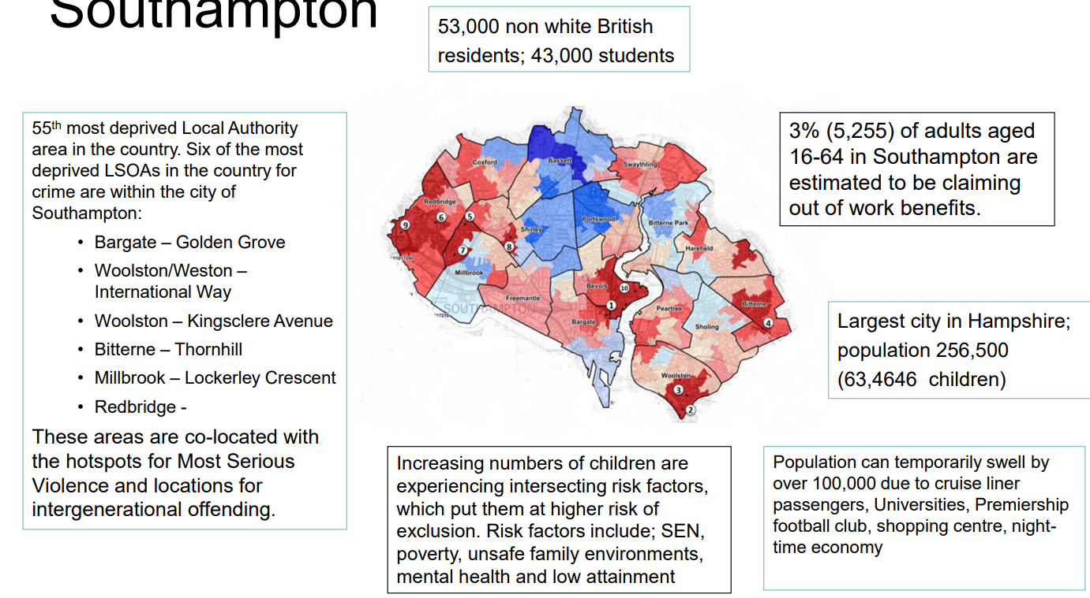
Southampton

Slide 23
PSYCHOLOGICAL SCREENING PROGRAMME
Extended to include all roles that have been identified through risk assessments
 | 2019 | 2020
Questionnaires completed | 1097 | 2470
Referrals for trauma therapy (following review, OH appointments, Psychological assessment) | 47 | 72

Slide 25
First six months – Key risks and opportunities
Opportunities
Risks
The benefit of an uplift of officer numbers starting to be truly felt
Promoting greater inclusion and a more representative workforce
Making the most of the key technology that is rolling out, and will help to make officers even more productive
Building on best in class wellbeing services to keep our officers and staff fit, healthy and serving the public
Building on partnerships and our duty to collaborate
Embedding early learning from operating in COVID (Remote working new ways of working)
Maximising technology benefit of Contact Management Platform (CMP) implementation and JOU working across Hampshire Constabulary and TVP (greater collaboration opportunity)
The impact of COVID on Justice and the wider criminal justice system
The Isle of Wight estate
Investigation resources (PIP2) to meet high harm crime demand
Global and UK events effect public confidence in policing.
Financially despite excellent support from PCC Lane on precept, Hampshire Constabulary remains one of the lowest funded forces nationally, HMICFRS comparison over £40 million underfunded.
Current sickness holding for Hampshire Constabulary officers and staff, next few months will show the true impact, alongside managing officer and staff confidence.

