Slide 1
Youth Commision
Serious Violence
Notes:
I wasn’t certain what to use for a background so I used the background from the instagram post about the definition of serious youth violence

Slide 2
What is serious violence?
Serious youth violence is defined as “any offence of most serious violence or weapon enabled crime, where the victim is aged 1-19” such as murder, manslaughter, rape, wounding with intent and causing grievous bodily harm.
Notes:
https://publications.parliament.uk/pa/cm201719/cmselect/cmhaff/1016/1016.pdf
https://www.ukcrimestats.com/

Slide 3
How serious is serious violence?
Serious violence is one of the many crimes the Police and other organisations are constantly trying to reduce, but unfortunately in the last 5 years homicides have increased by a third and knife crime by 70%, along with other unfortunate increases in violent crime.
Also to the surprise of some, violent crime is usually reported around 150,000 to the Police compared to the 10,000 drug reports and the 25,000 vehicle crimes.
Notes:
https://publications.parliament.uk/pa/cm201719/cmselect/cmhaff/1016/1016.pdf
https://www.ukcrimestats.com/

Slide 4
Serious violence questions
Out of the two types of punishable assault actual bodily harm (ABH) and grievous bodily harm (GHB) which is worse?
GHB is worse, GHB is a caused injury that pose a detrimental risk to the victims health, whereas AHB is less harmful assault.
Is it legal to carry a knife?
Only in reasonable circumstances (such as for a job) and only if it’s a 3 inch folding blade or less
Why do young people carry knives?
There are many reasons, but most young people say they need it for protection
Does carrying a knife actually keep you protected?
No, it actually does the opposite and increases your chances of
being stabbed. 7 out of 10 young people admitted into A&E with
a knife injury were stabbed with their own knife.

Slide 5
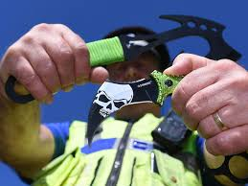
How about knife crime?
Knife crime going up by 70% may not be a shock considering how often it’s seen in the news, but if it’s on the rise what’s being done about it?
Some new laws have been implemented in the past couple of years to tackle this surge in knife crime, such as carrying a knife in public without a good reason (such as for a job) is illegal, no one under 18 can buy a knife (unless it has a 3 inch folding blade or less) and carrying a knife is punishable with 4 years in prison and a unlimited fine. There are also knives that are illegal to own in any circumstances
Notes:
https://publications.parliament.uk/pa/cm201719/cmselect/cmhaff/1016/1016.pdf
https://www.ukcrimestats.com/

Slide 6
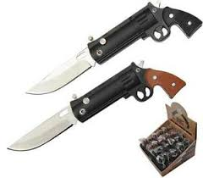
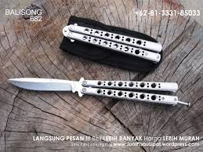
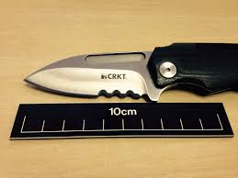
Which knives are illegal?
Legal
Or Illegal?

Slide 7
What is the Youth Commission doing about youth violence?
Youth Commision members attends events such as workshops and community events to help teach young people about the dangers of crime, spread awareness about the Big Conversation and tell young people and other organisations about the youth commission's work.
Youth Commission members also meet and work with previous young offenders, youth agencies and other relevant people to help gather information about young offenders, how to prevent young people from offending and how to help previous young offenders.

Slide 8
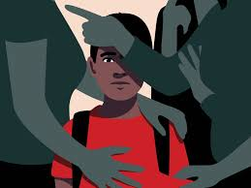
The Big Conversation.
The Big Conversation is a collection of young people’s opinions gathered through big conversation cards or a online version of those cards, that is used to build a report on how to more effectively deal with young people and crimes that affect them, the big conversation works because it asks the young people who don’t usually have a voice to express their opinions about how crime affects them what could be done to prevent it. The report is seen by many important people such as the Police, the Police and Crime Commissioner and other agencies that would hopefully use this unique information to help young people.

Slide 9
How report crime
The obvious way is to call 999, but this should only be used in emergencies.
If it’s not an emergency you can call 101 the non emergency number, this number should be used to report crimes that aren’t urgent and that aren’t causing any immediate danger.
If you’re afraid of your identity being revealed once you report a crime, you should contact Crime Stoppers who help people report crimes completely anonymously.
You can contact Crime Stoppers with 0800 555 111 or through their website https://crimestoppers-uk.org/
However if you’re a young person who want to report a crime anonymously or want advice about crime then contact the Fearless organisation who help young people. You can contact them through Fearless@crimestoppers-uk.org or https://www.fearless.org/en

Slide 10
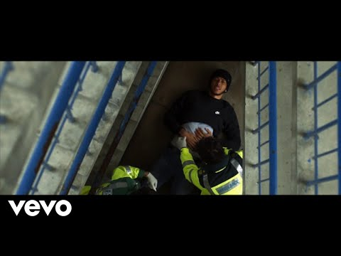
Knife crime rap

