Slide 1
Serious Violence Workshop
Knives

Slide 2
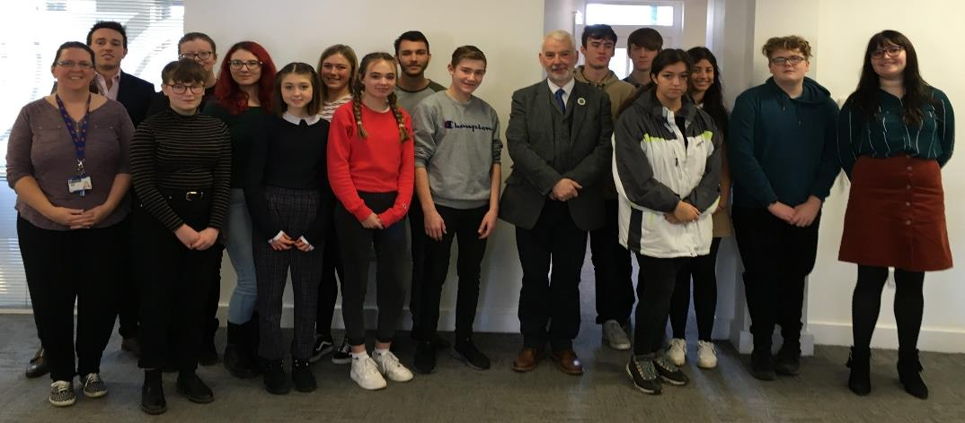
Who we are:
Young people aged between 14 and 25
With an interest in social change
Who want to give young people a voice
And want to make a difference
Hampshire and Isle of Wight Youth Commission
Notes:
Introduce yourself and say how long you have been involved in the Youth Commission.
Example : Hi my name is Casey and I am a volunteer with the OPCC. I have been involved with the Youth Commission for 6 years, from member to mentor to volunteer
The Youth Commission is a group of young people aged 14-25 from across the Hampshire Constabulary area, as members we go out and speak to other young people to get their views and opinions on our priorities linked to crime and policing. We work along side the Police and Crime Commissioner and relay our findings back to him.

Slide 3
Our 2020 Priorities
Exploitation
Hate Crime
Serious Violence
Notes:
Hate Crime
Exploitation
Serious Violence- we are here today to deliver a workshop to you around this issue, today we are going to be focusing on knives.

Slide 4
Let’s talk
Knife Crime
Notes:
Here today to talk to you about knife crime and give you some information around it. Knife crime is on the rise so this is a really important topic to talk about.
We are going to be doing a couple of activities throughout this session, to help give you a better understanding of this topic.

Slide 5
Knives
What do you think:
Law?
Carry?
Buying?
Types of knives?
Why do people carry knives?
Statistics around knives
Knife Crime offences are at a 10 year high
NHS figures show knife related hospital admissions have risen
Notes:
Have a think whilst we do the next activity about these topics, we will go through them after the next activity.
We are now going to show you some photos of knives, I will say the name of each knife then I will ask you to put your hand up if you think it is legal, then I will ask you to put your hand up if you think it is illegal.

Slide 6
Activity
Look at the following pictures of knives and
guess what its name is and
whether it is illegal or legal

Slide 7
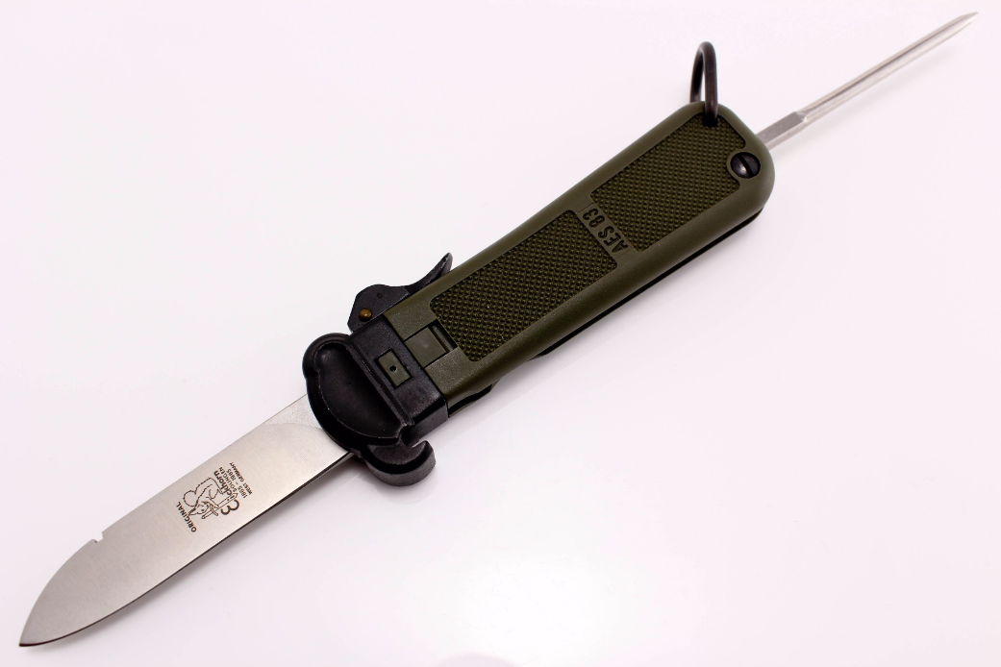
Gravity Knife – this is illegal
Notes:
Gravity Knife
Old military knife, push a button and the knife slides out from the handle and locks in place, spike at the end is for untying knots on a Para shoot.
This knife is ILLEGAL

Slide 8
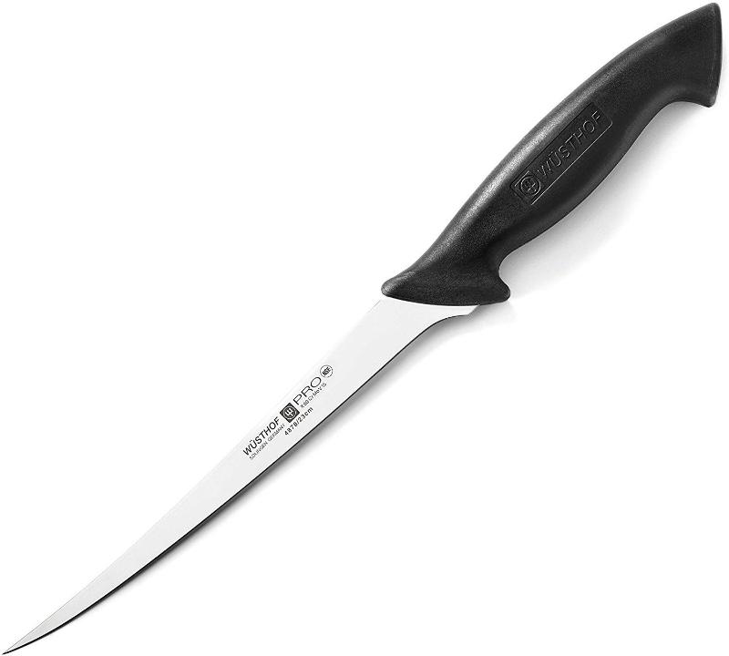
Fish fillet knife - is LEGAL
Notes:
Fish fillet knife, found in kitchens
This knife is LEGAL

Slide 9
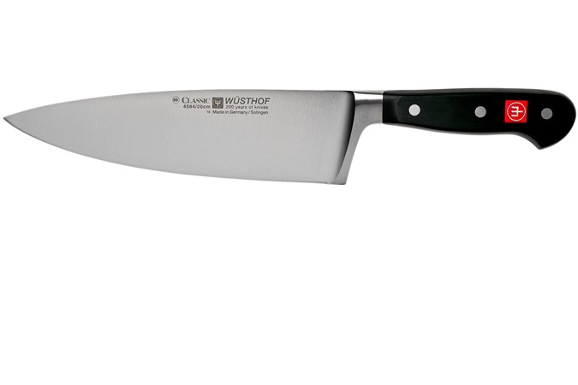
Kitchen Knife – is legal
Notes:
Kitchen Knife
This knife is LEGAL

Slide 10
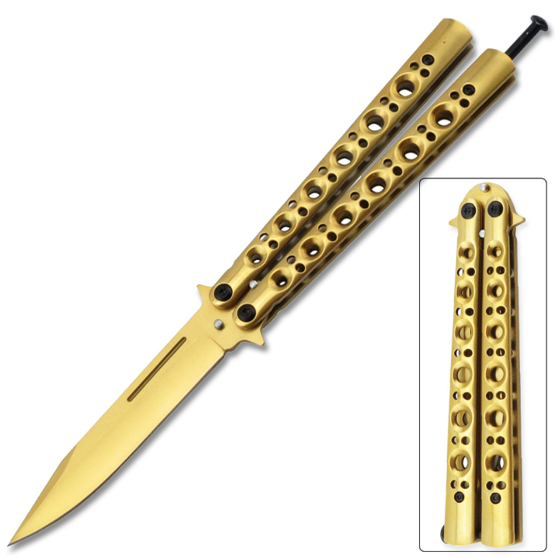
Butterfly Knife – this is illegal
Notes:
Butterfly Knife
This knife is ILLEGAL

Slide 11
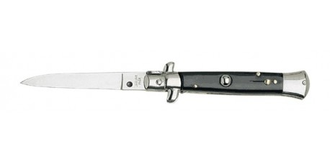
Flick knife – this is illegal
Notes:
Flick knife
This knife is ILLEGAL

Slide 12
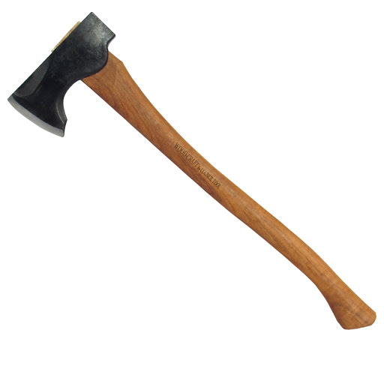
Axe – this is legal
Notes:
Axe
This is LEGAL

Slide 13
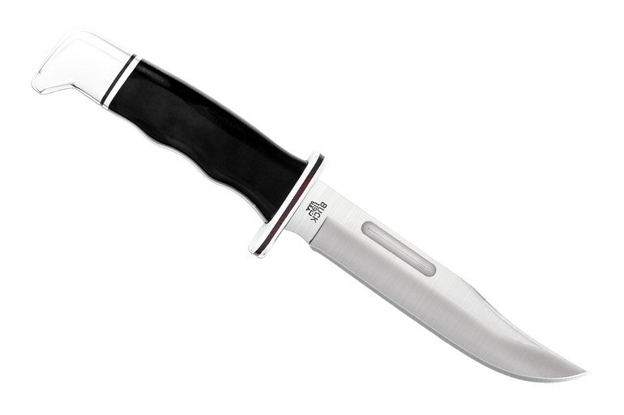
Buck knife – this is legal
Notes:
Buck knife
This knife is LEGAL

Slide 14
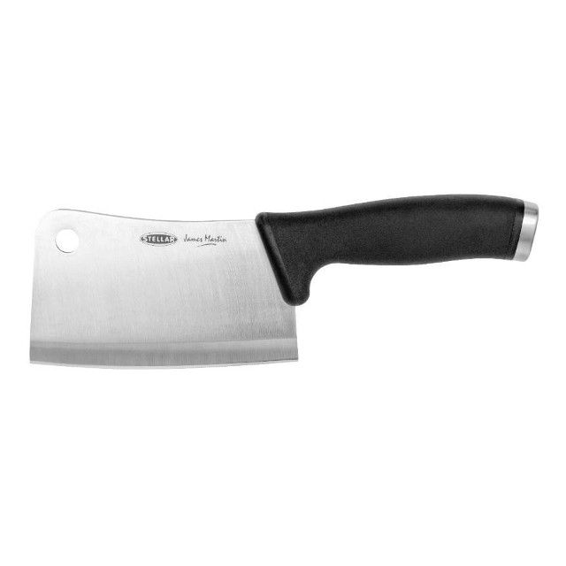
Meat cleaver
This knife is LEGAL
Notes:
Meat cleaver
This knife is LEGAL

Slide 15
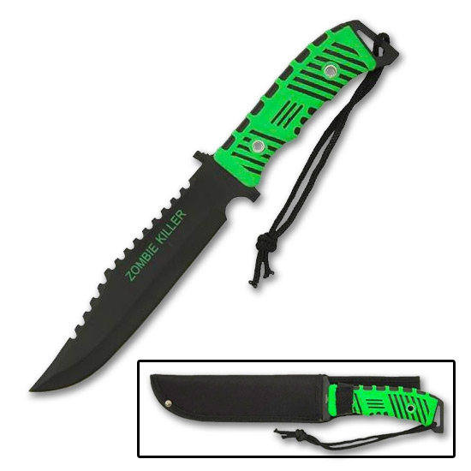
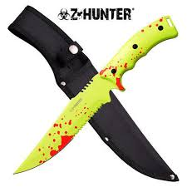
Zombie knife - This knife is ILLEGAL
Notes:
Zombie knife
This knife is ILLEGAL

Slide 16
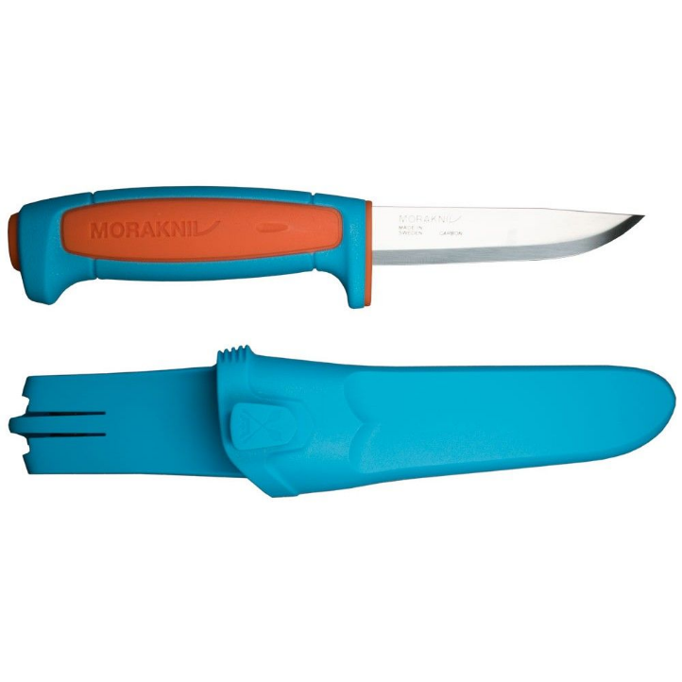
Bushcraft knife - this knife is LEGAL
Notes:
Bushcraft knife
This knife is LEGAL
Not all knives are illegal, it doesn’t matter about the size of the blade, its all to do with if the knife got made for a purpose.

Slide 17
Legal or illegal
A knife is legal if was created for a specific/legal purpose i.e. cooking, fishing
Examples of good reasons to carry a knife or weapon in public can include:
taking knives you use at work to and from work
taking it to a gallery or museum to be exhibited
if it’ll be used for theatre, film, television, historical reenactment or religious purposes, for example the kirpan some Sikhs carry
if it’ll be used in a demonstration or to teach someone how to use it

Slide 18
Law
It is illegal to:
Sell a knife to anyone under 18, unless it has a folding blade 3 inches long (7.62 cm) or less
Carrying a knife in public without good reason, unless it has a folding blade with a cutting edge 3 inches or less
Carry, buy or sell any type of banned knife
Use any knife in a threatening way (even a legal knife)

Slide 19
Why young people
carry knives
County Lines – Organised drug networks
Gang affiliation – Protection / status
Media attention / glamorisation
Fear of crime – Being attacked / self protection
Victim of bullying – Self-protection
Peer pressure – Perception that most people carry knives
Notes:
In groups please look at the reasons why young people carry knives

Slide 20
Consequences
Death
Injury
Prison
Fine
Criminal Record
Restricted Job Opportunities
Families – where does it end?
Notes:
In groups please think about what the consequences could be for carrying knives

Slide 21
Impact
Notes:
Eastenders real life stories around knife crime

Slide 22
Solutions
What can be done to tackle the issues around knife crime?
Come up with some ideas
Notes:
In groups
Then feedback
So my next challenge for you is in groups of around 4, I want you to choose 5 words that you think describes Crimestoppers. There is a list of words for you to choose from on the next slide. Can you choose the correct 5 words that describe Crimestoppers, there will be a prize for the group with the highest score.

Slide 23
What is Crimestoppers ?
Choose 5 words that describe Crimestoppers…
Police
Charity
For 18+
0800 555111
Crimewatch
Government
Local Council
Confidential
Rewards
24/7
Batman
Anonymous
Vigilante Crimefighters

Slide 24
Answers
Charity
Anonymous
0800 555111
24/7
Rewards
Notes:
The correct 5 words that describe what Crimestoppers are:
Charity
0800 555111
24/7
Anonymous
Rewards

Slide 25
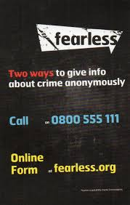
Reporting
If you know anyone who carries knives you can report it anonymously at fearless.org
Always phone 999 in an emergency situation.
Notes:
999
101
Online https://www.hampshire.police.uk/ro/report/ocr/how-to-report-a-crime/

Slide 26
Big Conversation
Thank you for participating in the workshop, we hope you found it interactive and useful.
We have got one final task for you to complete, please can everyone complete our big conversation survey;
www.surveygizmo.eu/s3/90201150/Youth-Commission-Big-Conversation-2020

