Slide 1
ANGLER
Sneakiness 82
Strength 15

Slide 2
What is …
Loot box ?
Scam?
Clickbait?
Phishing?

Slide 3
Clickbait, loot box, scam or phishing?
Click
If it looks too good to be true it probably is…
Don’t
click

Slide 4
17 Tricks About ROBLOX You Wish You Knew Before. Trick #15 is the best one yet. Click here to find out!!!
Click
Don’t
click
Notes:
Clickbait

Slide 5
What do we need to lookout for?
The title – does it sound too good to be true?

Slide 6
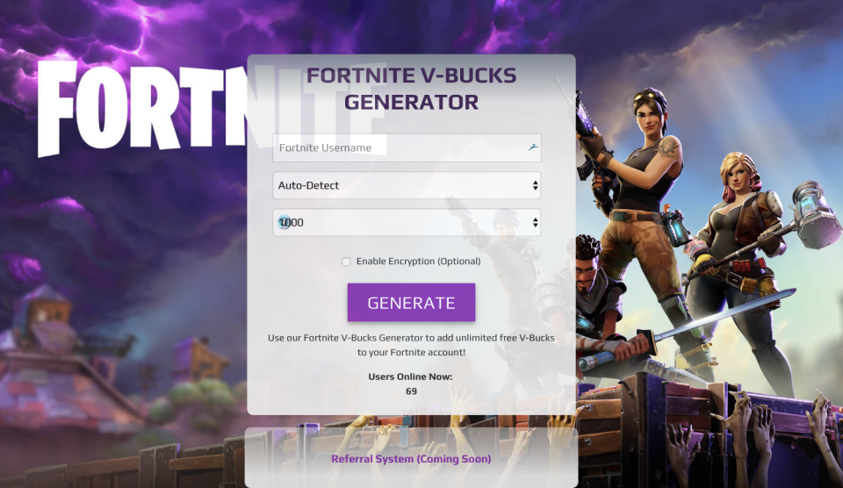
Click
Don’t
click
Notes:
Scam

Slide 7
What do we need to lookout for?
External links/websites– when buying something always purchase from the official website and avoid third party sites.

Slide 8
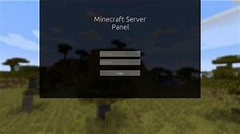
You’re already logged into Minecraft. You will need to login again to carry on playing and get VIP access to Minecraft.
Click
Don’t
click
Notes:
Phishing

Slide 9
What do we need to lookout for?
Look alike websites – if you’re already logged in, should you log in again?

